Slide 1
If Time Matters
OnTime Group Calendar

Slide 2
Agenda
About Us
Why OnTime?
Interfaces & Add-ons
Architecture & Security
Live Demo

Slide 3
Together We Create
Started in 1998
Team located in Denmark, Germany, Japan, and Ukraine
Partners supporting customers locally
Dedicated to delivering the most powerful, versatile, and yet easy to use scheduling tool for groups
Focus on delivering modern design, logical navigation, and user- friendliness unsurpassed by other products in the market
Co-designing our solutions with our key stakeholders - our customers and partners in order to continuously improve OnTime
About us
and our Passion for Innovating Groups Calendars

Slide 4
Why OnTime?

Slide 5
A Calendar that Drives Outcomes
OnTime Group Calendar transforms individual agendas into a synchronised force, aligning thousands of calendars into one harmonious vision.
Featuring online meetings, legend filters, polling, calendar sharing, and vacation planning tools, simplifying the coordination of both internal and external meetings.
Collaboration and diversity are key drivers in achieving successful business outcomes, and that’s precisely what OnTime facilitates.
What is OnTime?

Slide 6
Outlook & Teams “Best Friend”
”We" focused contra "Me" focused
Think BIG not Small - thousands of calendars in one
Full collaboration within MS Teams and the MS Teams Mobile app
Handle your “out of office” plans with ease
Powerful tool to work On Behalf Of other people (eg. personal assistants)
Range of other add-ons - Polling, Catering, Visitor, Integrations
OnTime “Keywords”

Slide 7
Interfaces &
Add-ons

Slide 8
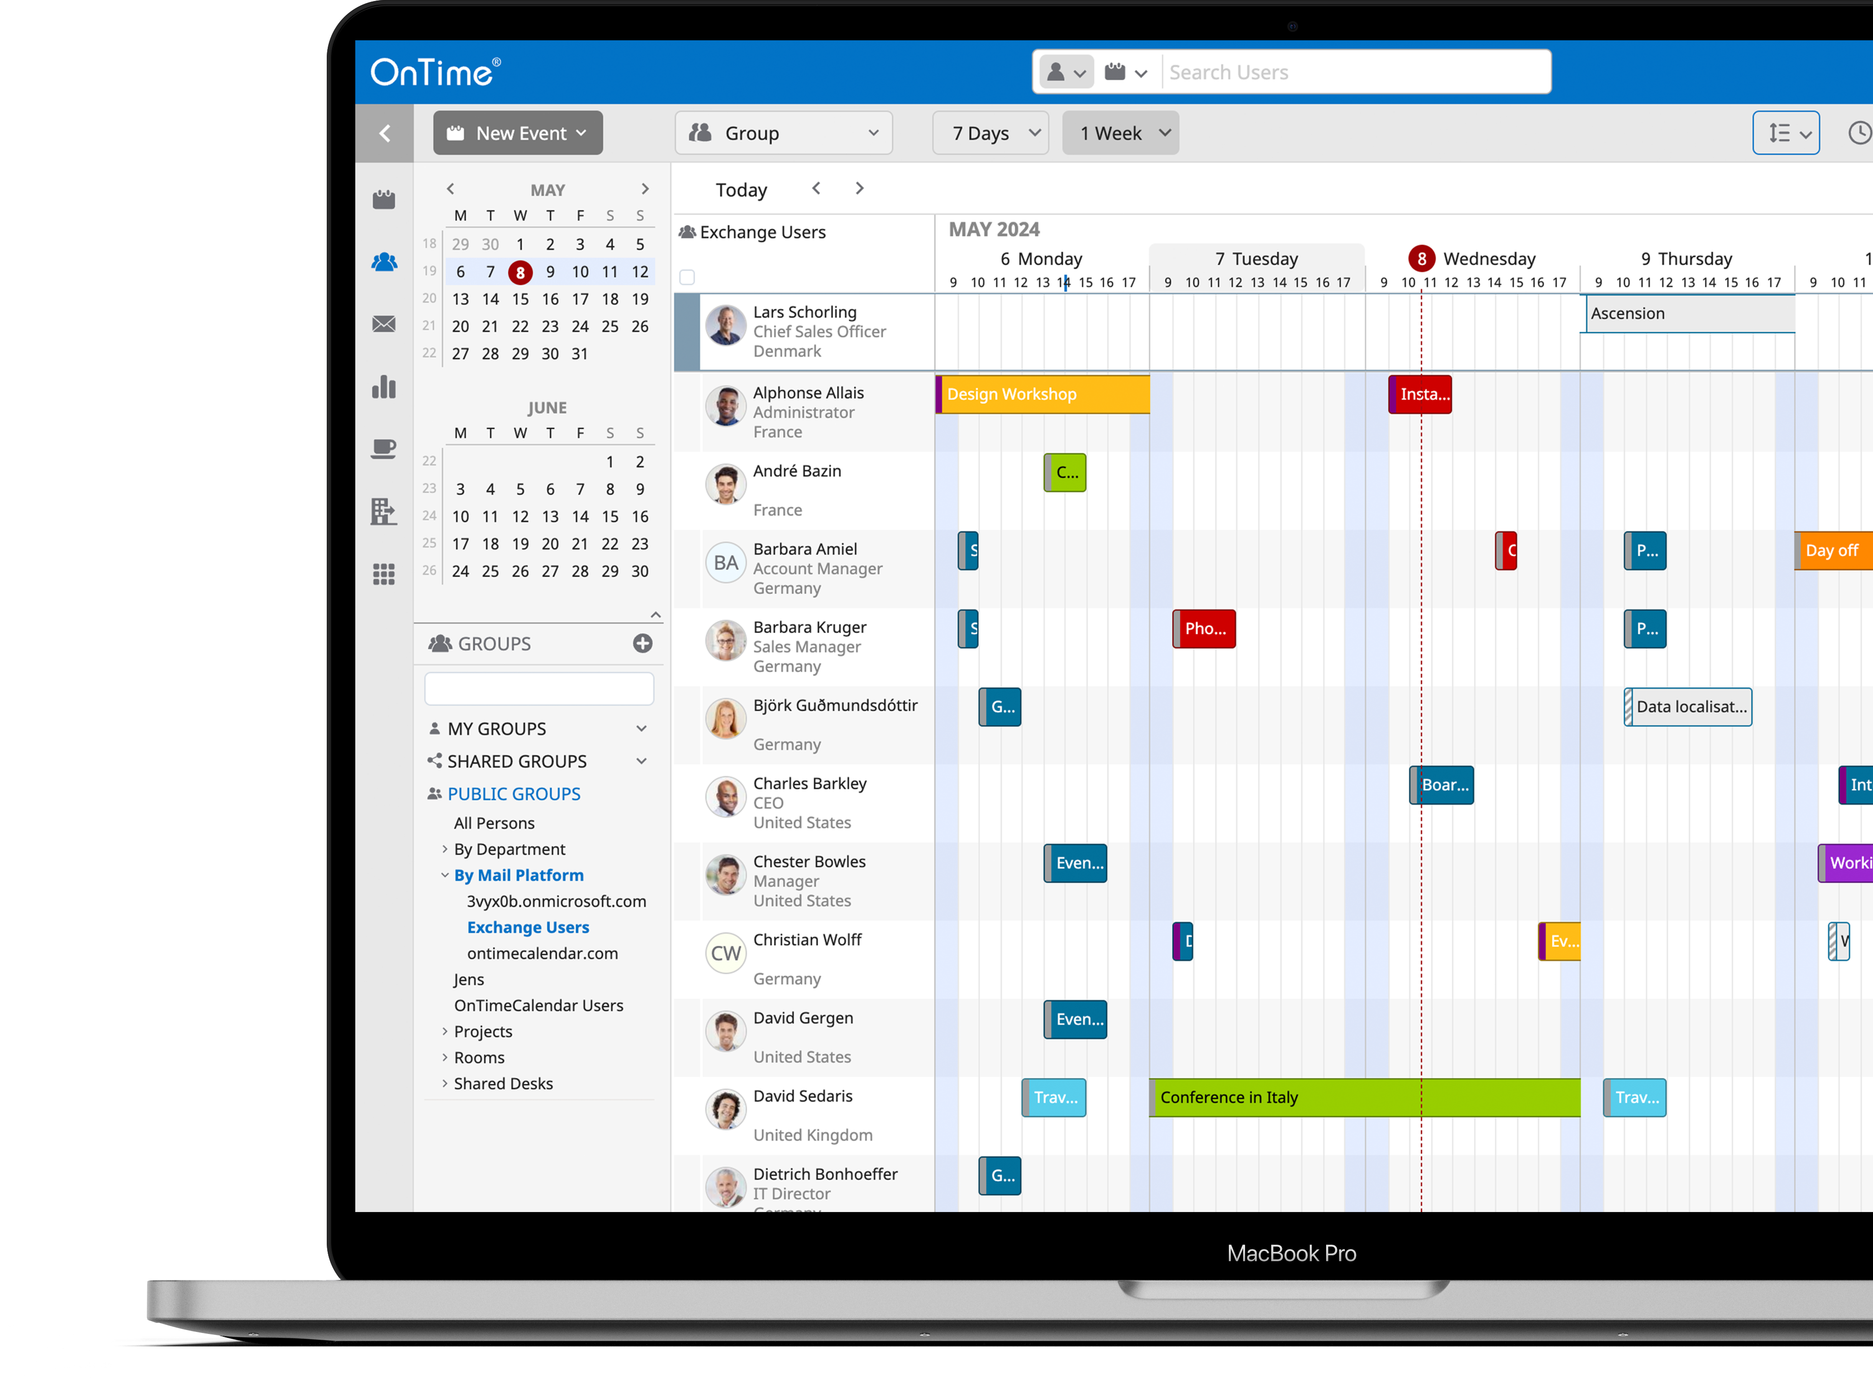
Group
Desktop Client
Overview your entire organisations calendars, from one place
View, Create, modify, search and filter calendar entries
The central group viewer delivers a high speed, row-based display of multiple users' calendars
Drag and drop actions
Customisable via the sidebar, top navigation and action bar
Notes:
Streamline Team Scheduling
The OnTime Interface is designed to provide a comprehensive suite of calendar management tools, offering functionalities such as viewing, creating, modifying, searching, and filtering calendar entries.
Central to this interface is the Group Viewer. The Group Viewer delivers a scalable, high- speed, row-based display of multiple users’ calendars, allowing for the selection and manipulation of calendar data through intuitive drag-and-drop actions. This central feature of OnTime is customizable via the Sidebar, Top Navigation, and Action Bar, providing a versatile platform for diverse calendar management needs.

Slide 9
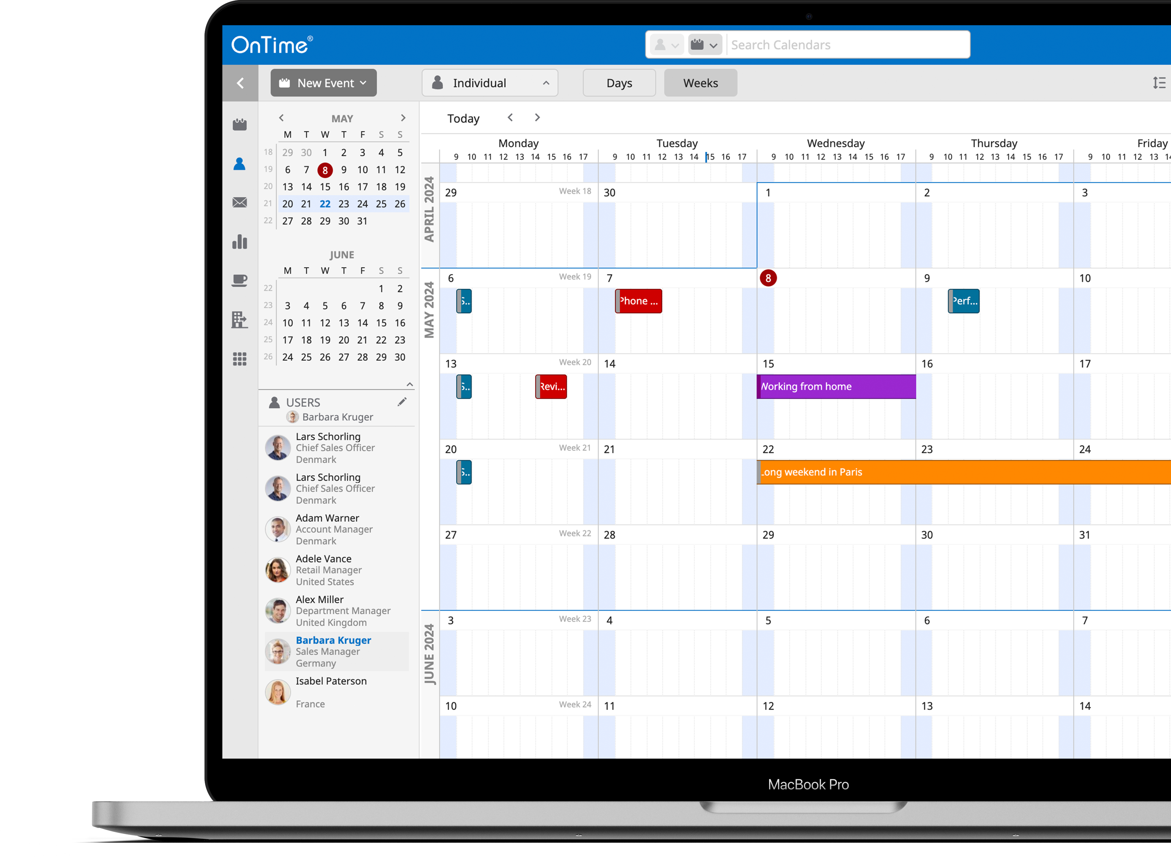
Individual
Desktop Client
Deep dive into a selected person’s calendar
View a period of a day or even several months.
Switch between calendars from the Users panel in 1-click
Respond to another user’s calendar invites.
Allow to create polls and send these out on behalf of other users
Add Catering to close the circle for the personal assistant to fully support his/her manager’s agenda.
The perfect solution for the personal assistant trying to find time to meet for people with busy agendas.
Notes:
Manage Individual Calendars
The OnTime Interface provides dual functionality for calendar management. The Group perspective aggregates multiple users’ calendars, allowing for a broad overview. Conversely, the Individual perspective offers detailed management of a user’s own calendar.
With appropriate permissions, a user can also access and administer the calendars of colleagues. This includes sending invitations, replying to meeting requests, and creating polls in the name of another user and even sharing the availability of that user through the Share My Time feature. This functionality is particularly beneficial for administrative staff tasked with coordinating schedules for individuals with demanding agendas.

Slide 10
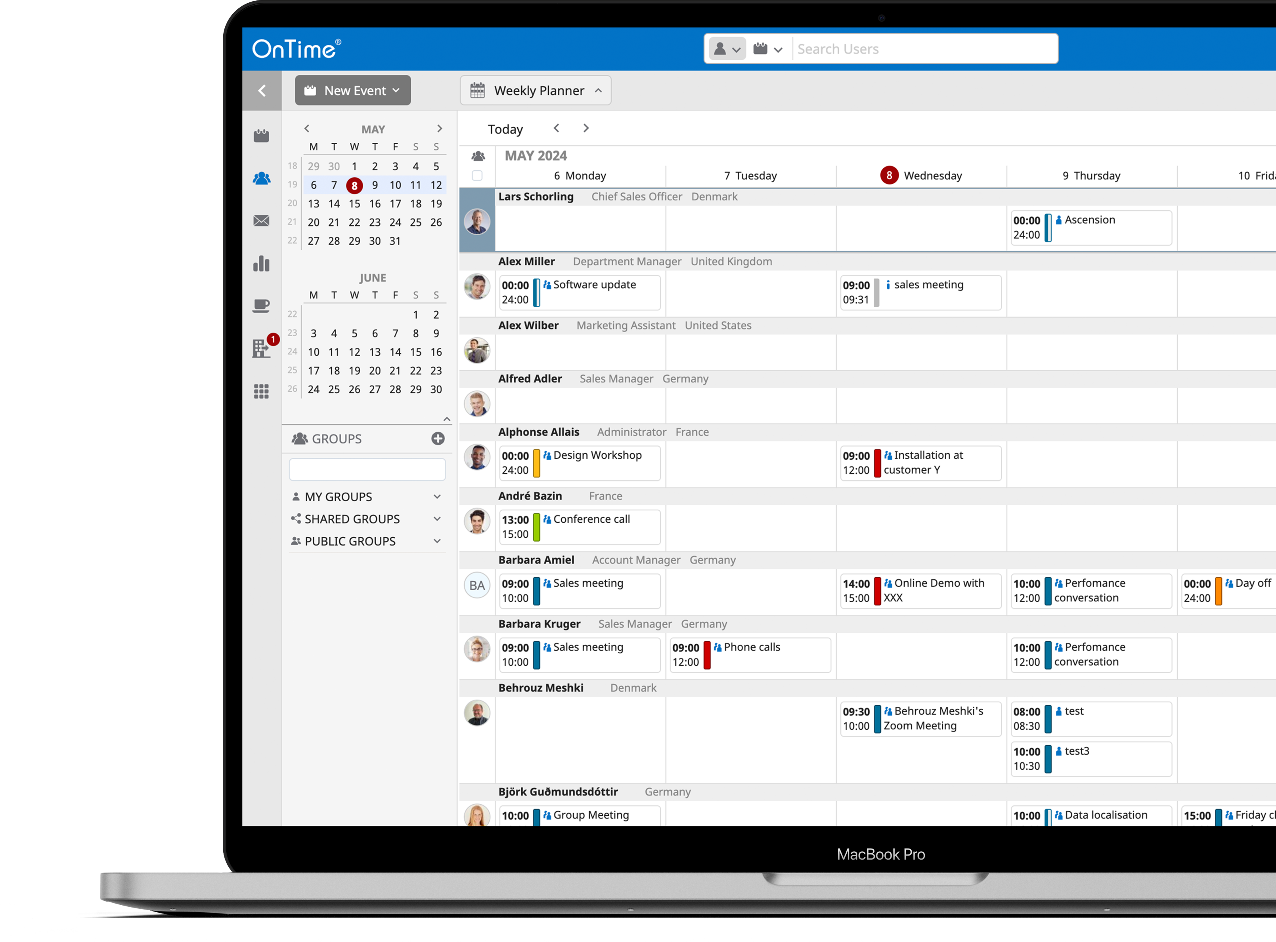
Weekly Planner
Desktop Client
Allows you to see your colleagues most important agenda detail from a new perspective
Drag and drop entries to new times or people

Slide 11
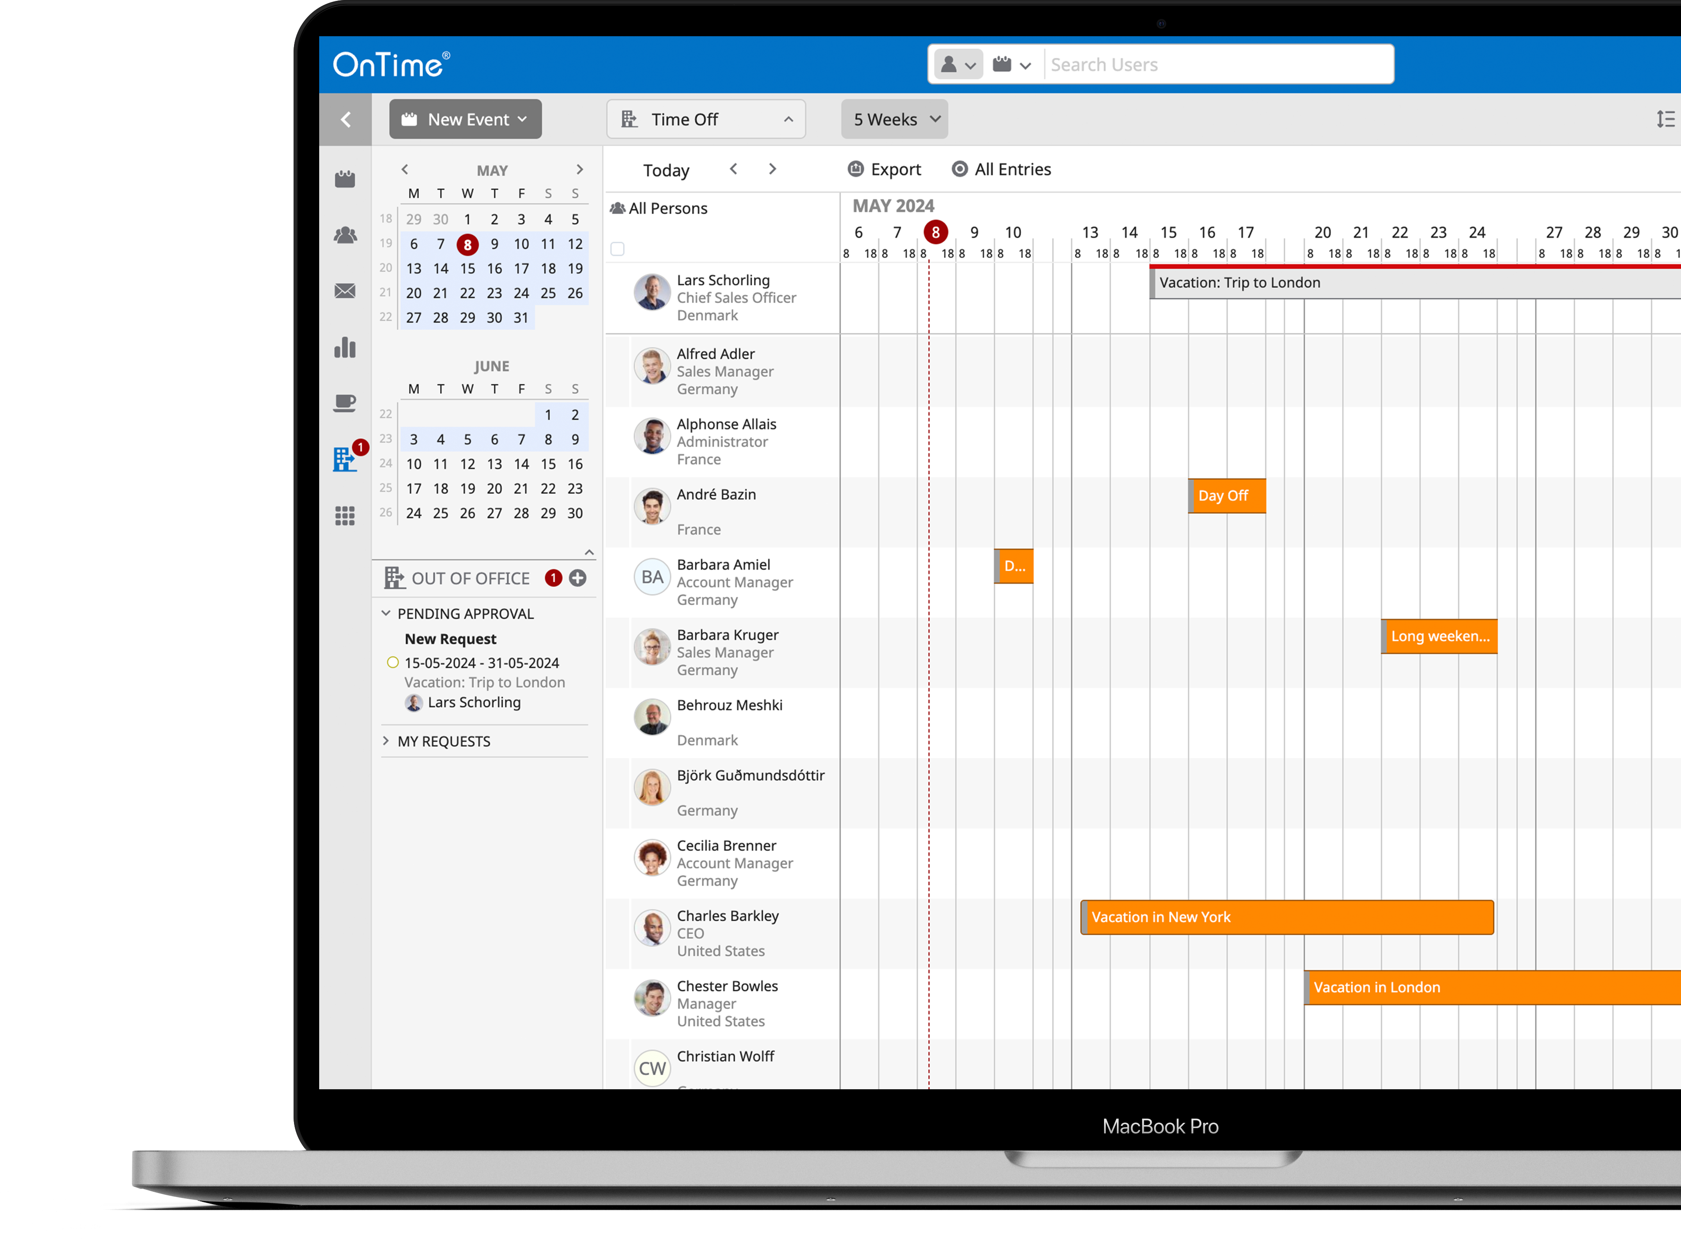
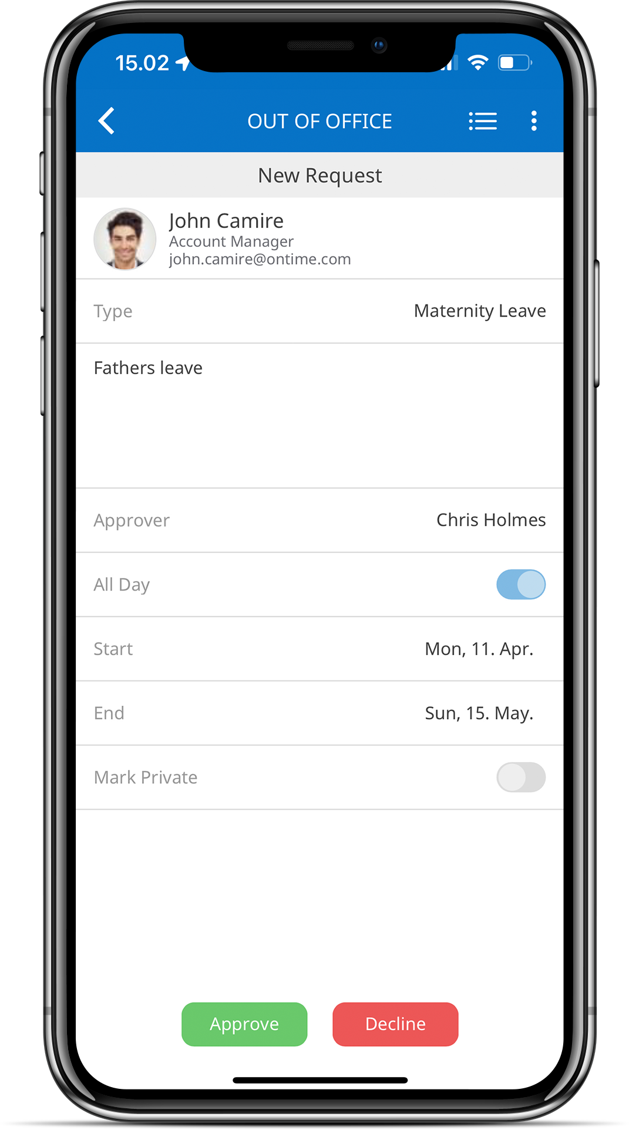
Time Off
Desktop Client
Request/Approve/Book Your Vacation Plans and Other OoO Requests
With people working in Hybrid modes, it can become confusing to figure out who is where and whether they are available.
In short, the OnTime Out of Office feature is a workflow module with an integrated approval process that helps organisations keep track of the whereabouts of co-workers.
Whether working from home, attending a conference, or away on vacation OnTime help guide you.

Slide 12
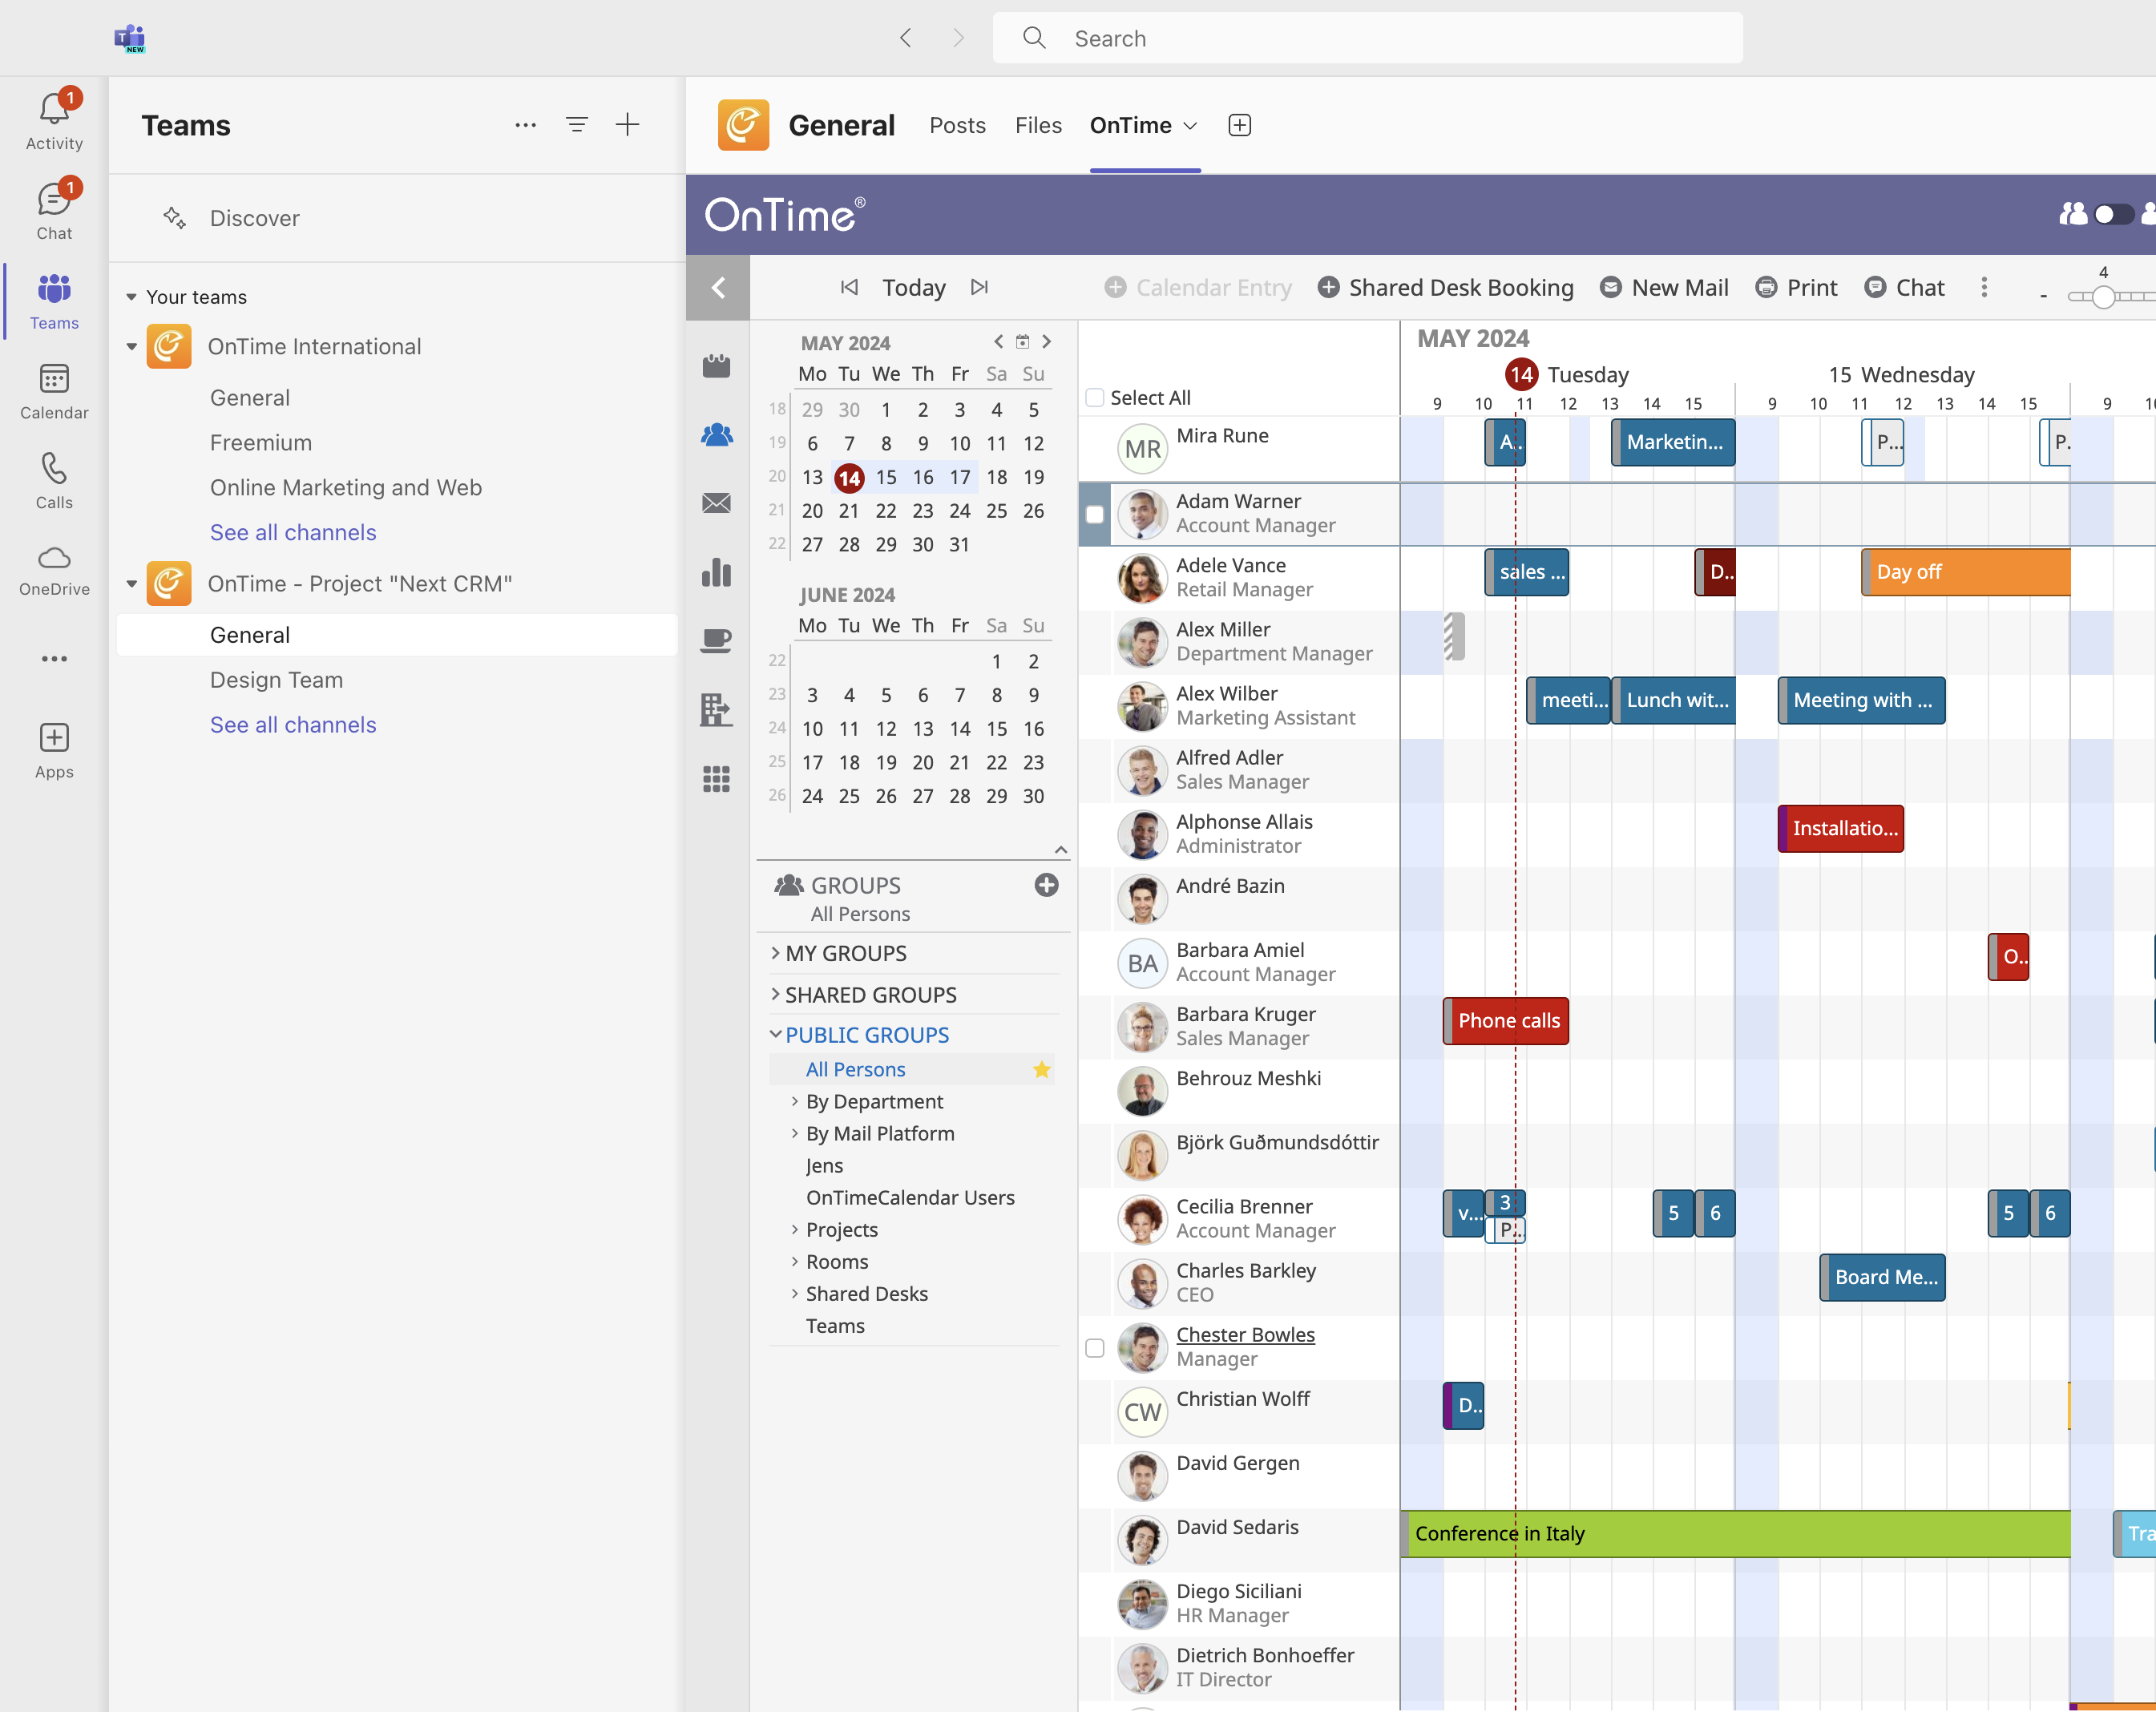
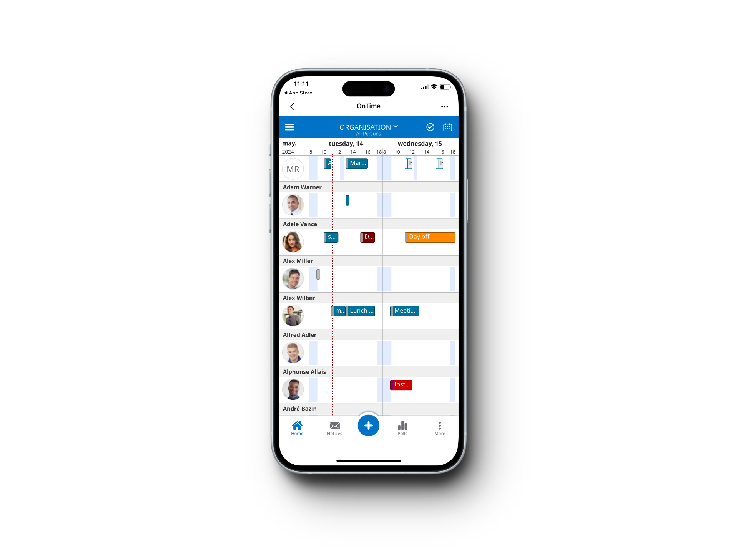
MS Teams
In the Flow of Microsoft Teams
MS TEAMS has rapidly become the number one communication tool for many organisations and with that, requests from many organisations have made it evident that a fully-fledged embedded group calendar is needed for MS TEAMS.
Teams Channel Group Calendar
Sidebar Organisational Calendar
Teams Chat action
Meet Now action

Slide 13
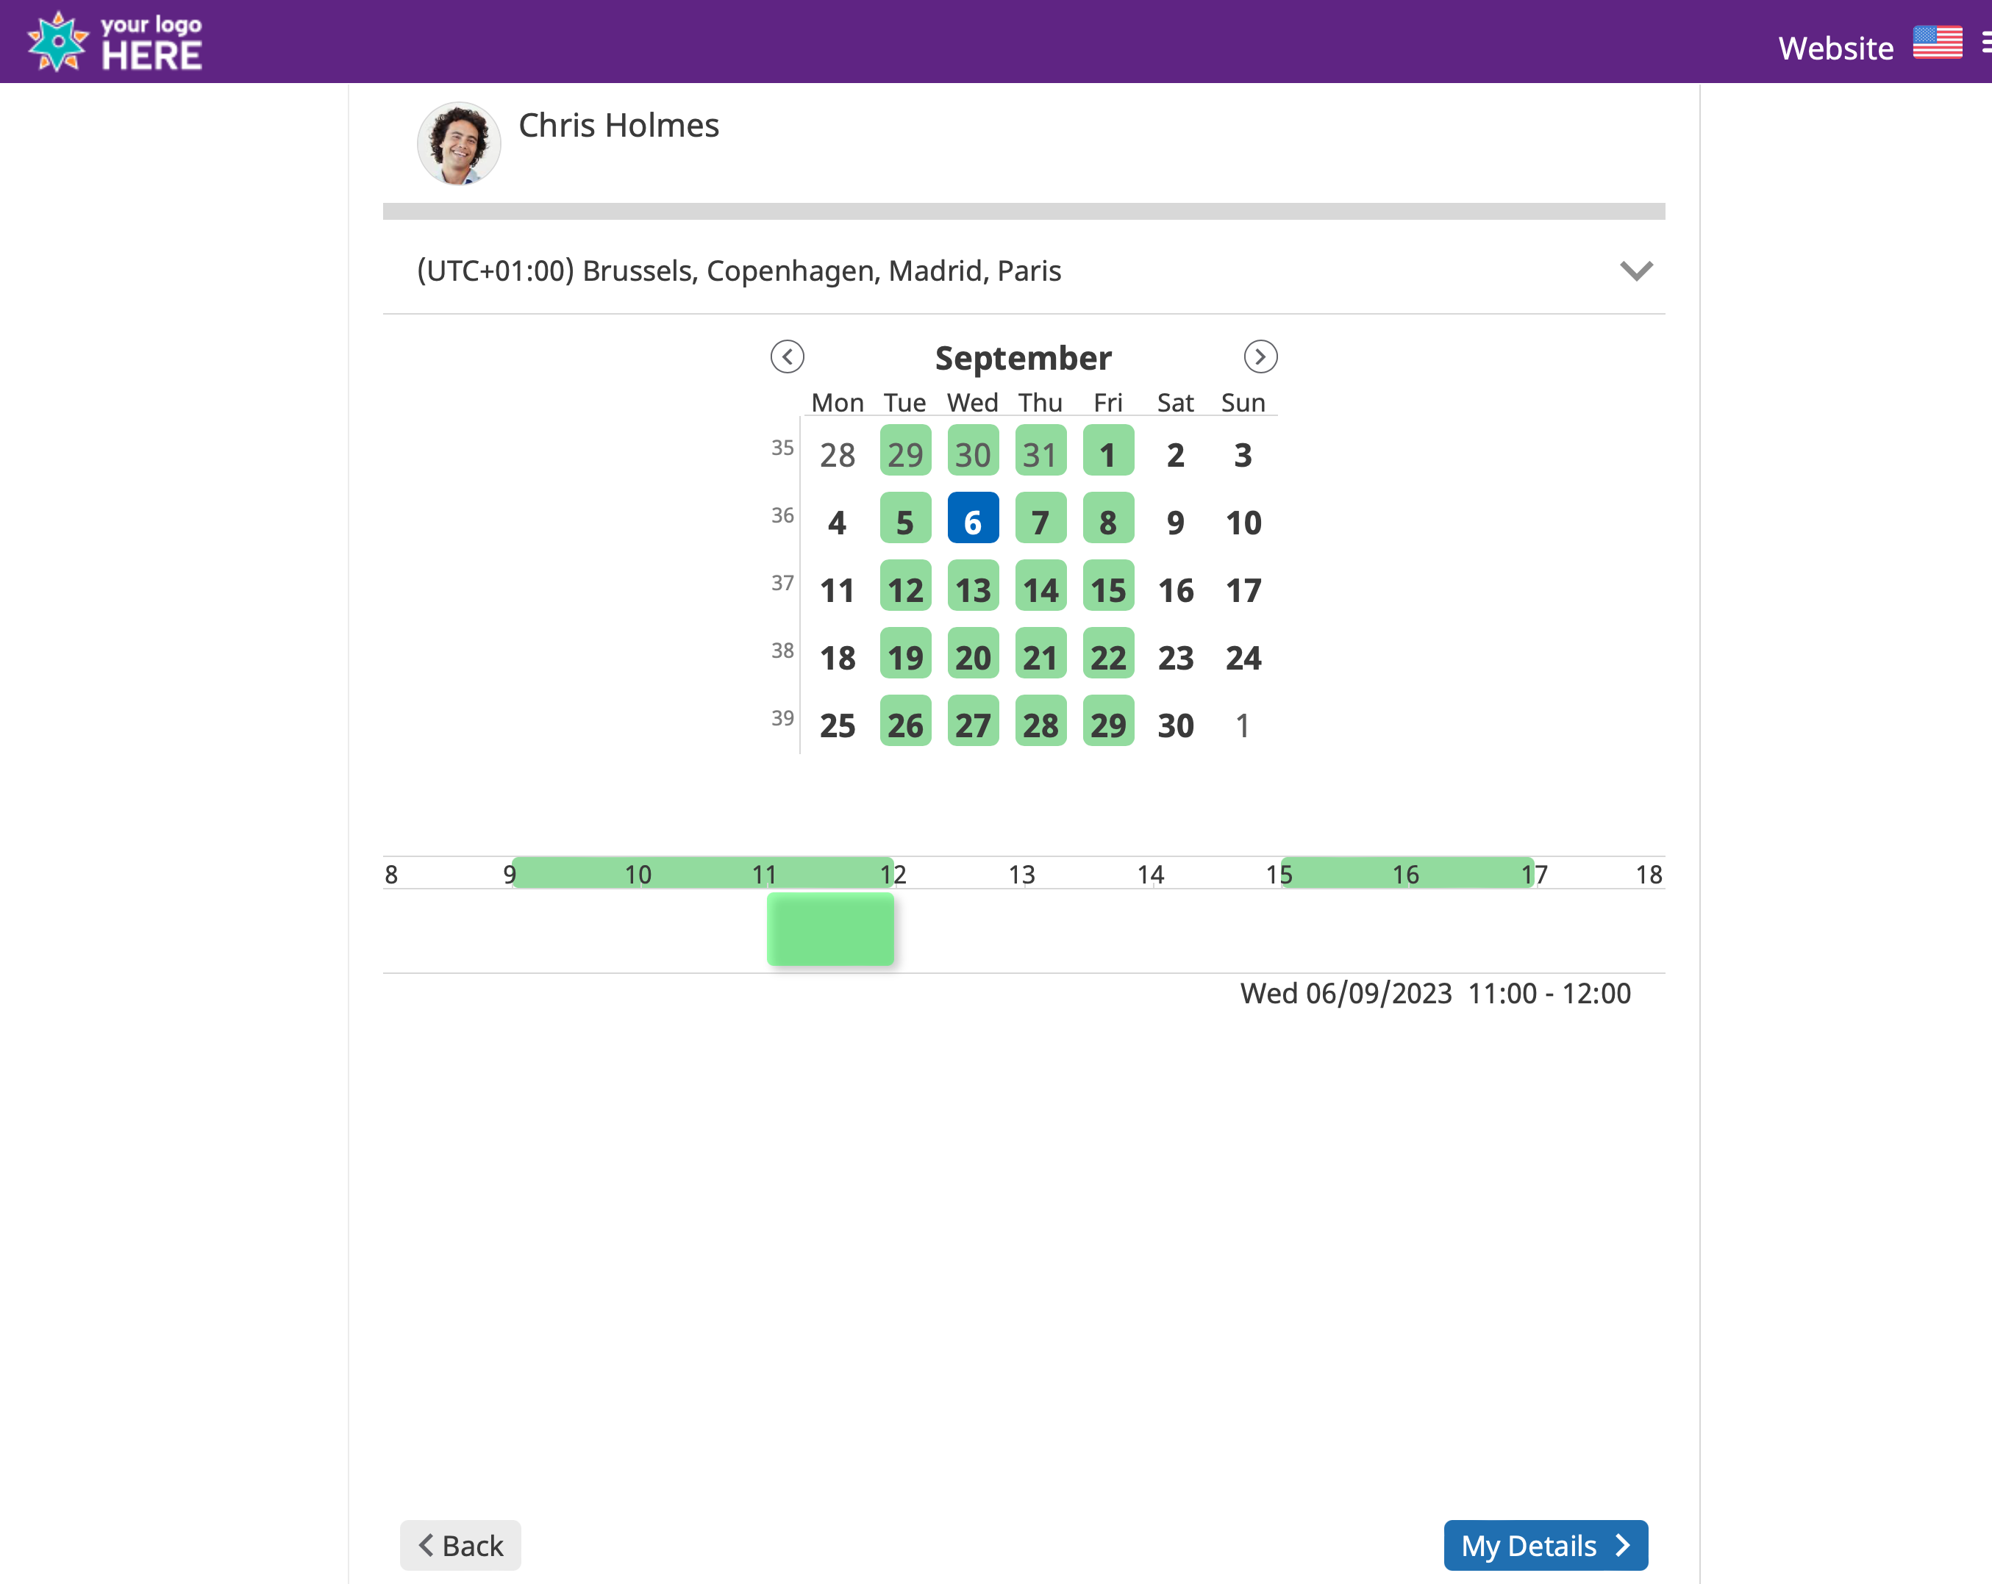
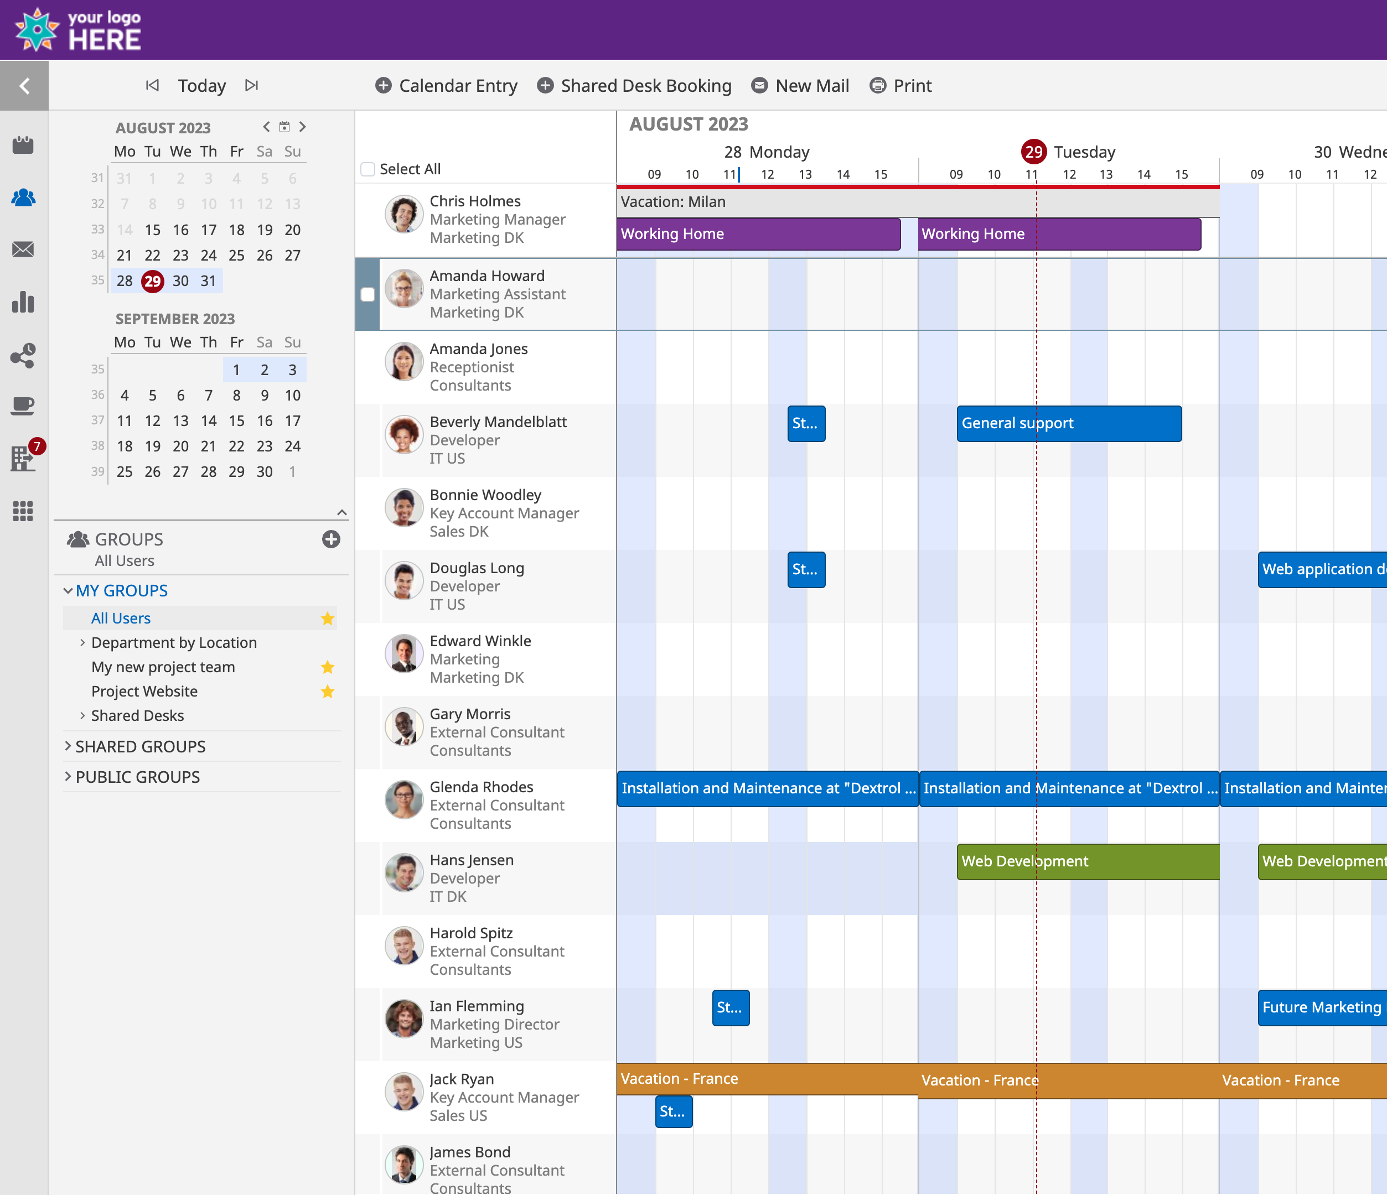
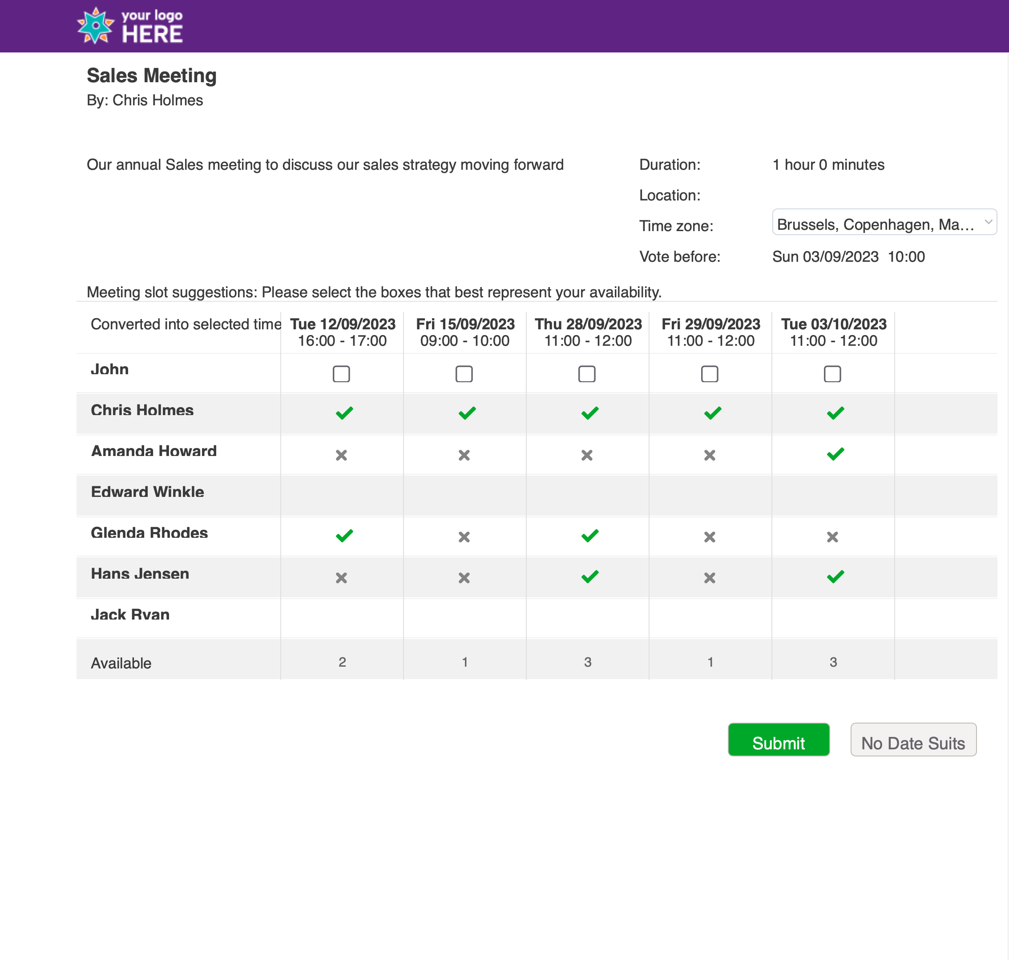
Branding
Branding
Branding
Customise your OnTime
Room Display
See if the room is free or busy including meeting details.
Quick book an available room
Share My Time
Desktop Client
Pollarity

Slide 14
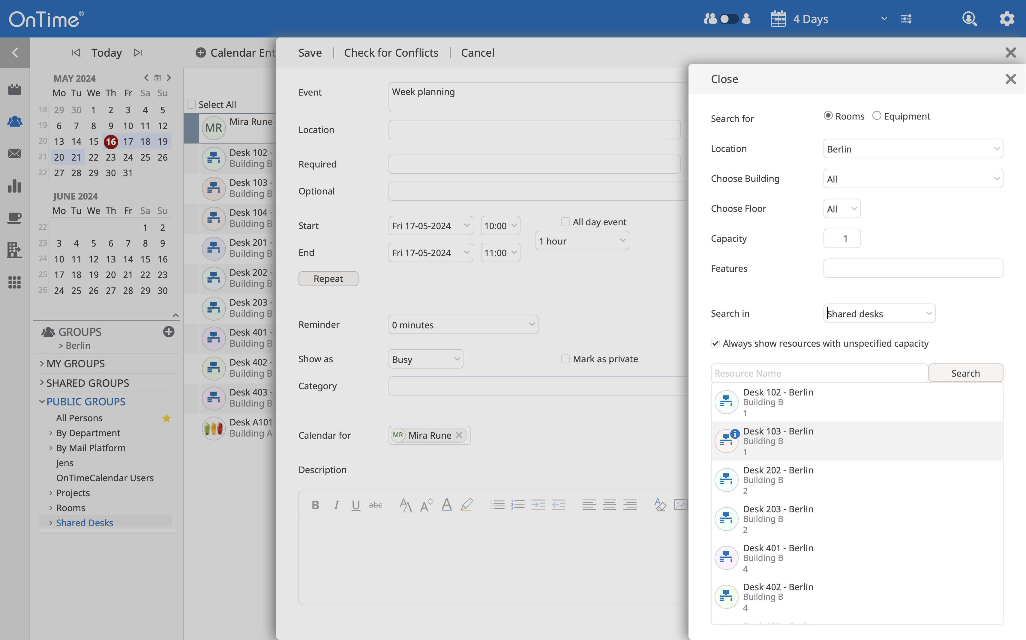
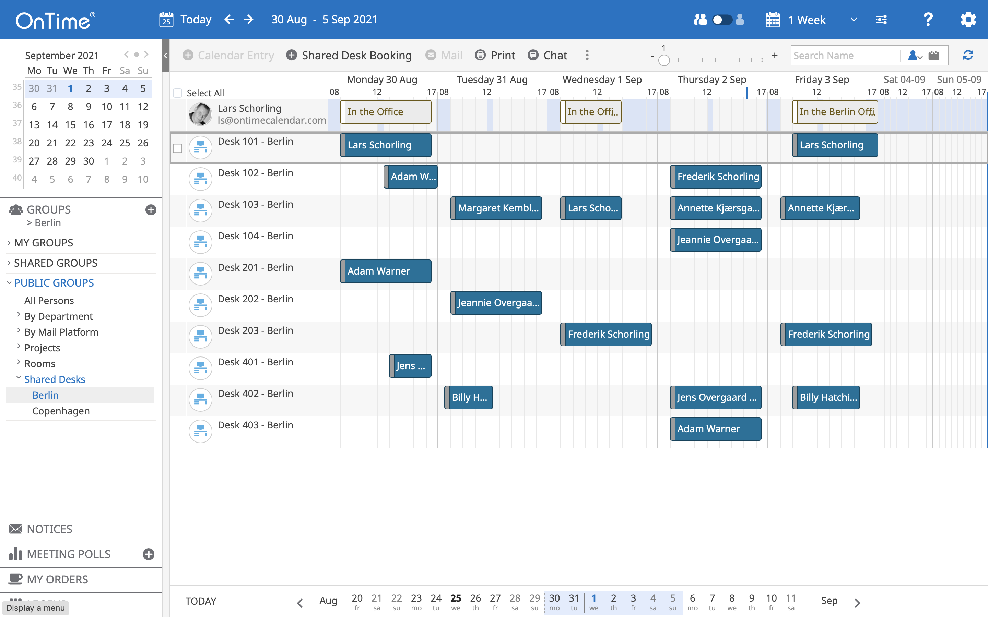
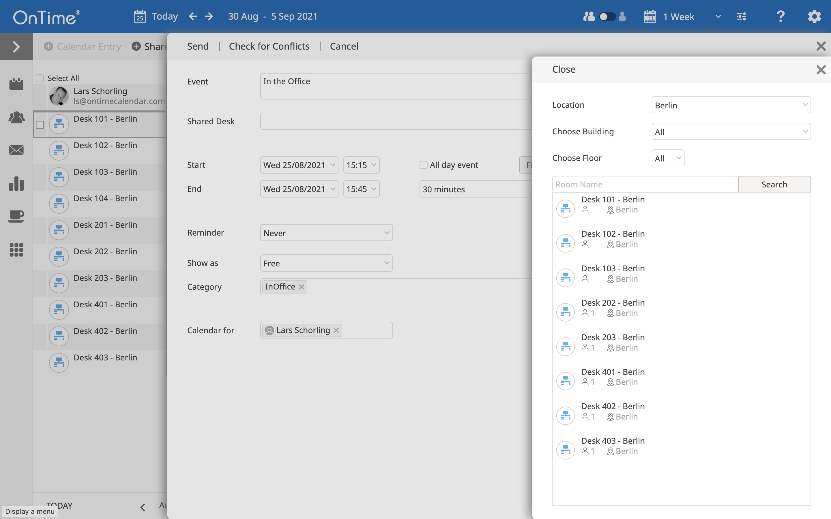
Shared Desks
Managing Your Shared Desks
How can we avoid overcrowding in the office?
How can we implement a hybrid working concept without giving ourselves too much manual work?
Find and Book Desks
View Workspace Availability

Slide 15
Add-ons
Mobile
Find Time
A simple user interface which provides the user with a clear overview of tasks and availability of their teams and even the entire enterprise
Significantly reduces the time used to decide upon a common time slot for a meeting by polling or sharing with the intended participants.
Room Display
Catering Manager
Optimise your utilisation of your rooms. Visualise and book in no time..
the organisation's one-stop shop for managing catering within the organisation, in a simple and timesaving way for everyone involved.
Visitor Manager
Open API
Complete overview of all your visitors while reducing security and reception workload.
Integrating your Calendar Data with your Business Solutions

Slide 16
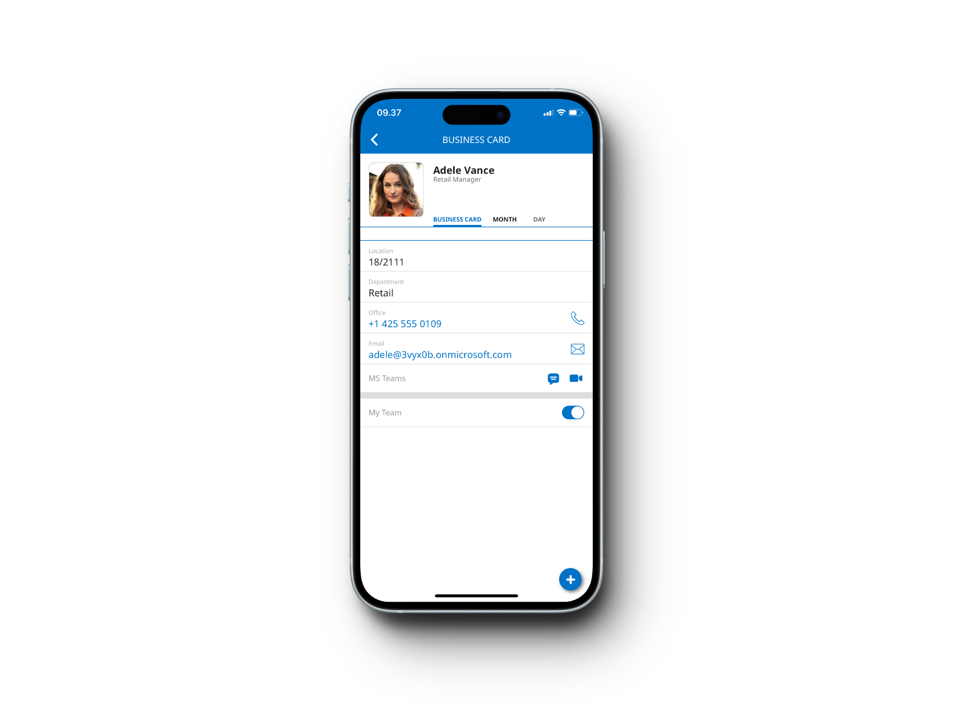
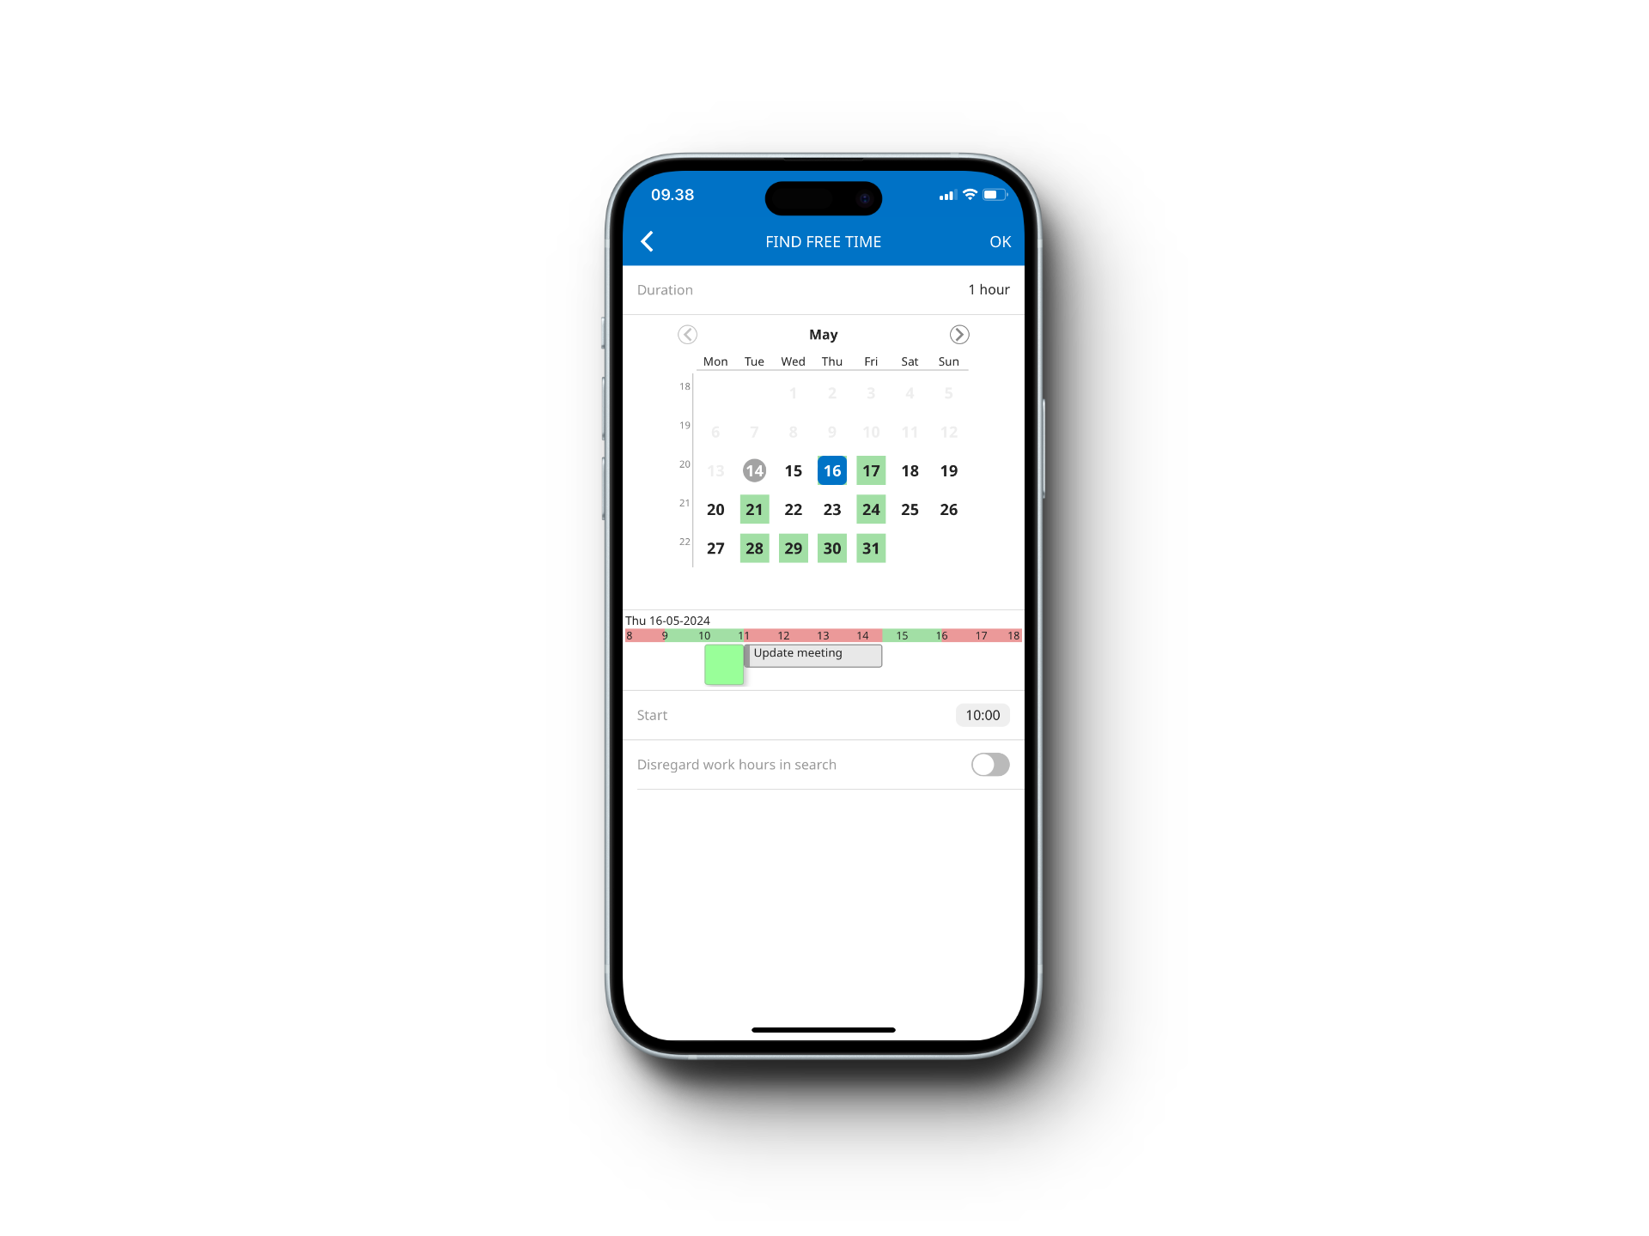
OnTime Mobile
Corporate Calendar goes Mobile
Allows you to:
Find available time for a meeting
Create and send out invitations
Create new appointments for co-workers
Find and book available rooms or shared desks
Call, e-mail or send a text message based on information in your co-worker’s business card
and much more…

Slide 17
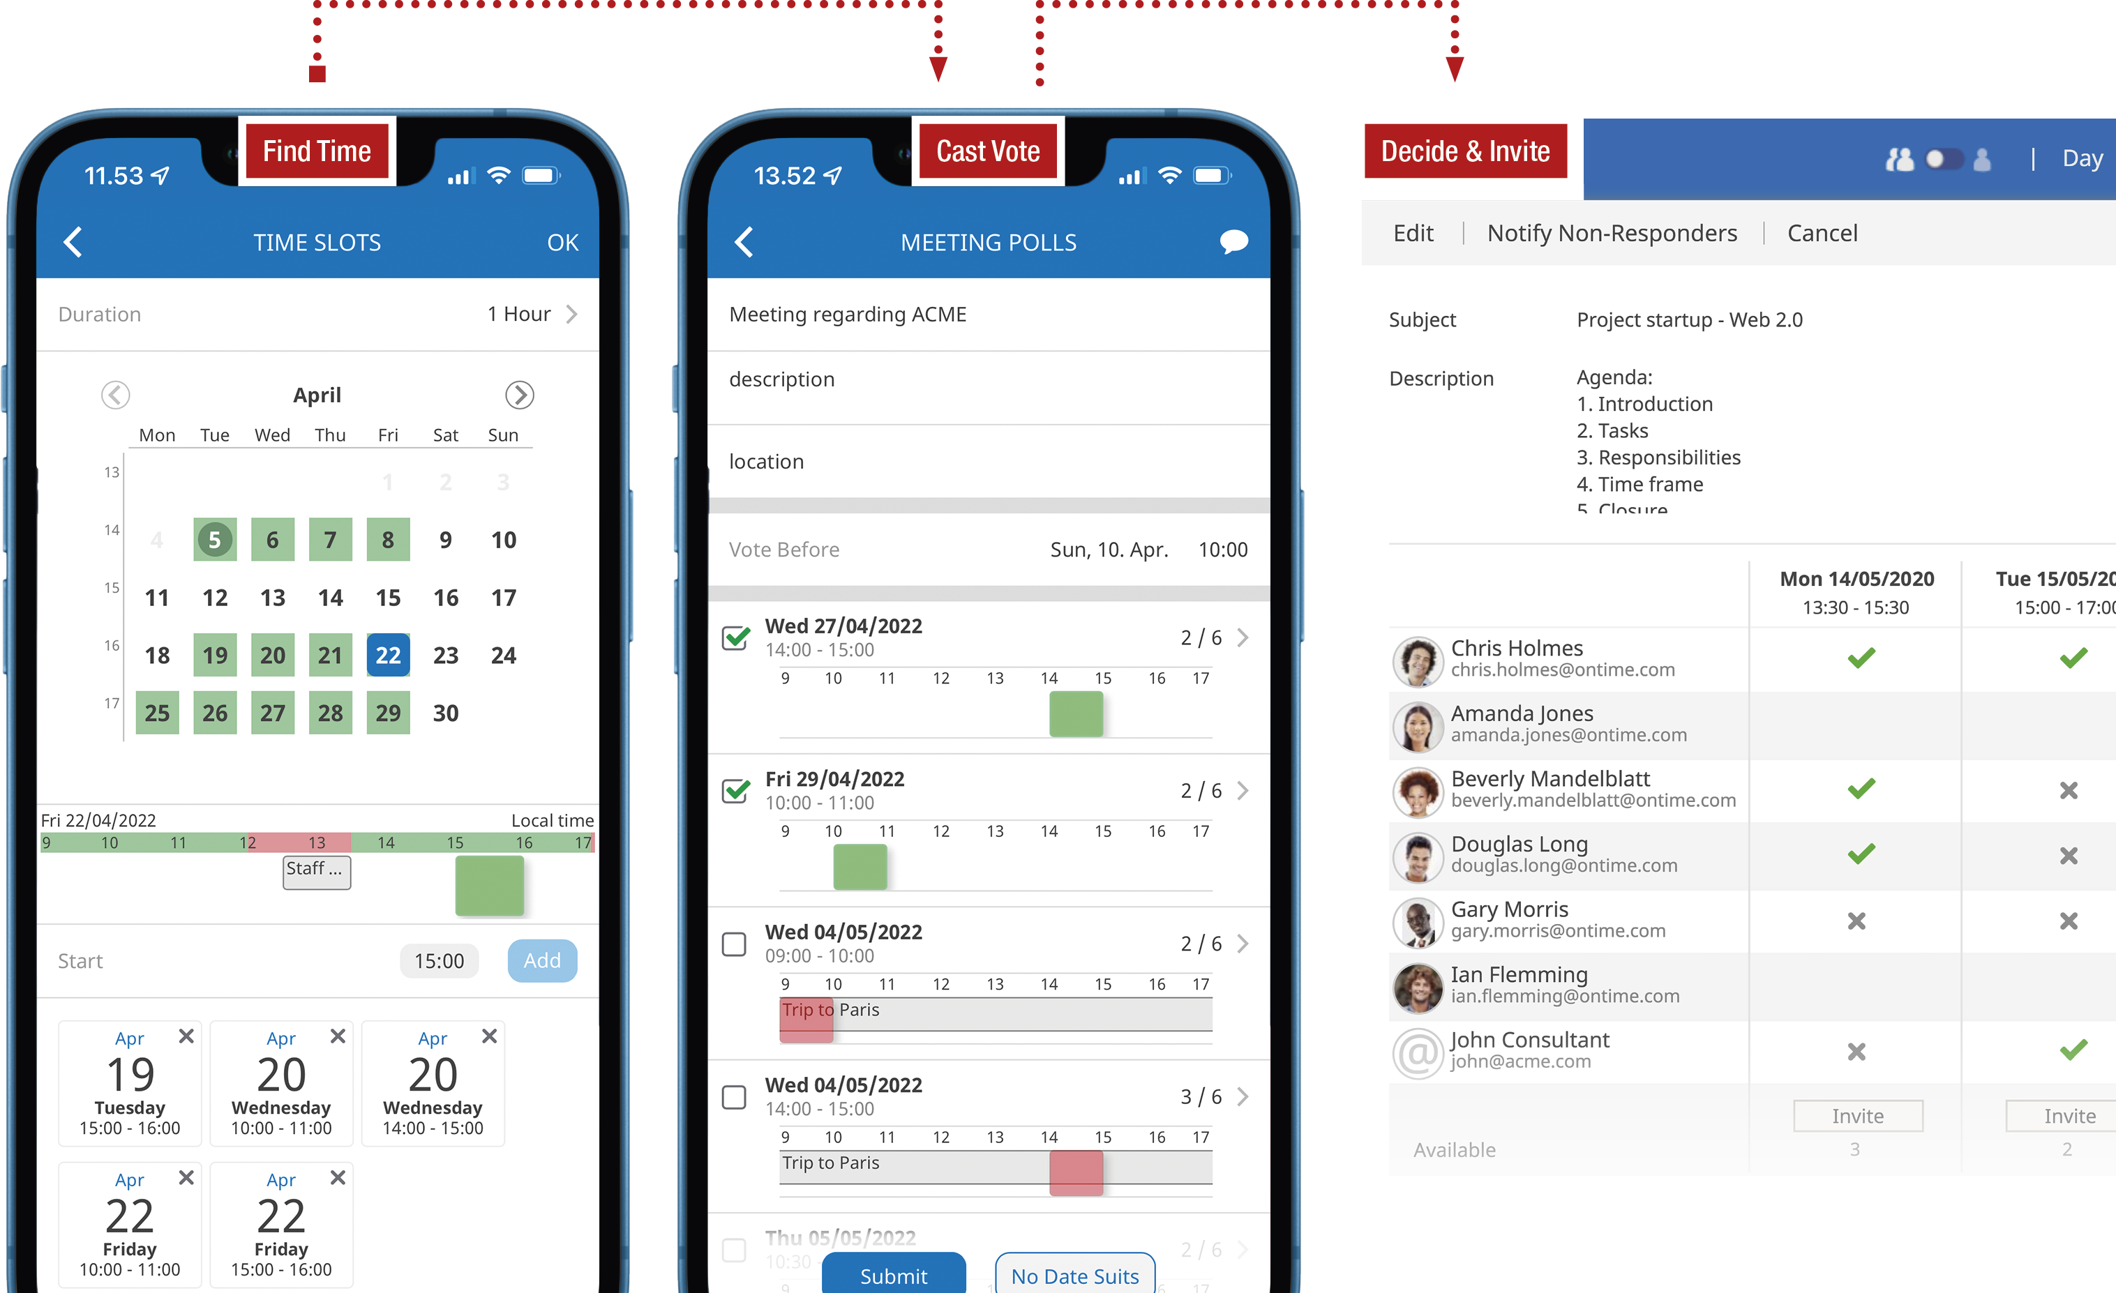
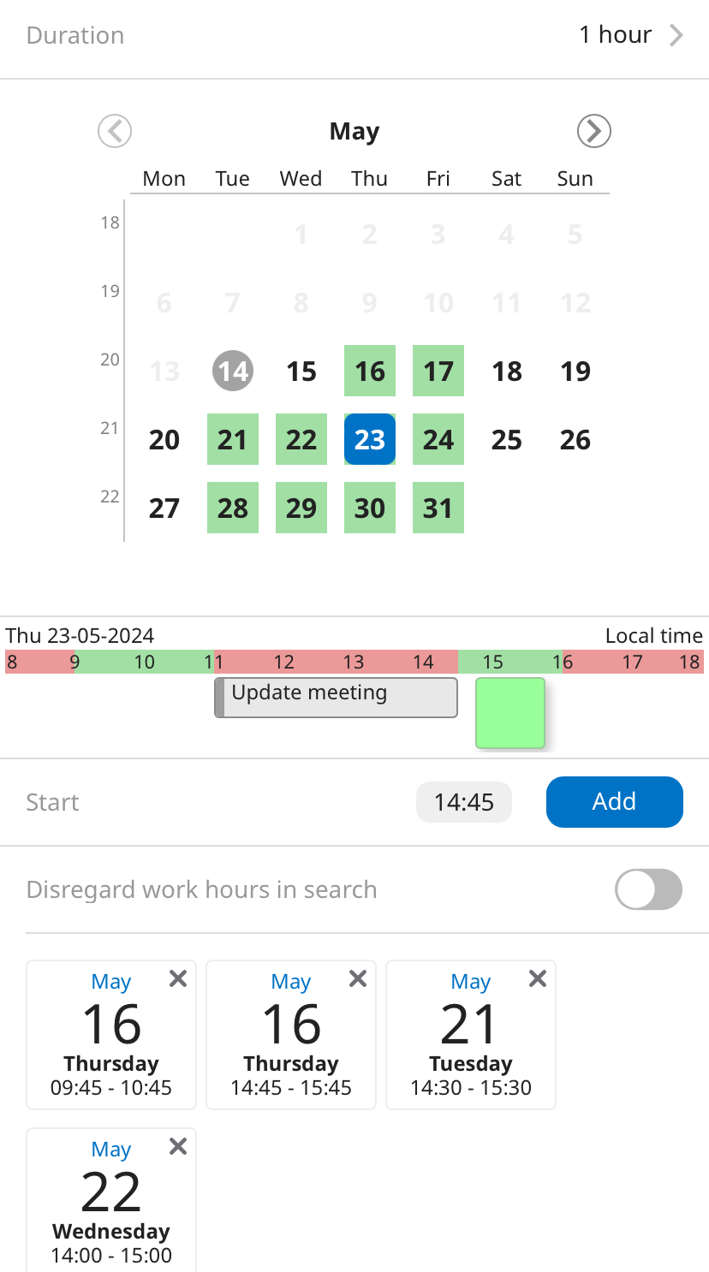
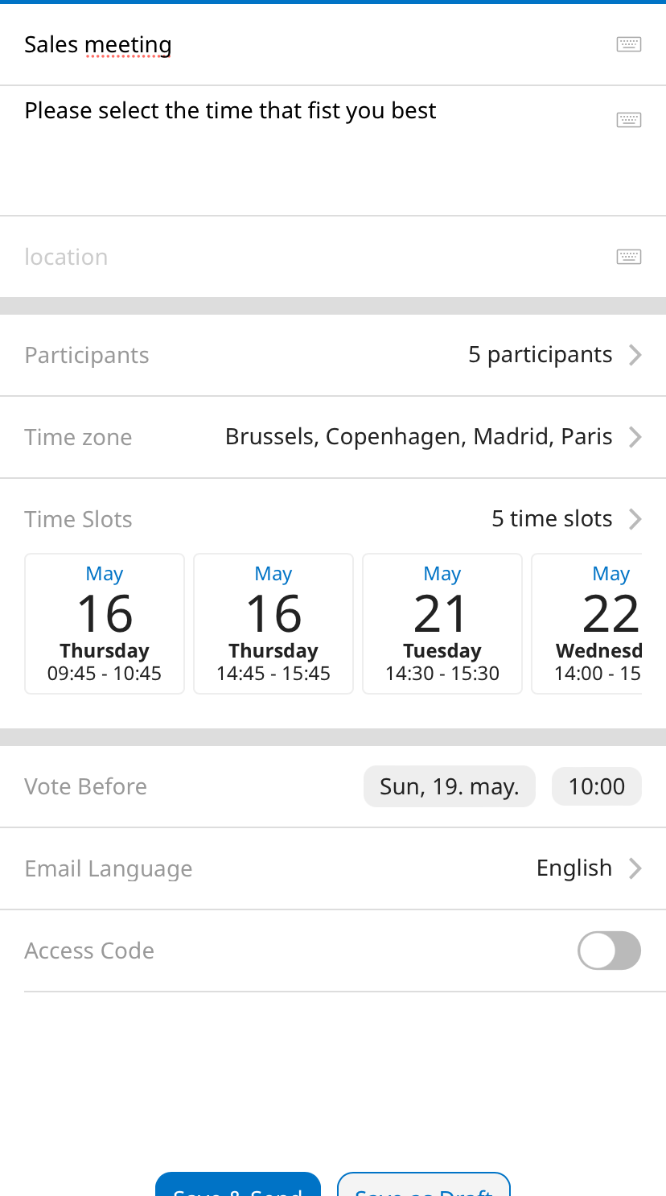
Streamline Scheduling by Polling
Find Time
Significantly reduce the time used to decide upon a common time slot for a meeting by polling the intended participants. Poll both internally or poll mixed groups which include external participants.
Increase your probability of success for each proposed time slot by enriching the poll with the current calendar information for internal OnTime users.

Slide 18
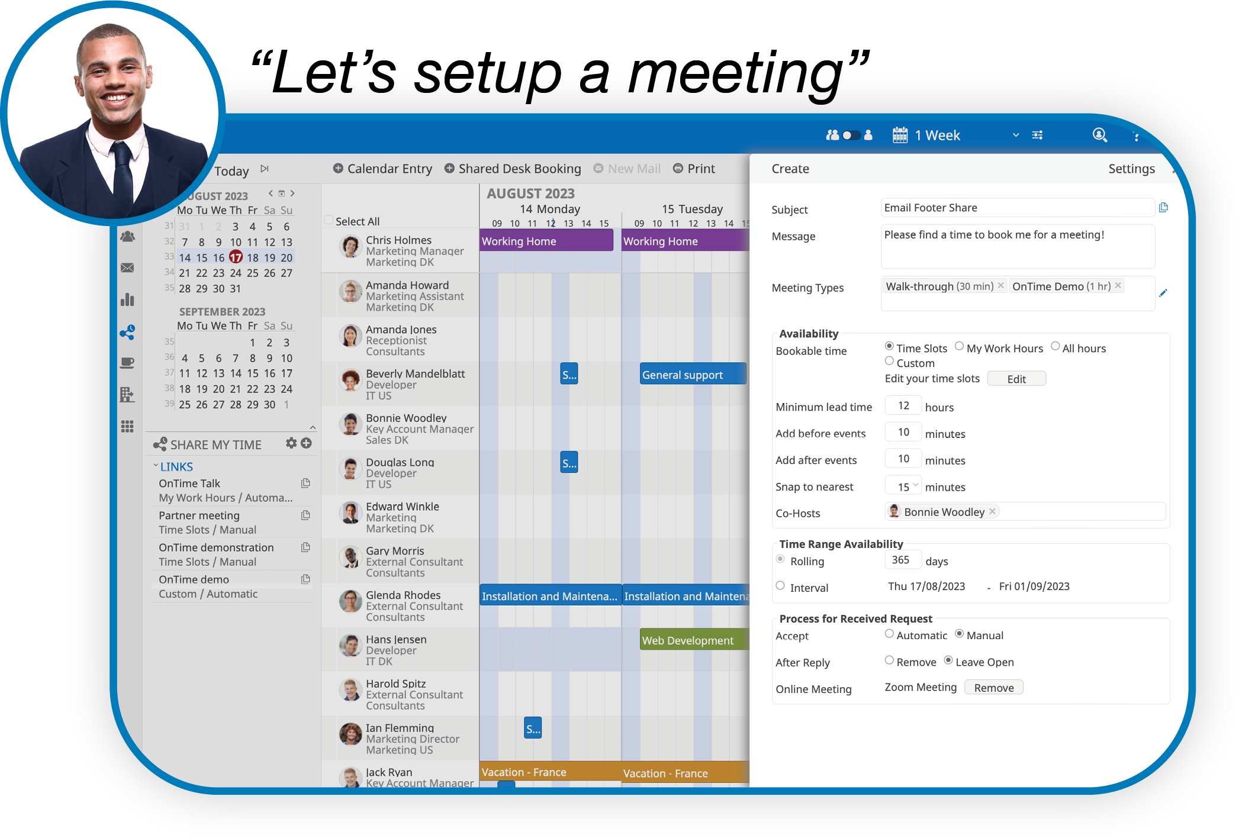
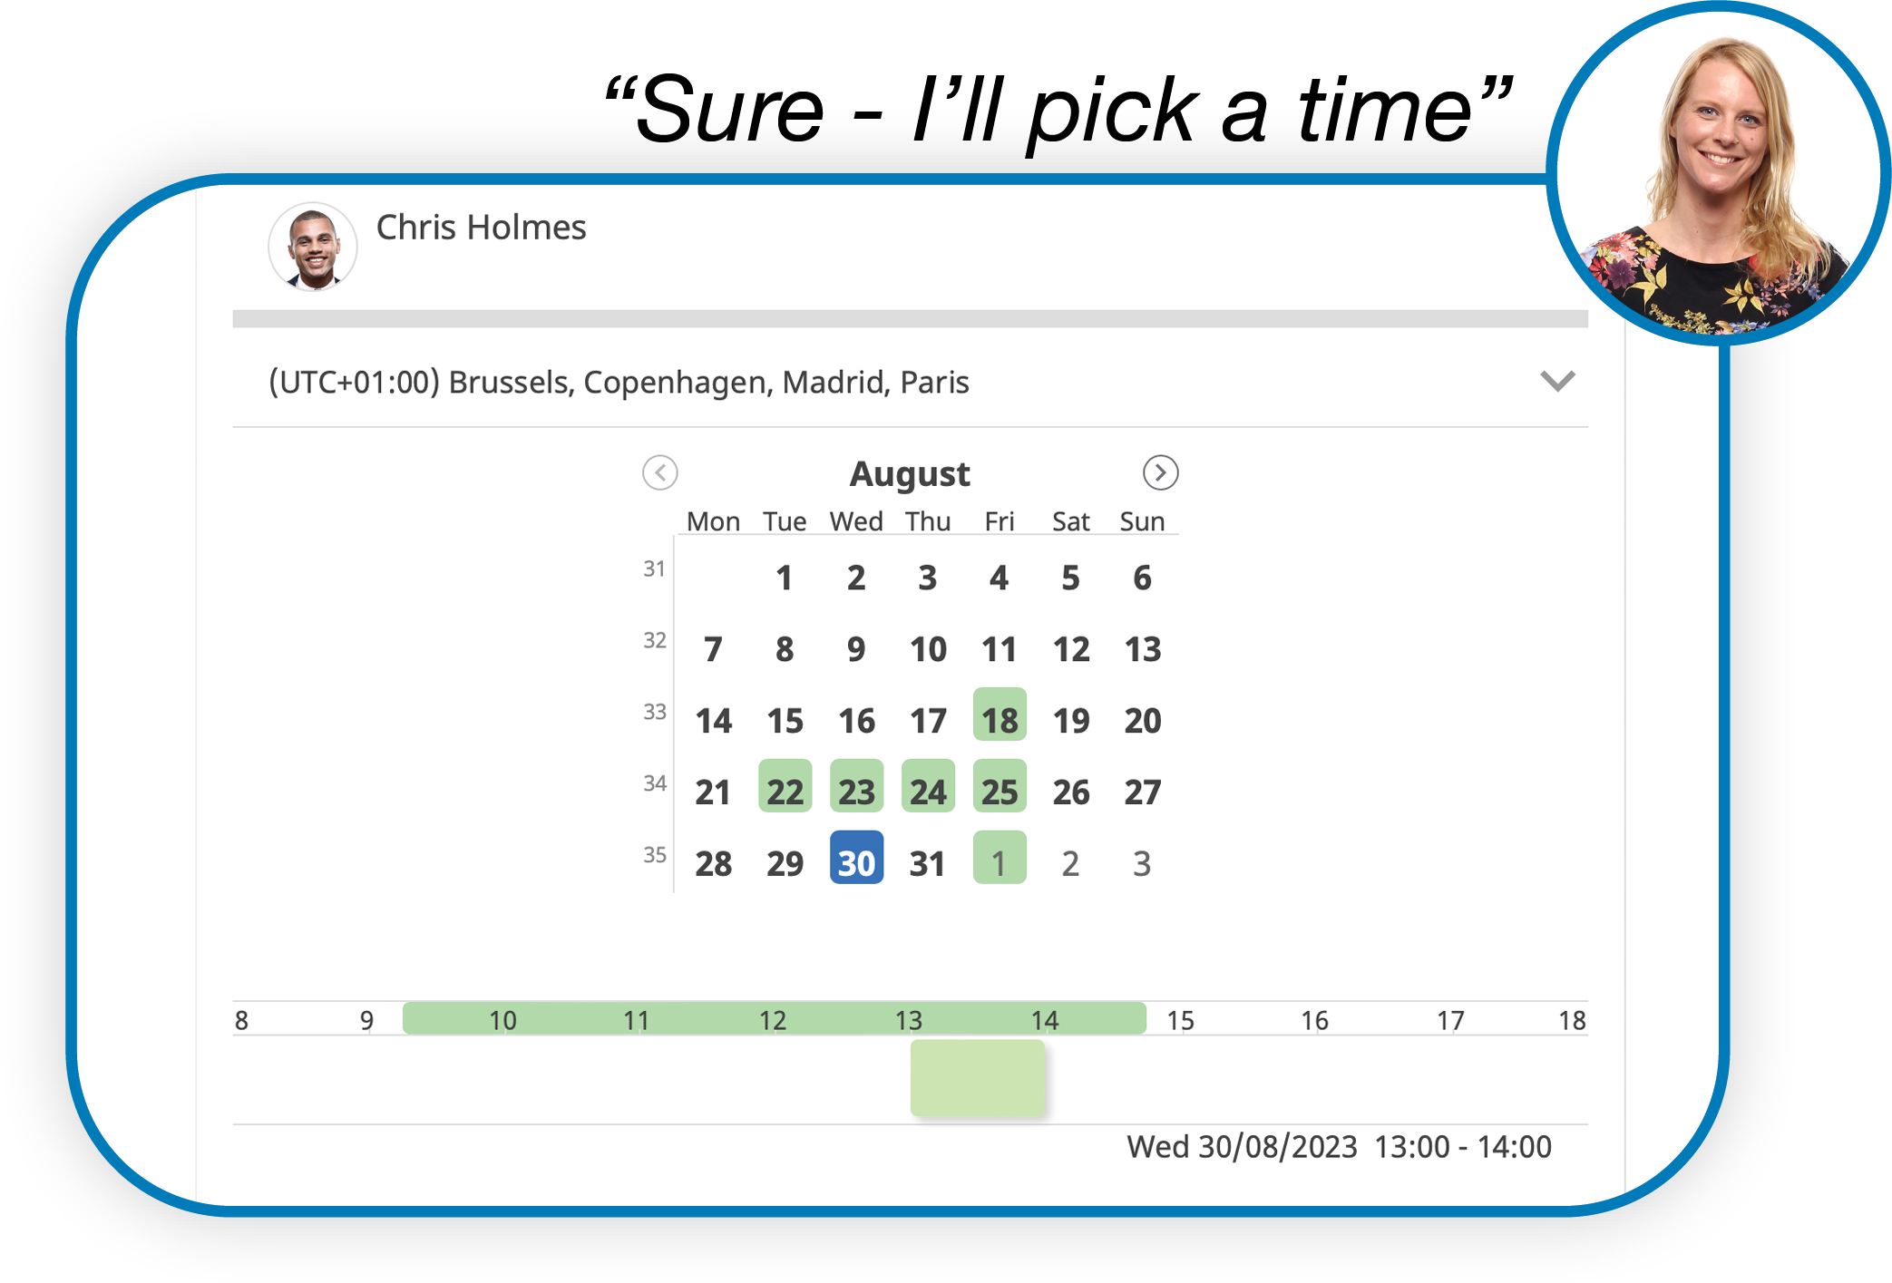
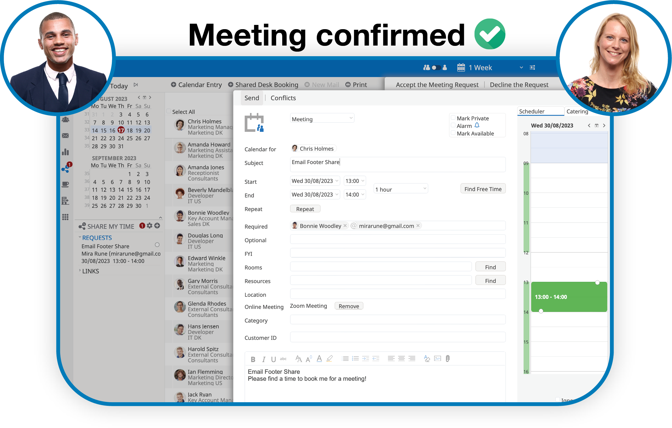
Find Time
Effortless Scheduling with Calendar Sharing
Tired of wasting hours coordinating conflicting meetings and dealing with endless back-and-forth messages?
With Share My Time, You Can give external parties access to your calendar, Allowing Them to seamlessly view and book Meetings without revealing your actual schedule, but only your availability.
It is available for all registred OnTime users, but with different features depending on your OnTime commitment.

Slide 19
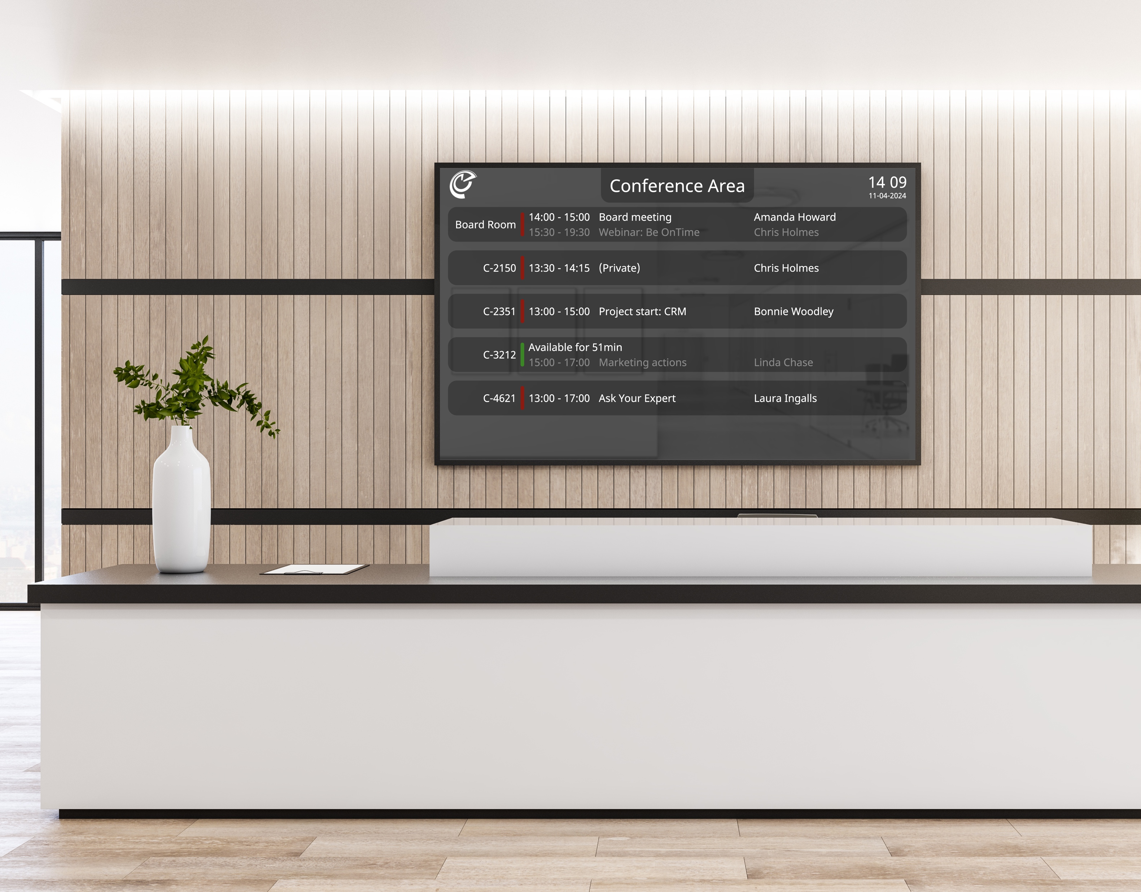
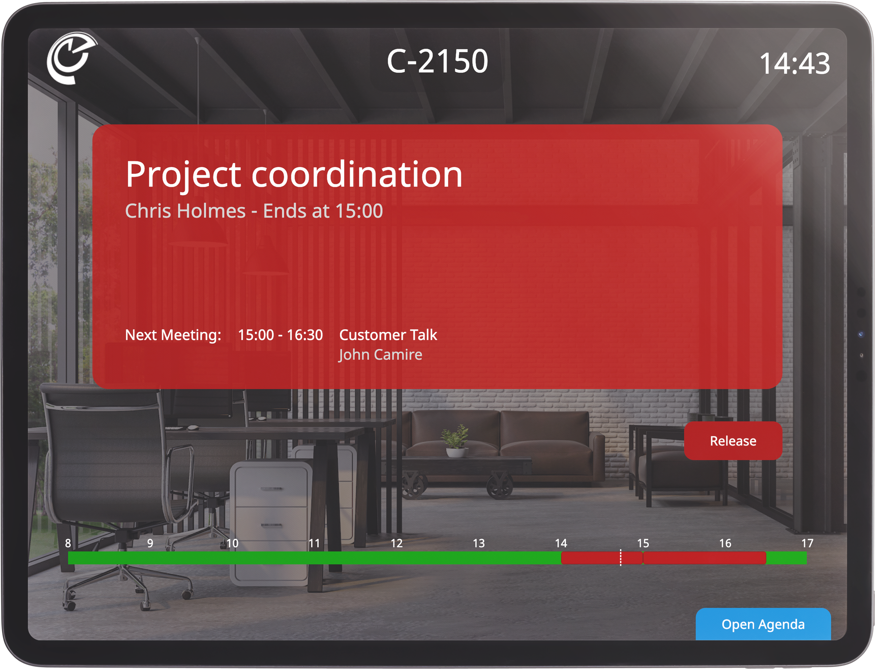
Room Display
Increase Utilisation Rates
of Your Rooms!
Room Display offers a convenient solution to seamlessly manage meeting rooms and conference areas.
With Room Display, you can effortlessly cross-check, book, and monitor the availability of meeting spaces, whether you’re using your OnTime client or directly interacting with the display itself.

Slide 20
Streamline Your Catering Process
New
Accept
Serve
Finalise
Complete
Organisation's one-stop shop for managing catering within the organisation, in a simple and timesaving way for everyone involved..
Catering Manager

Slide 21
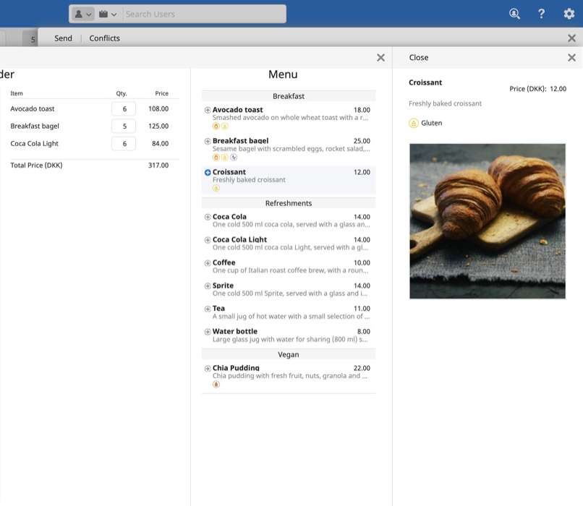
Catering Manager
Business User
Selected Benefits
Catering can be ordered in the same process as the meeting invitation in OnTime.
Only items that are available at the scheduled time of the meeting are offered to the user.
Change of schedule for a meeting automatically initiates the required changes to the catering order.

Slide 22
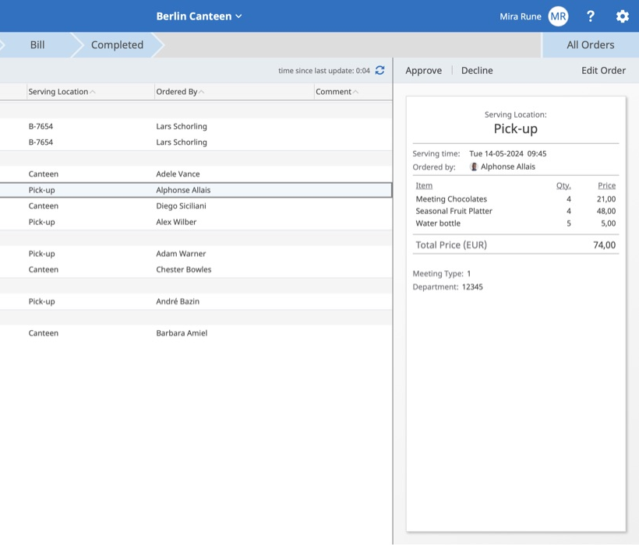
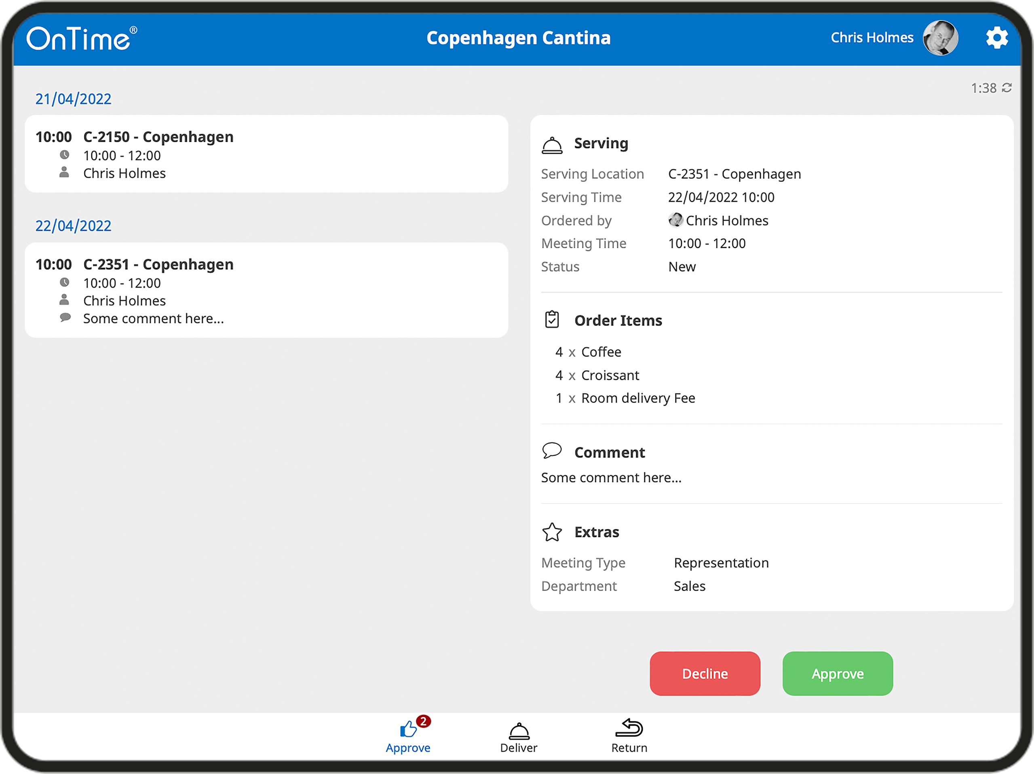
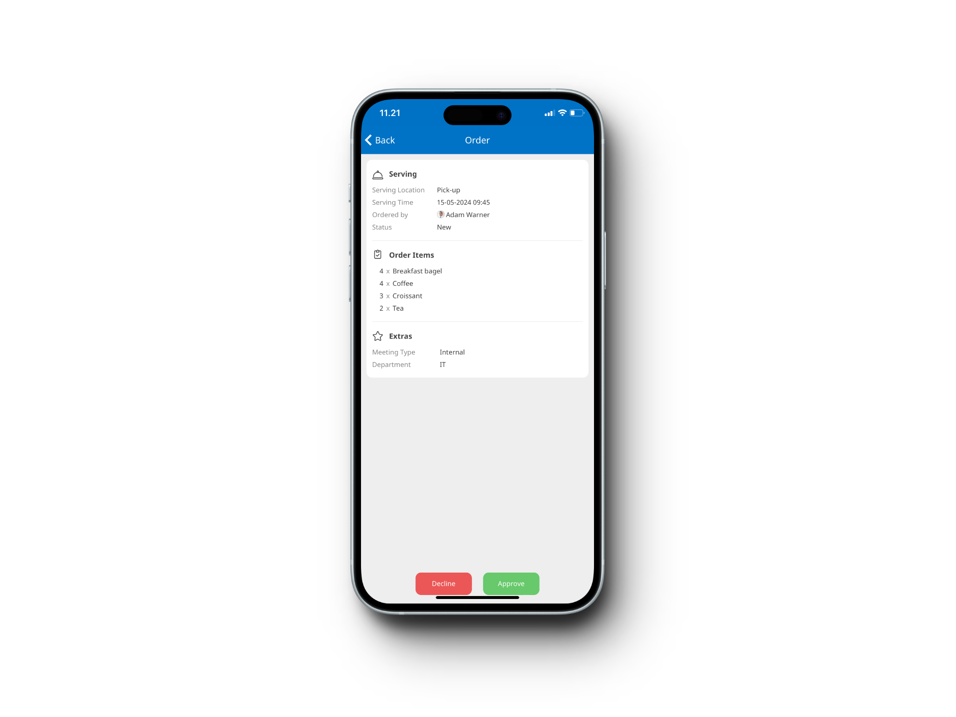
Catering Manager
Catering Manager and Staff
Selected Benefits
Catering desktop for tracking, accepting, delivering and invoicing of orders.
Catering rosters ensures that the correct order is delivered at the right time.
Changes between ordered and actual consumption can easily be adjusted.
Completed orders can be exported to an ERP system.
Working with both your desktop, tablet, and mobile devices

Slide 23
Streamline Your Visitor Process
Pre-register
Check-in
Check-out
Complete
The visitor management solution to give you a complete overview of all your visitors while reducing security and reception workload…
OnTime Visitor

Slide 24
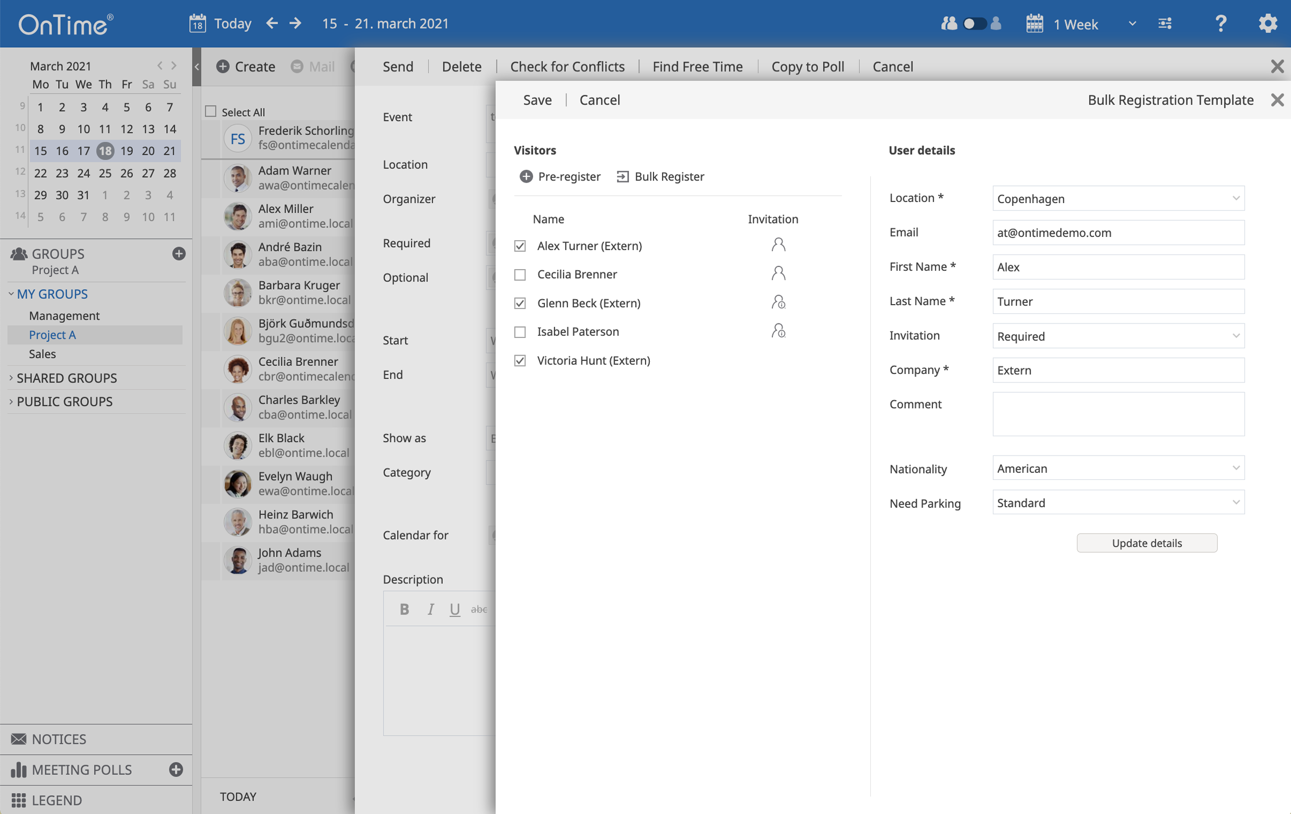
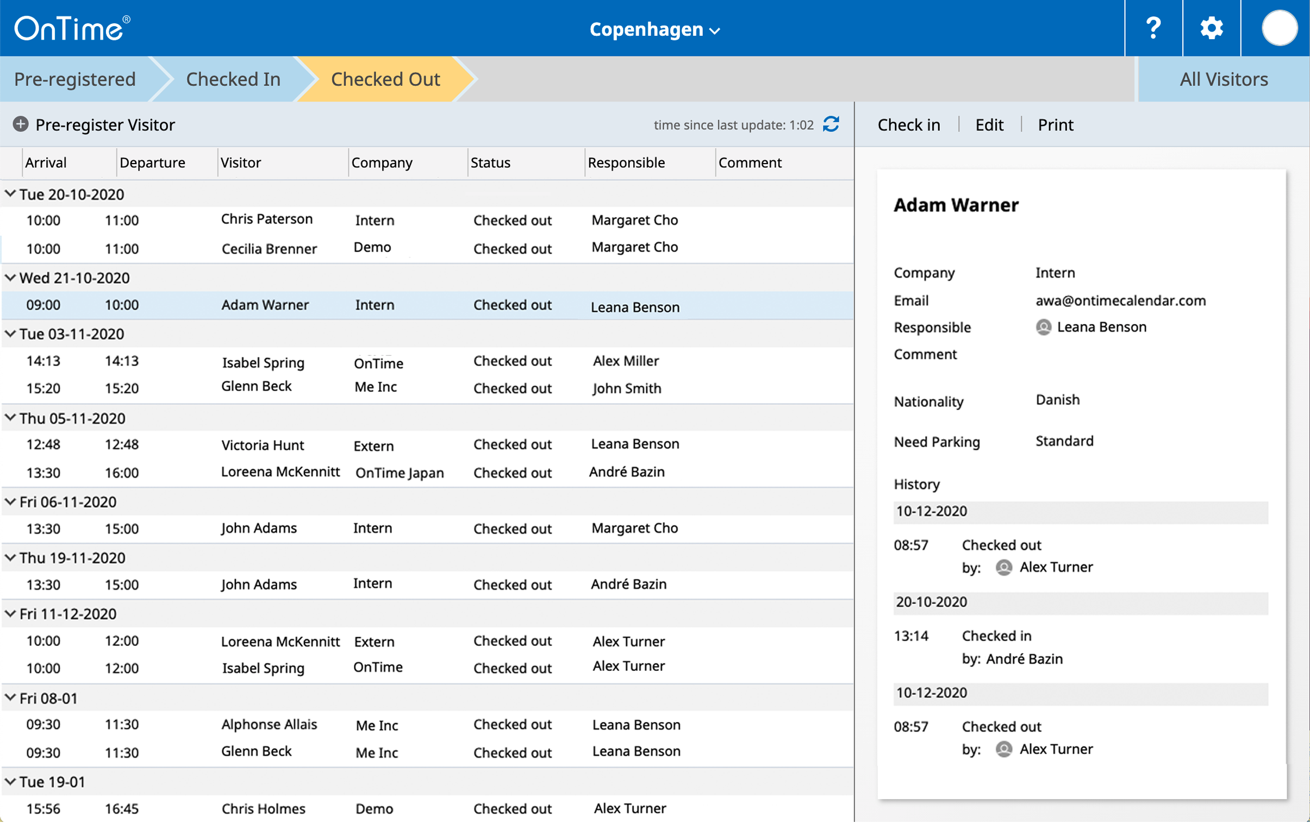
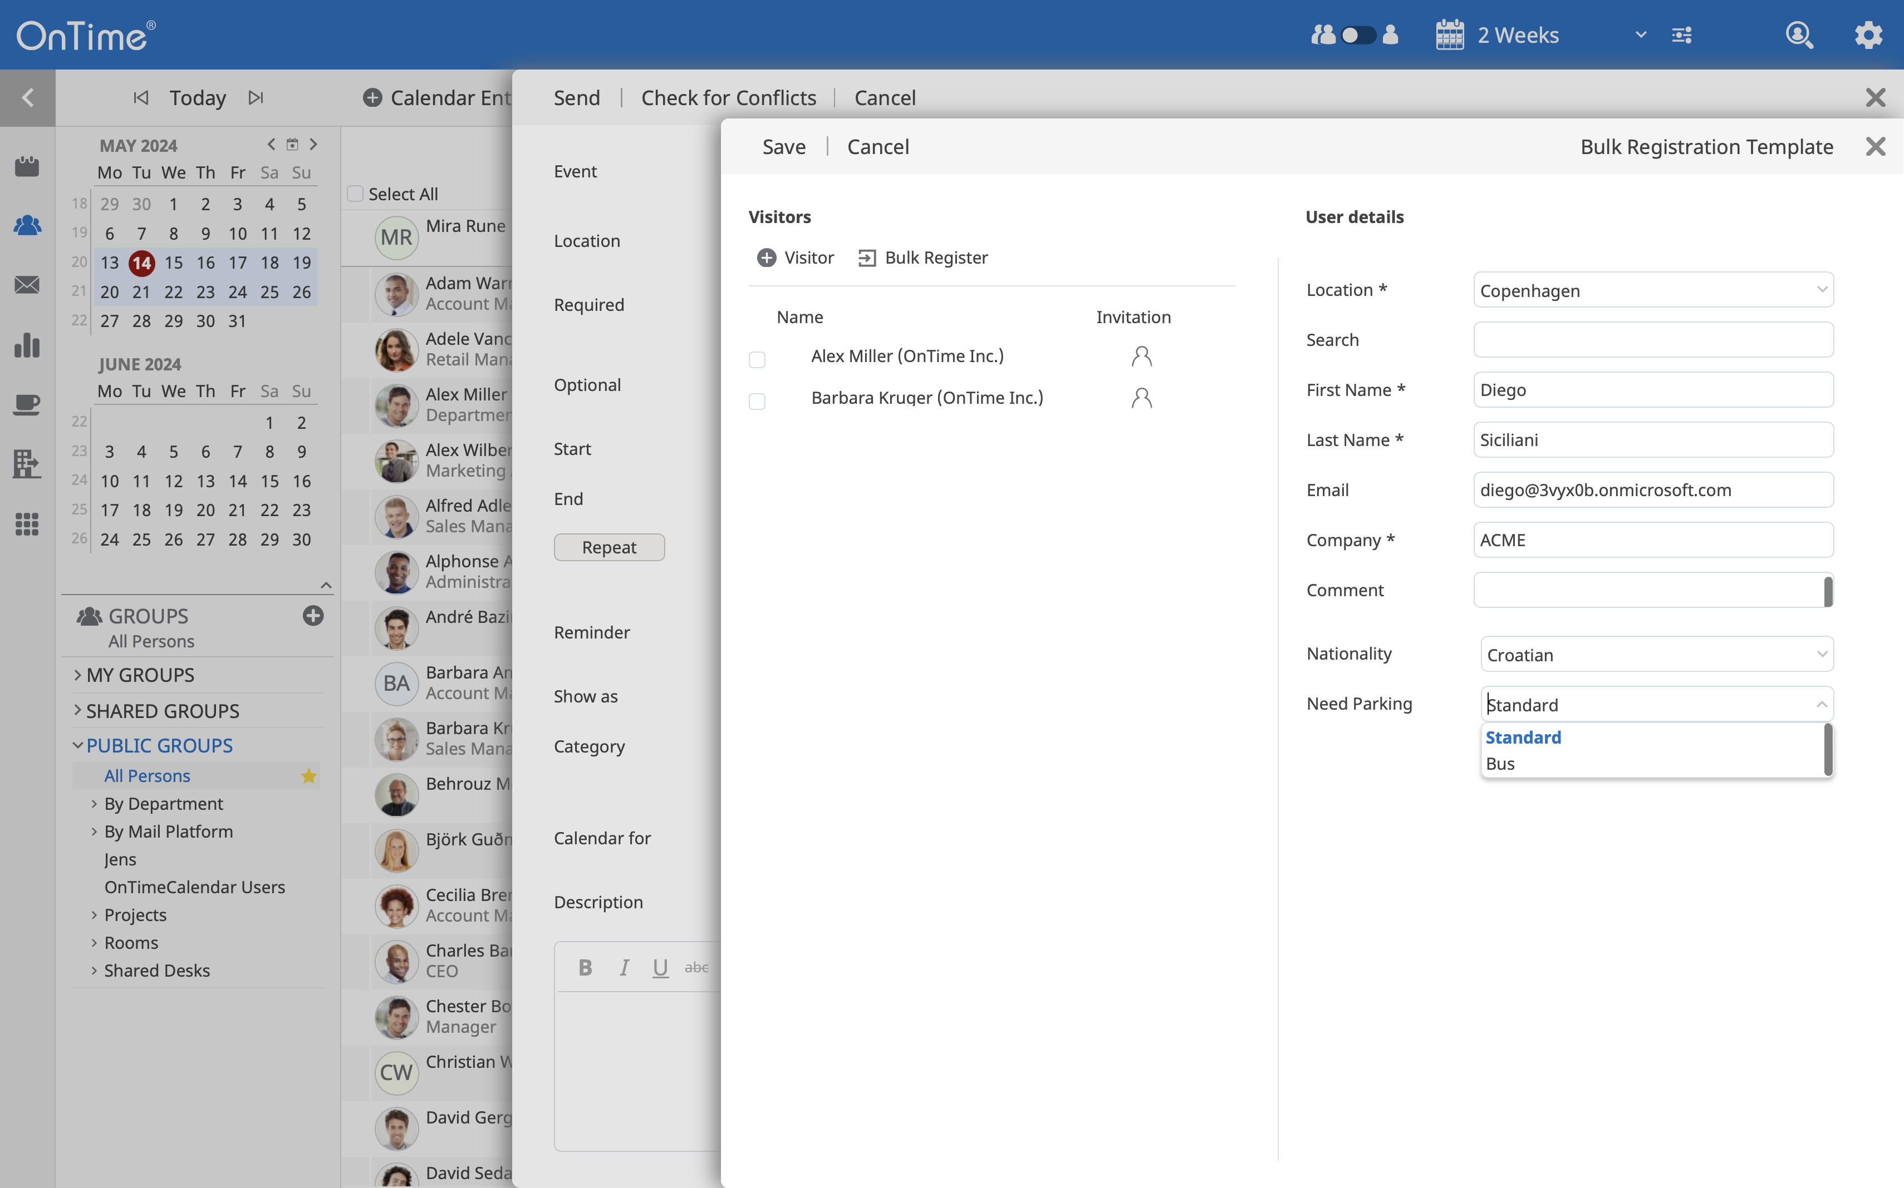
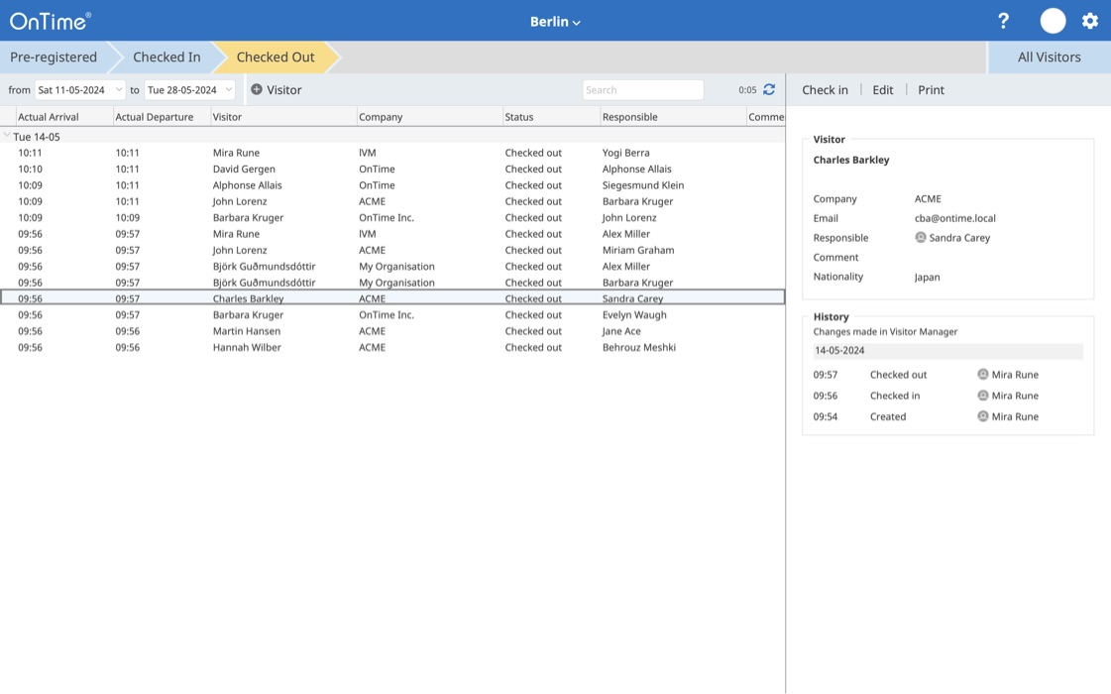
OnTime Visitor
Supporting the Process
Directly available for the user when booking meetings
The OnTime Visitor improves the visiting-experience for visitors, employees and reception
Full visiting history in case of potential disease reporting
Pre-register Visitors
Visitor Manager

Slide 25
Integration
using the OnTime API

Slide 26
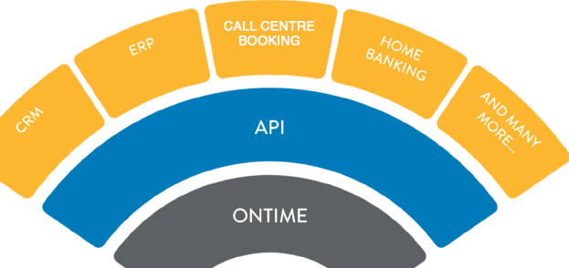
OnTime API
The Power of Integration
With the OnTime REST API, you can easily create real-time CRUD integration of your corporate calendar data with your other business applications.
No more updating of multiple systems, no more issues with keeping scheduling data in sync.
Examples from our customers:
SIEBEL CRM
SALESFORCE CRM
HOMEBANKING
SAP C4C
SAP PTO SYSTEM (Paid Time Off)

Slide 27
Architecture &
Security

Slide 28
Platforms, Interfaces and Languages
Supported platforms
Exchange Mail Server | Exchange 2010 SP2 and above | Office 365 | Support depending on cloud provider
OnTime Application Server | Apache Tomcat on Windows Microsoft SQL / SQL Express | Apache Tomcat on Windows Microsoft SQL / SQL Express | Apache Tomcat on Windows Microsoft SQL / SQL Express
 | On Premises | Public Cloud | Private Cloud
Supported interfaces and languages:
Clients
Mobile
Languages

Slide 29
Architecture
Active Directory
Desktop
OnTime
Service
Mobile
Administration
SQL Server
Configuration
Calendar data
OnTime API
REST like http based API
Synchronisation
Room Display
Mail
Personal calendars
Business API
Exchange
on prem
Office 365
cloud

Slide 30
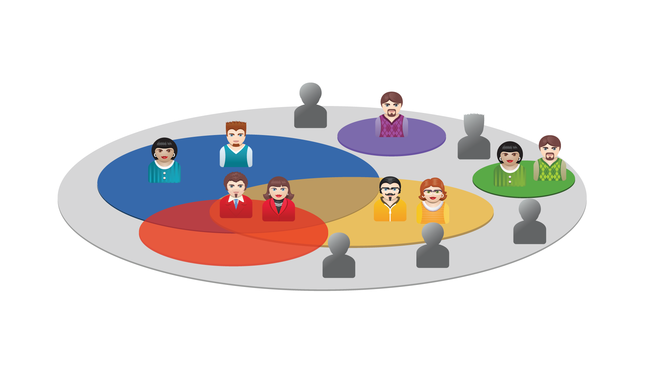
Roles
PRIVATE SHARING
(as all the below)
EDIT
(can create, edit & delete)
VIEW ALL DETAILS
(including description & attendees)
VIEW TITLES & LOCATIONS
(view titles & locations only)
VIEW WHEN BUSY
(view blocked time only)

Slide 31
Demonstration Time

