Slide 1
When Time Matters
OnTime Group Calendar

Slide 2
Agenda
About Us
Why OnTime?
Architecture & Security
Interfaces & Add-ons
Live Demo

Slide 3
OnTime® currently has more than 600,000 users worldwide
Located in Denmark, Germany, Japan, and Ukraine
IntraVision has partnerships with both HCL and Microsoft
OnTime® is sold and supported both directly by IntraVision and business partners around the globe.
Co-designing our solutions with our key stakeholders - our customers and partners in order to continuously improve OnTime
Who are We?

Slide 4
Why OnTime?

Slide 5
A Calendar that Drives Outcomes
OnTime Group Calendar transforms individual agendas into a synchronised force, aligning thousands of calendars into one harmonious vision.
Featuring online meetings, legend filters, polling, calendar sharing, and vacation planning tools, simplifying the coordination of both internal and external meetings.
Collaboration and diversity are key drivers in achieving successful business outcomes, and that’s precisely what OnTime facilitates.
What is OnTime?

Slide 6
Notes & Verse “Best Friend”
”We" focused contra "Me" focused
Think BIG not Small - thousands of calendars in one
Online meeting providers: Zoom, MS Teams, Webex & Sametime
Handle your “out of office” plans with ease
Powerful tool to work On Behalf Of other people (eg. personal assistants)
Range of other add-ons – Mobility, Polling, Catering Management, HCL Connections, Room Display, Integrations (API)
OnTime “Keywords”

Slide 7
Interfaces &
Add-ons

Slide 8
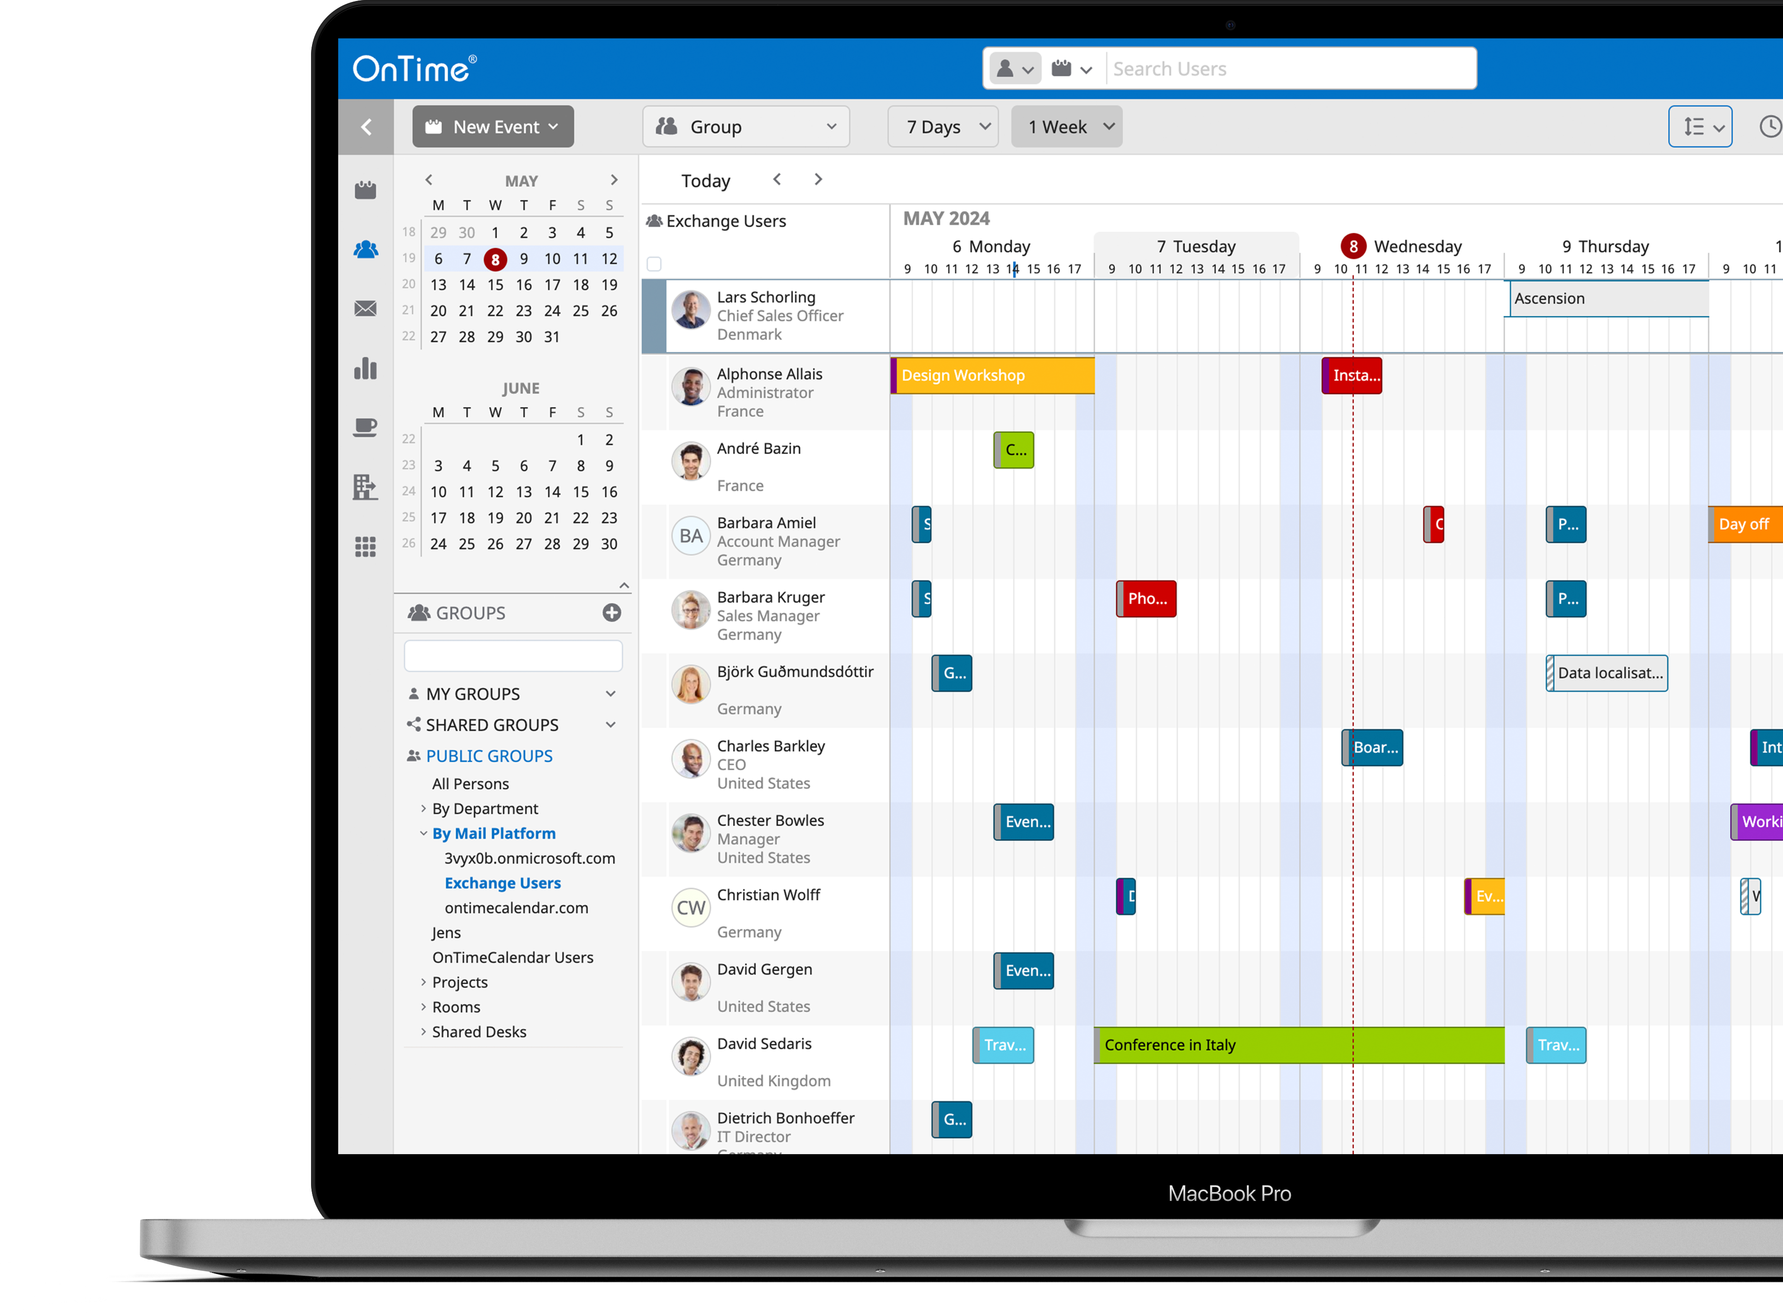
Group
Desktop Client
Overview your entire organisations calendars, from one place
View, Create, modify, search and filter calendar entries
The central group viewer delivers a high speed, row-based display of multiple users' calendars
Drag and drop actions
Customisable via the sidebar, top navigation and action bar
Notes:
Streamline Team Scheduling
The OnTime Interface is designed to provide a comprehensive suite of calendar management tools, offering functionalities such as viewing, creating, modifying, searching, and filtering calendar entries.
Central to this interface is the Group Viewer. The Group Viewer delivers a scalable, high- speed, row-based display of multiple users’ calendars, allowing for the selection and manipulation of calendar data through intuitive drag-and-drop actions. This central feature of OnTime is customizable via the Sidebar, Top Navigation, and Action Bar, providing a versatile platform for diverse calendar management needs.

Slide 9
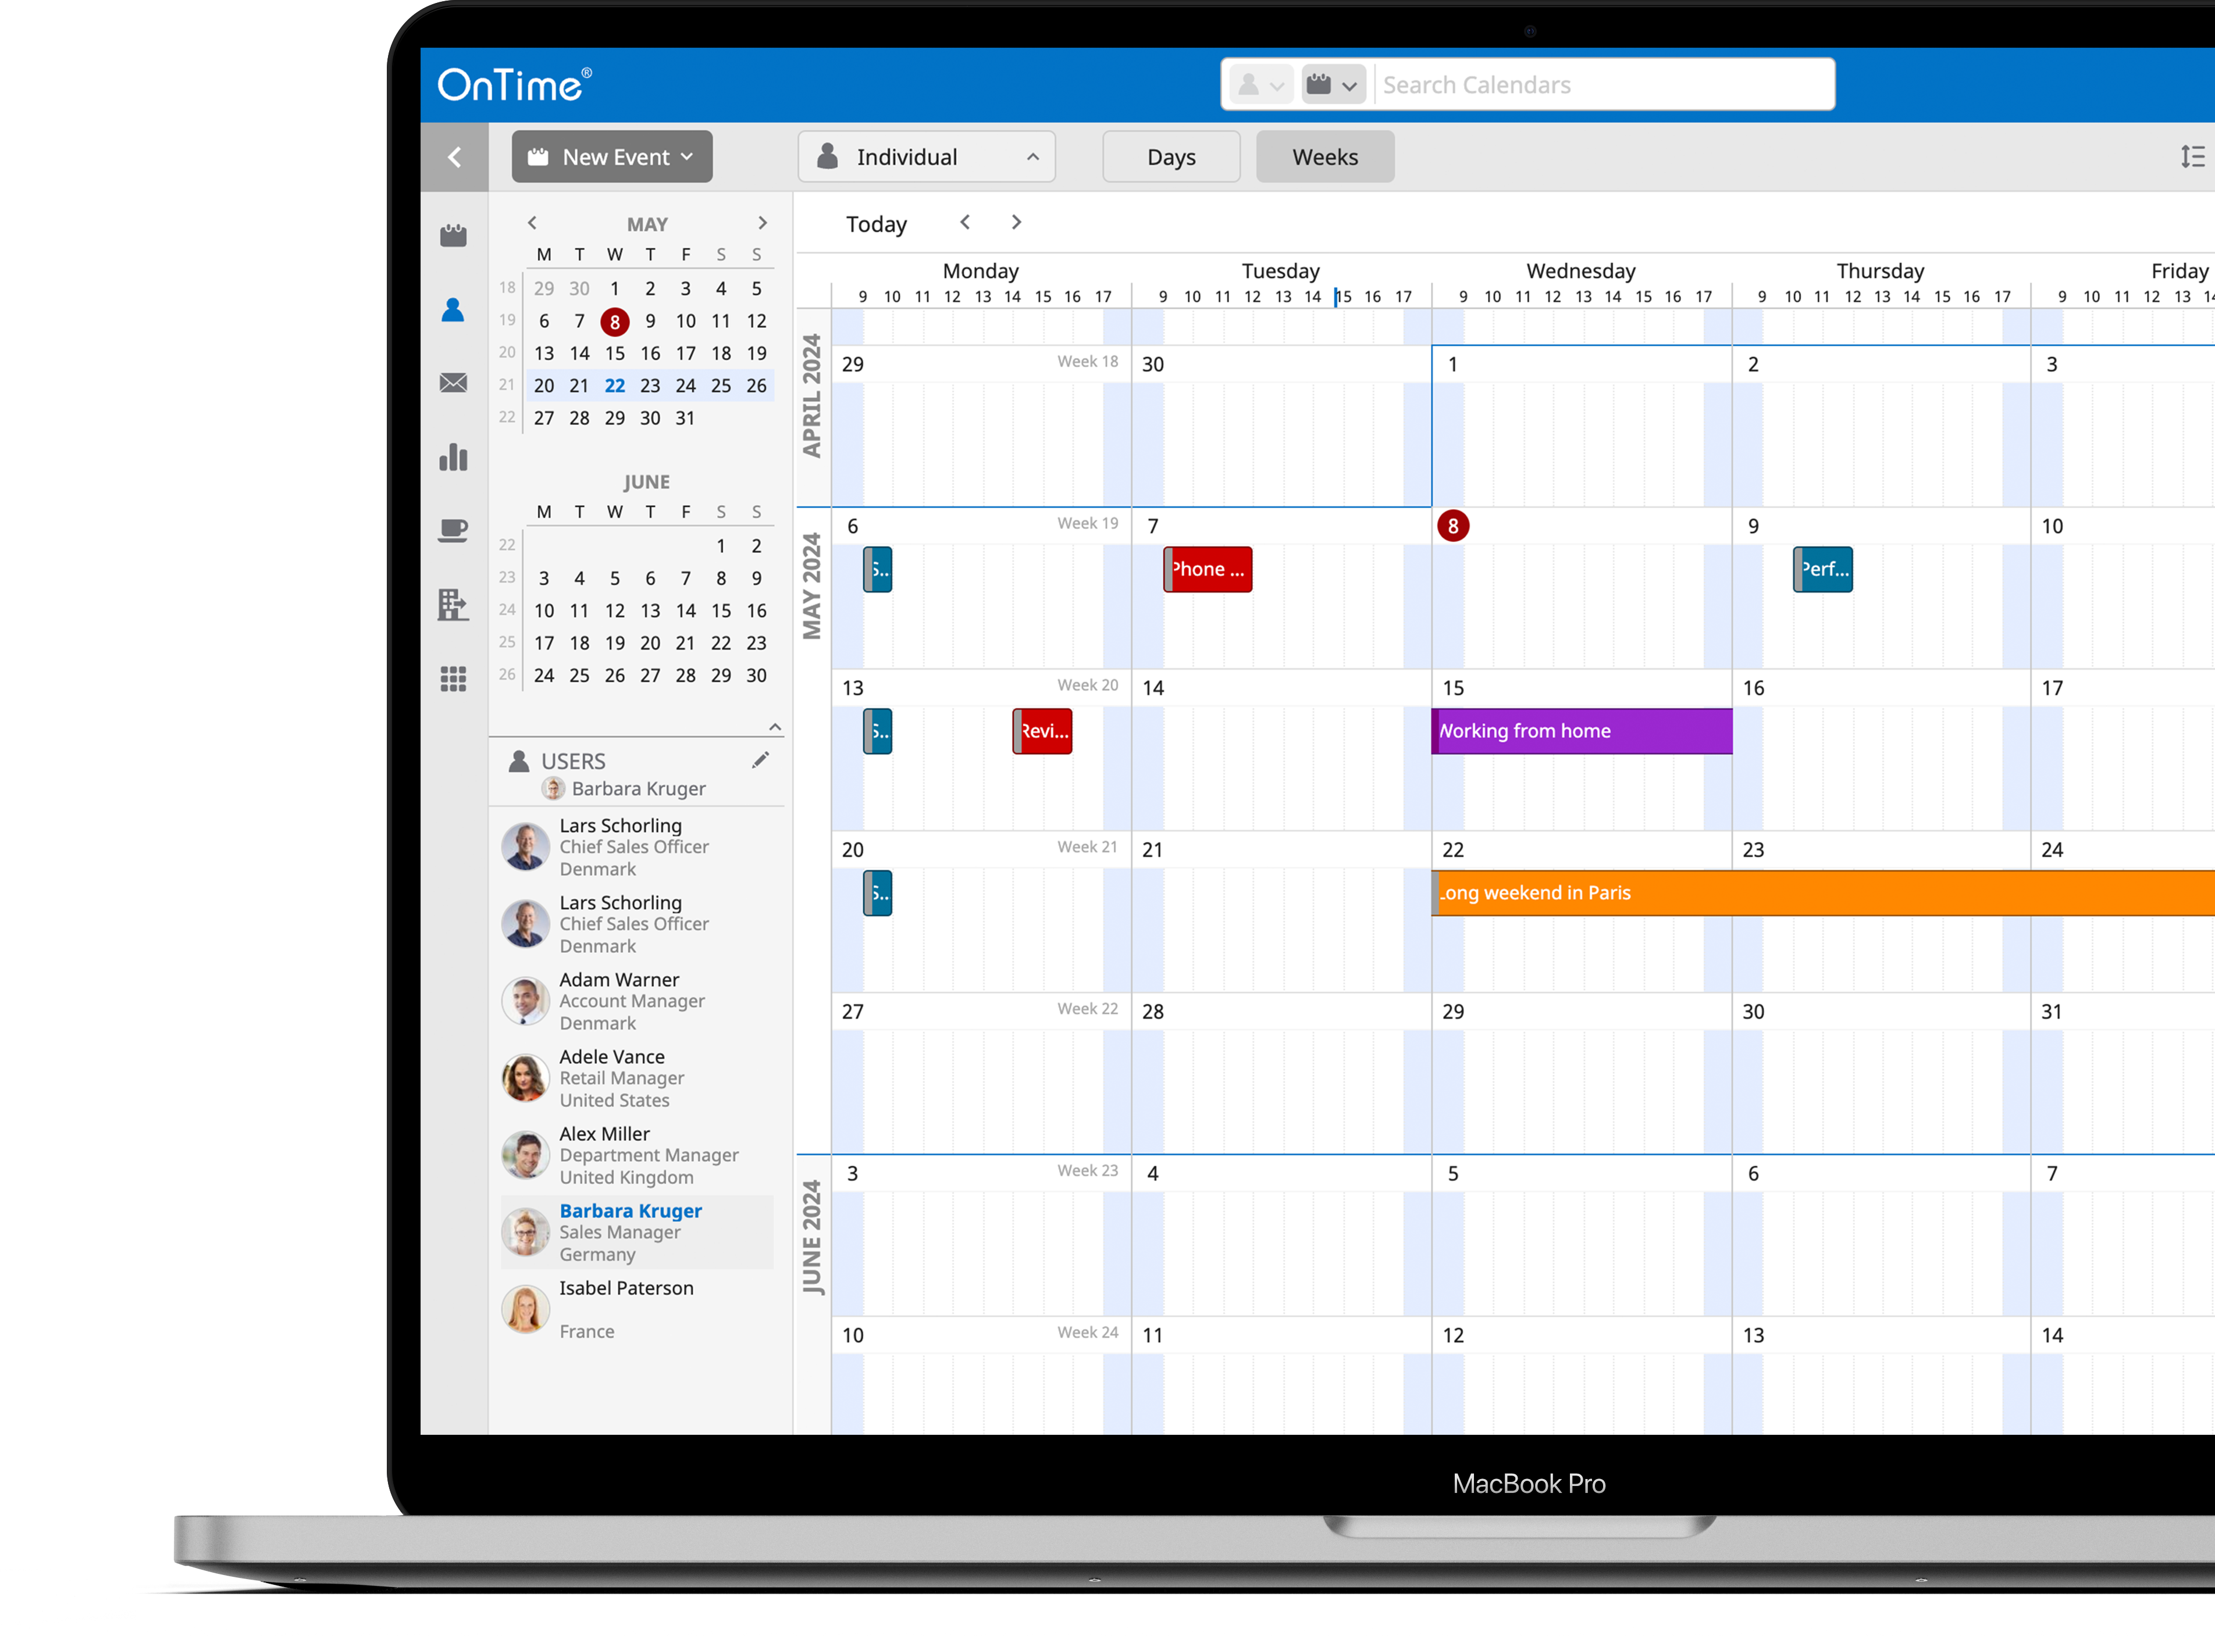
Individual
Desktop Client
Deep dive into a selected person’s calendar
View a period of a day or even several months.
Switch between calendars from the Users panel in 1-click
Respond to another user’s calendar invites.
Allow to create polls and send these out on behalf of other users
Add Catering to close the circle for the personal assistant to fully support his/her manager’s agenda.
The perfect solution for the personal assistant trying to find time to meet for people with busy agendas.
Notes:
Manage Individual Calendars
The OnTime Interface provides dual functionality for calendar management. The Group perspective aggregates multiple users’ calendars, allowing for a broad overview. Conversely, the Individual perspective offers detailed management of a user’s own calendar.
With appropriate permissions, a user can also access and administer the calendars of colleagues. This includes sending invitations, replying to meeting requests, and creating polls in the name of another user and even sharing the availability of that user through the Share My Time feature. This functionality is particularly beneficial for administrative staff tasked with coordinating schedules for individuals with demanding agendas.

Slide 10
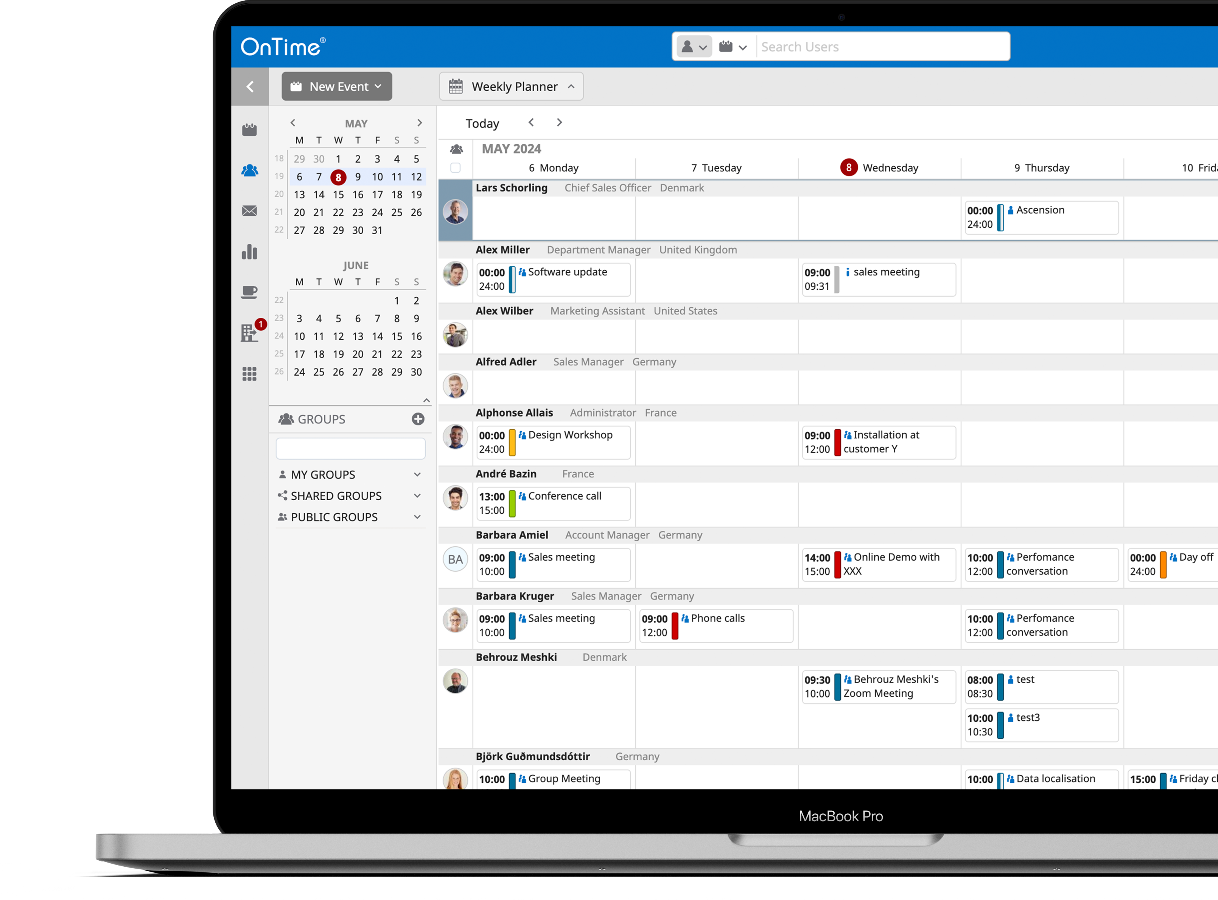
Weekly Planner
Desktop Client
Allows you to see your colleagues most important agenda detail from a new perspective
Drag and drop entries to new times or people

Slide 11
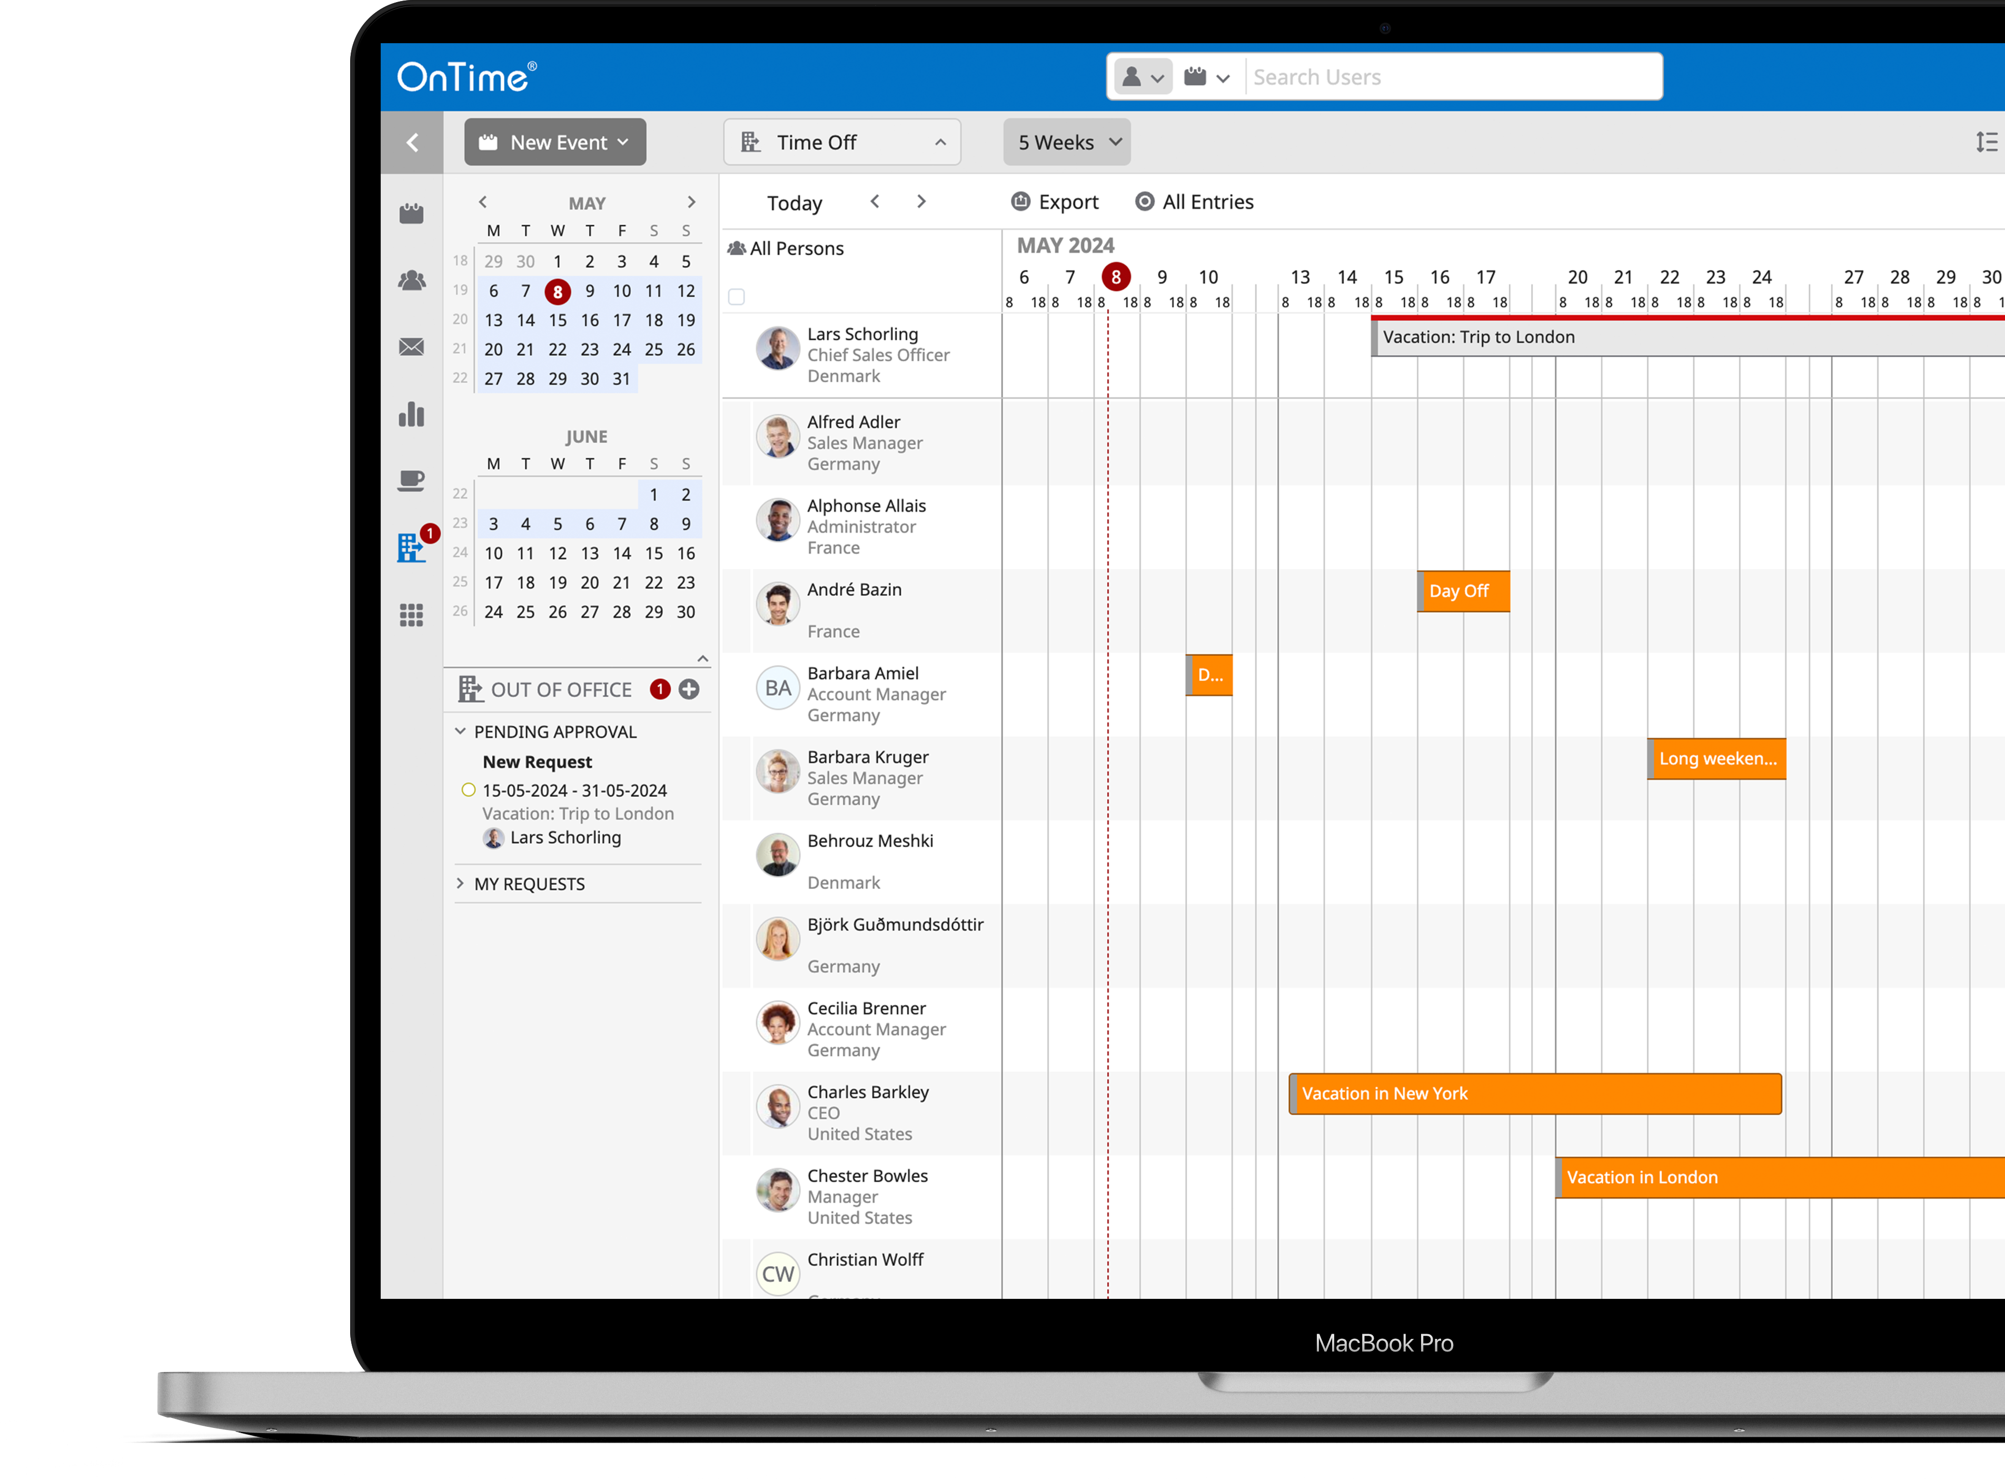
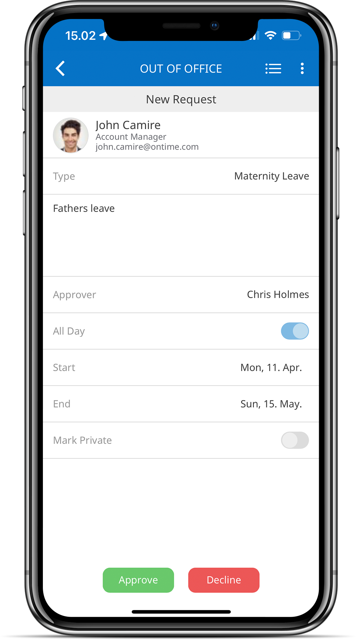
Time Off
Desktop Client
Request/Approve/Book Your Vacation Plans and Other OoO Requests
With people working in Hybrid modes, it can become confusing to figure out who is where and whether they are available.
In short, the OnTime Out of Office feature is a workflow module with an integrated approval process that helps organisations keep track of the whereabouts of co-workers.
Whether working from home, attending a conference, or away on vacation OnTime help guide you.

Slide 12
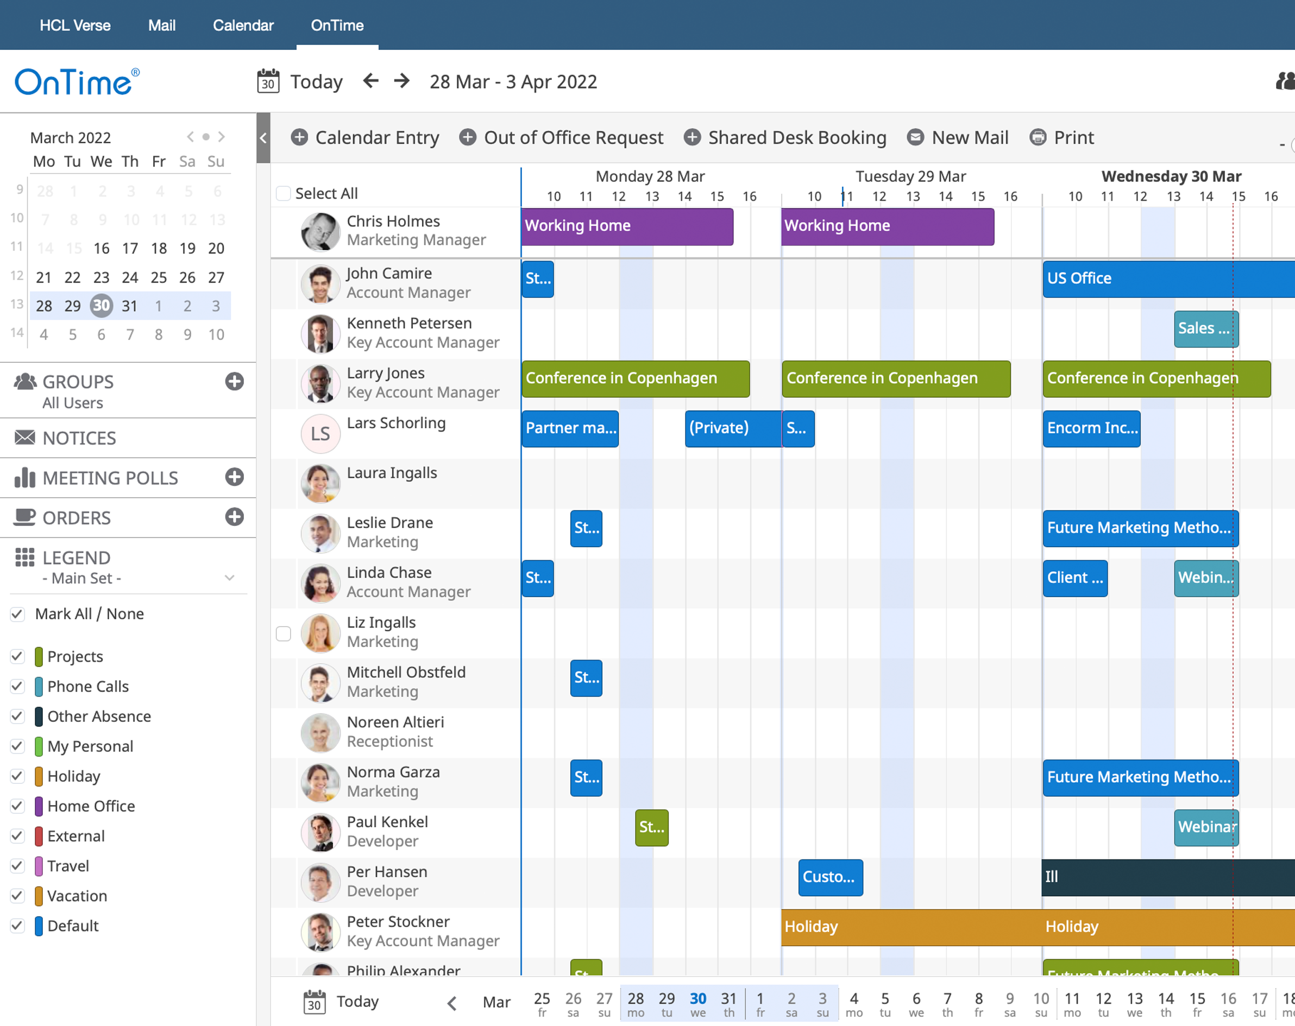
Embedded into Verse
Desktop Client
HCL Verse objectives are to help you prioritize information, people and tasks, anticipating what you need, and when you need it.
Therefore, we have made OnTime available from the Verse interface as well.

Slide 13
Desktop Client
Support Your
Online Meetings
Let OnTime help you in creating, maintaining, starting, and joining your favourite online meeting software.

Slide 14
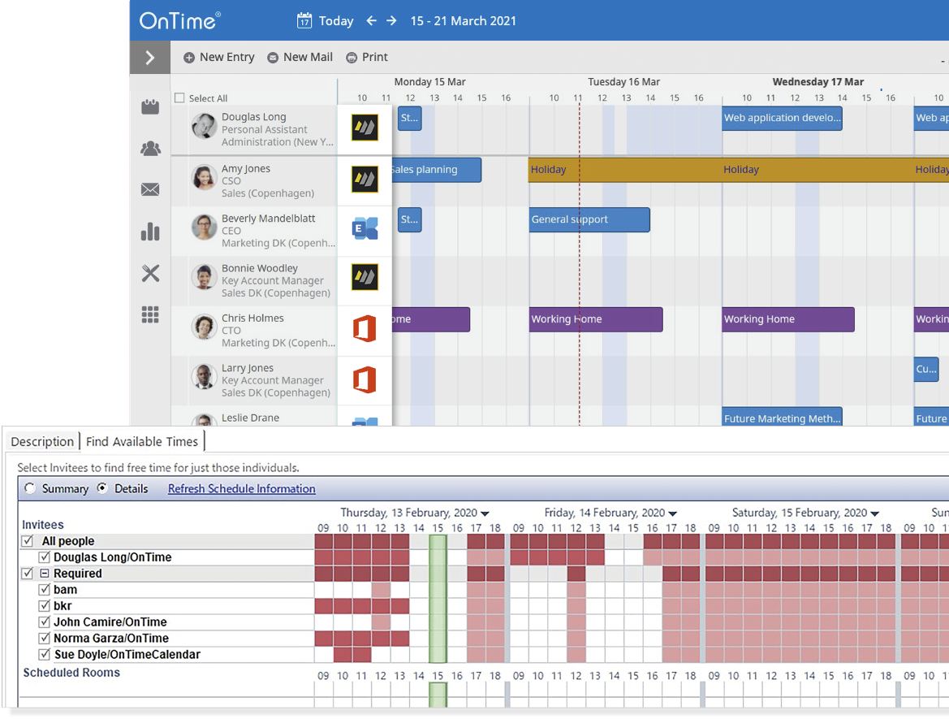
Domino & Exchange
Mixing Domino
and Exchange Users
Free Time search
Show availability and schedule meetings in the OnTime Desktop
Invite rooms
Work “On Behalf Of” – The perfect tool for PA’s and service centre personnel
Supporting:

Slide 15
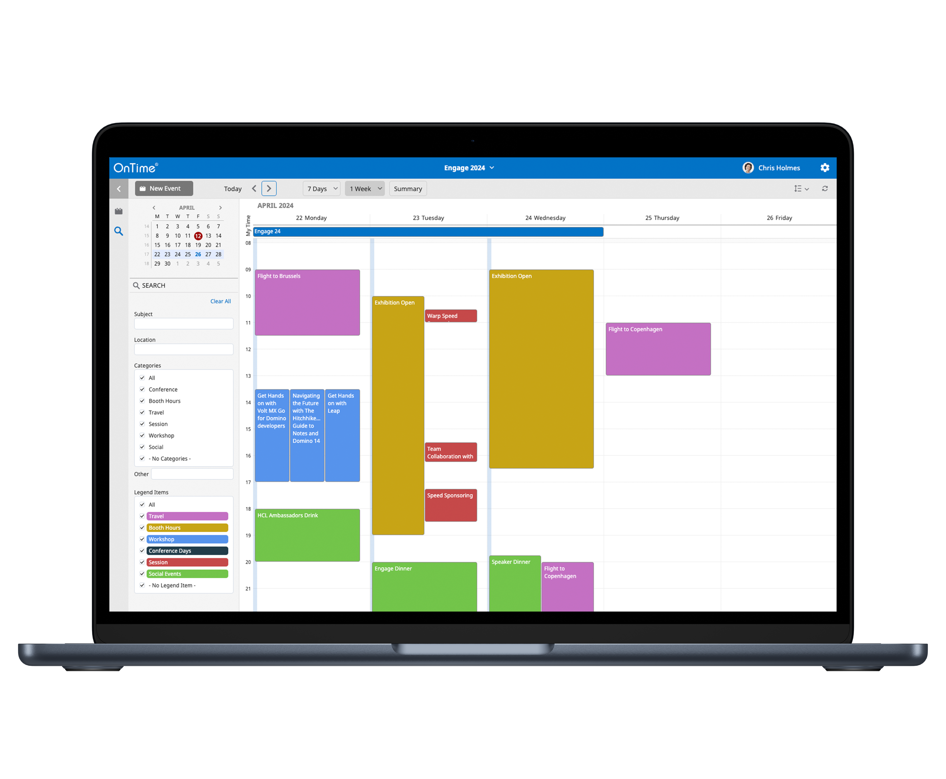
Event Hub
Event Planning Made Easy
Create Events before assigning members for it
Broadcast:
Synchronised with users calendars as broadcast.
Invitees:
Ad hoc members for an event. Invited as regular participants.
Self Sign-up:
Members can sign up for an events

Slide 16
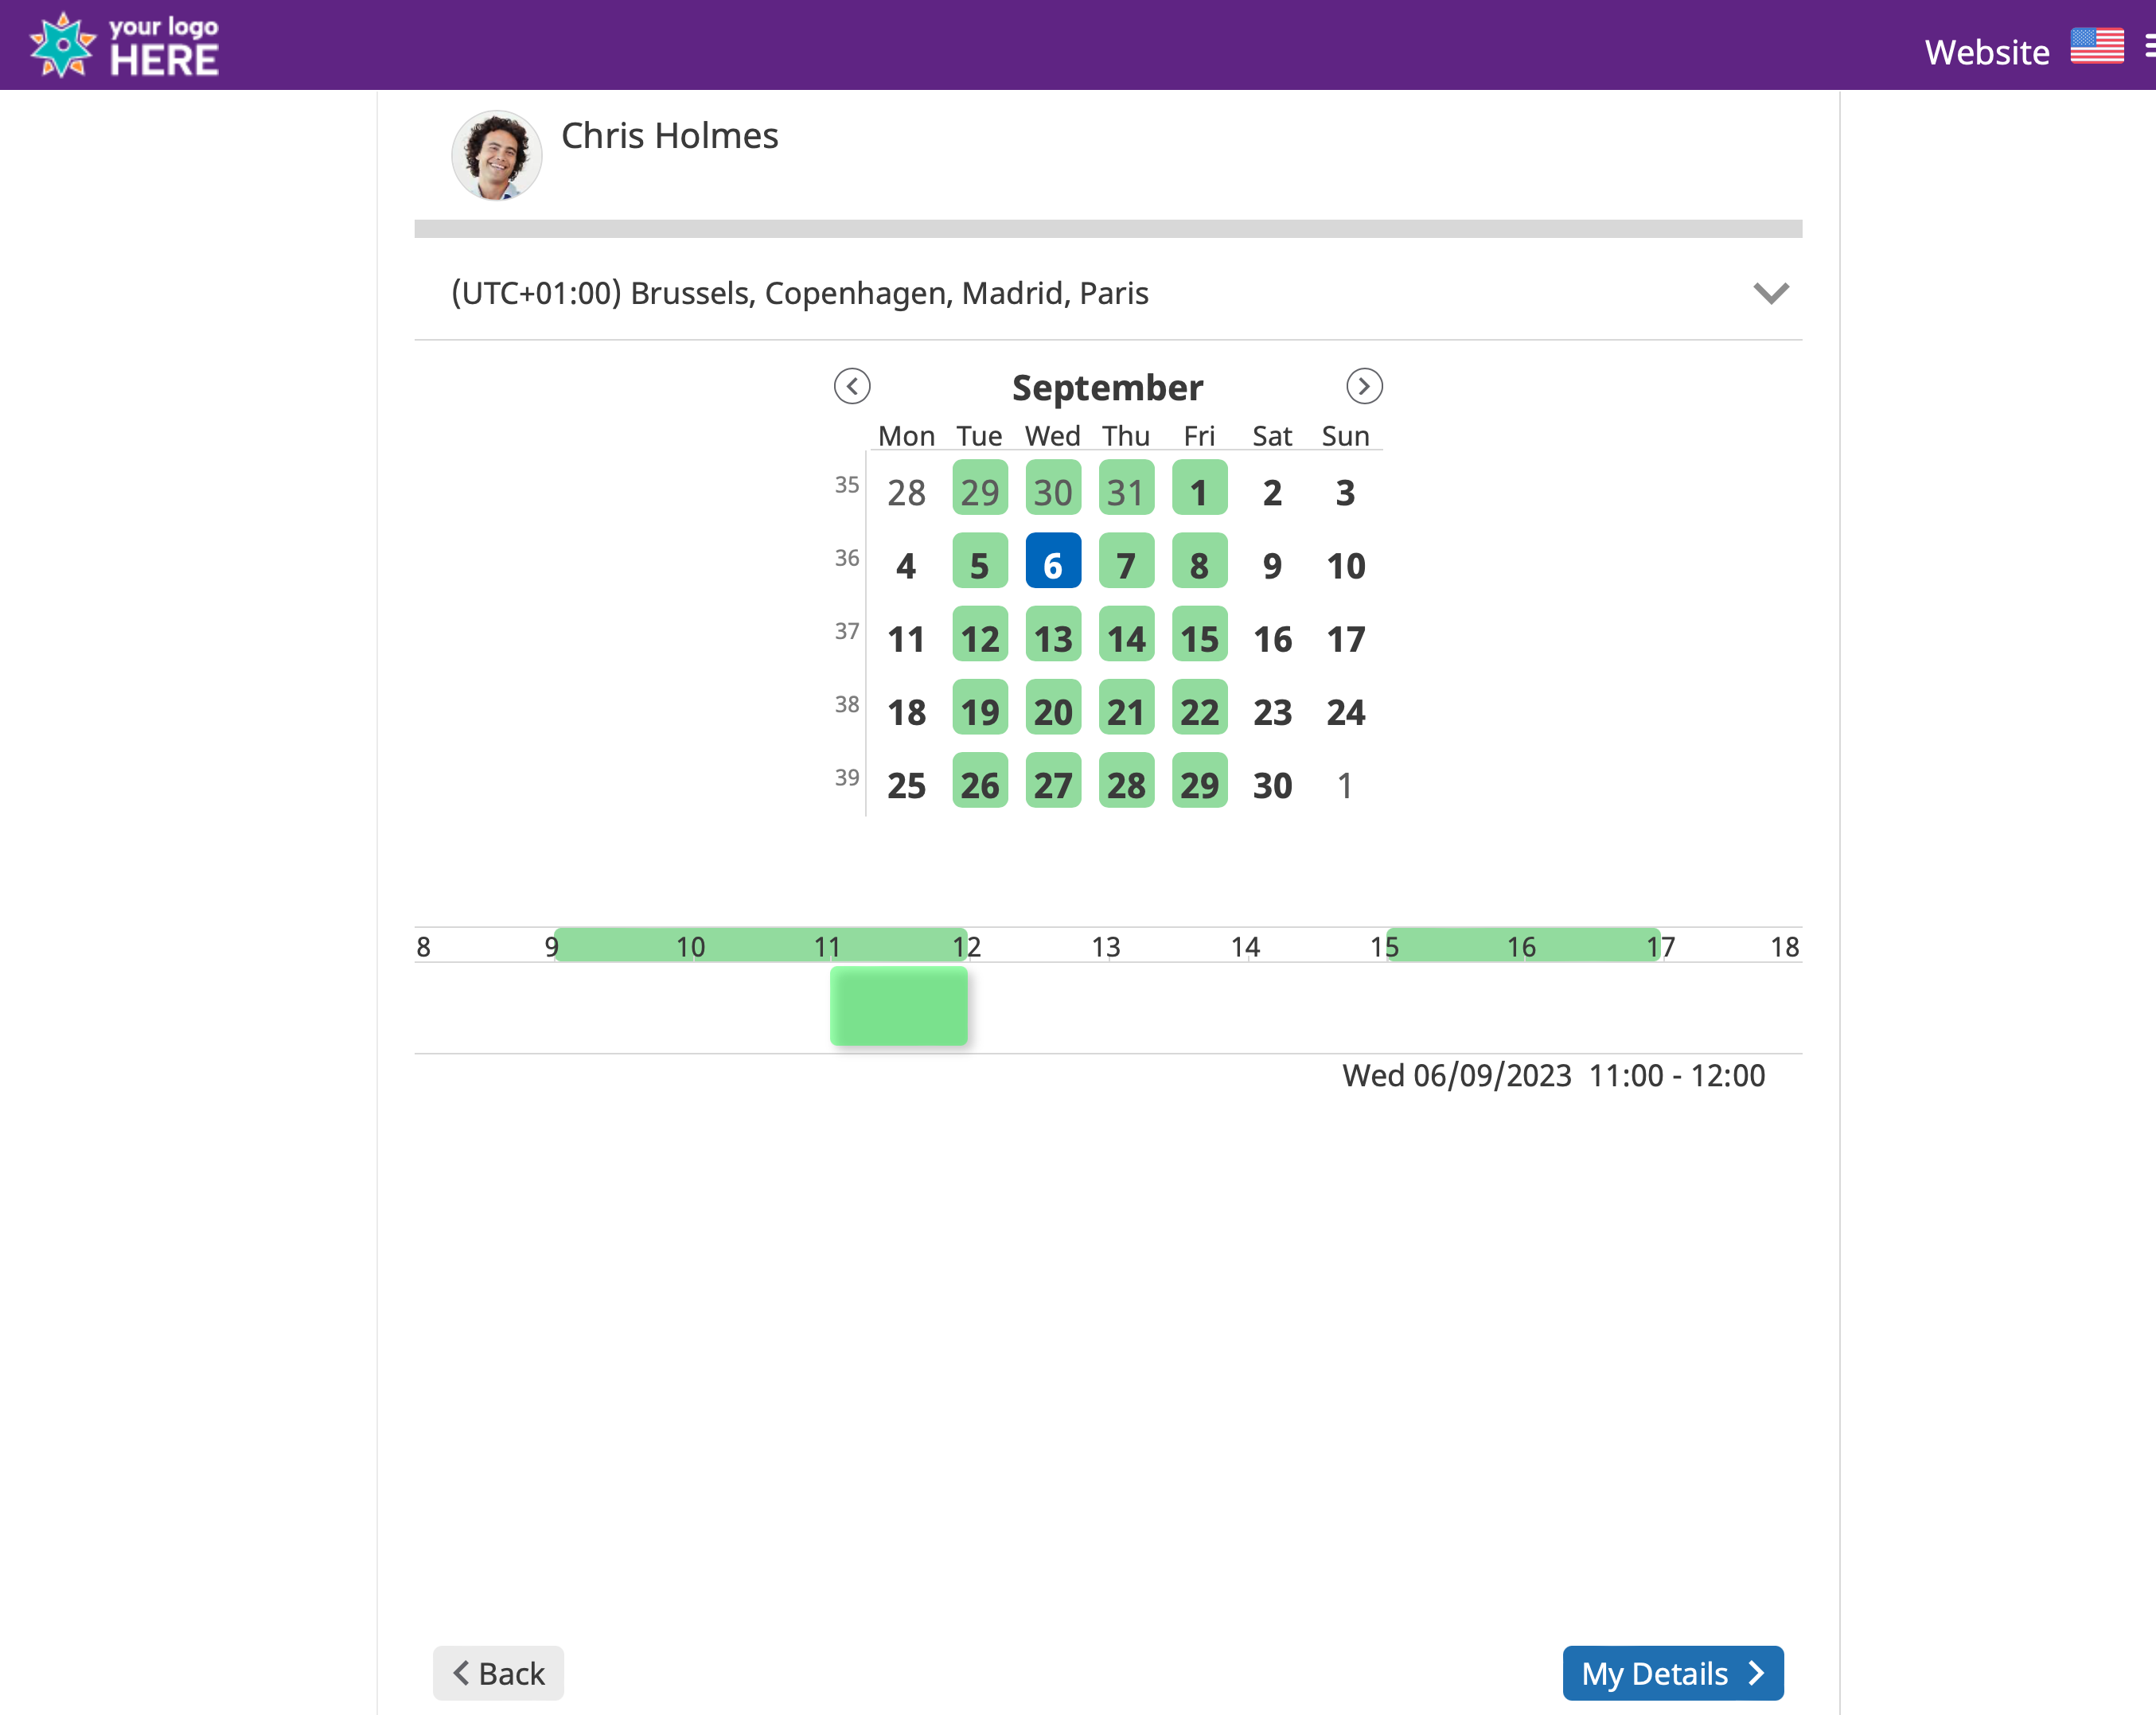
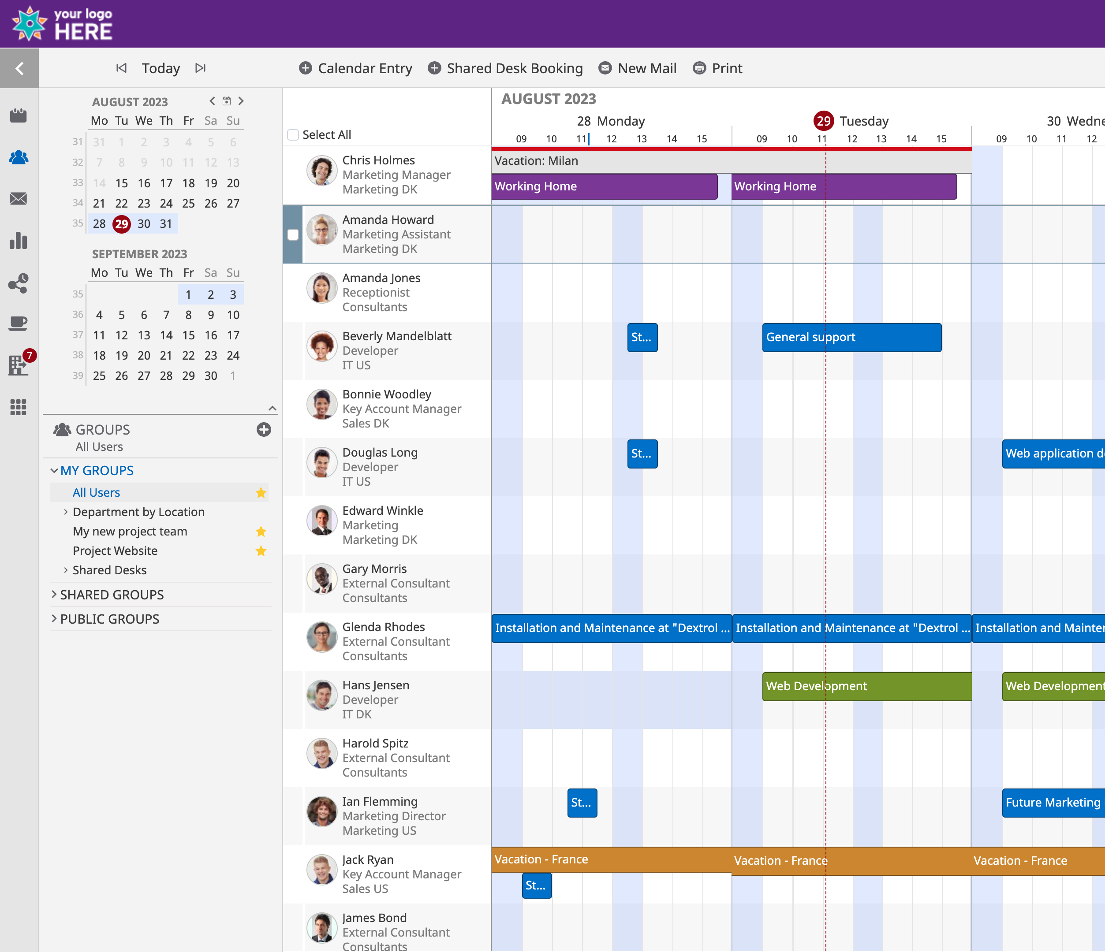
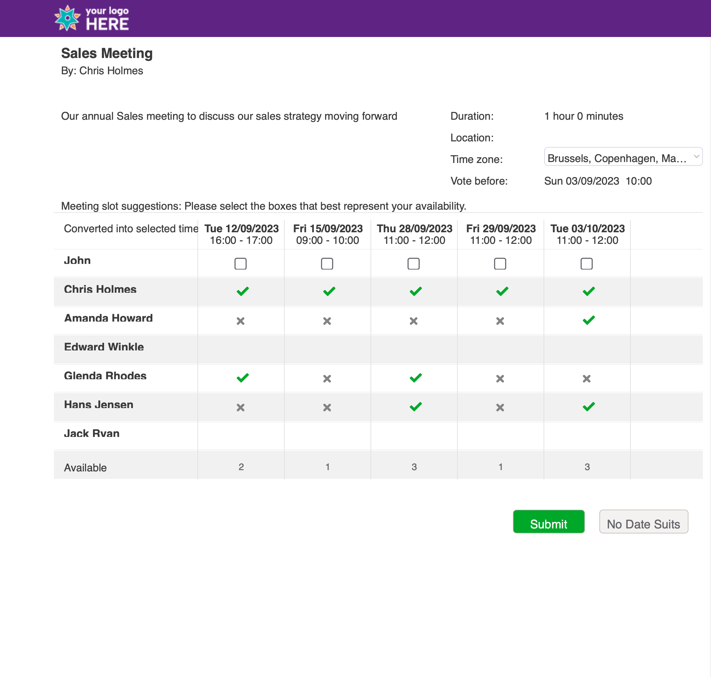
Branding
Branding
Branding
Customise your OnTime
Room Display
See if the room is free or busy including meeting details.
Quick book an available room
Share My Time
Desktop Client
Pollarity

Slide 17
What is OnTime Freemium?
The freemium version is a completely free version of the OnTime Group Calendar for HCL Domino CCB licensed organisations, however with limited features compared to the premium product and add-ons
OnTime Freemium

Slide 18
OnTime Freemium
 | Level 1 | Level 2
Free of charge
Total of users, rooms, and resources included in OnTime | 25 | 50
OnTime desktop client with limited features
Share My Time add-on (limited features)
Event Hub (limited features)
Mobile Add on
2 hours of complimentary support from OnTime/partners included
License key required (www.ontimesuite.com)
Included in the Domino 14.x download (Domino CCB entitlement required)
Terms and conditions applies for each level

Slide 19
Add-ons
Mobile
Find Time (Pollarity)
A simple user interface which provides the user with a clear overview of tasks and availability of their teams and even the entire enterprise
Significantly reduces the time used to decide upon a common time slot for a meeting by polling the intended participants or sharing your calendar.
Room Display
Catering Manager
Optimise your utilisation of your rooms. Visualise and book in no time..
the organisation's one-stop shop for managing catering within the organisation, in a simple and timesaving way for everyone involved.
HCL Connections
Business API
Knowing What We as an Organisation Can Do and When to Do It
Integrating your Calendar Data with your Business Solutions

Slide 20
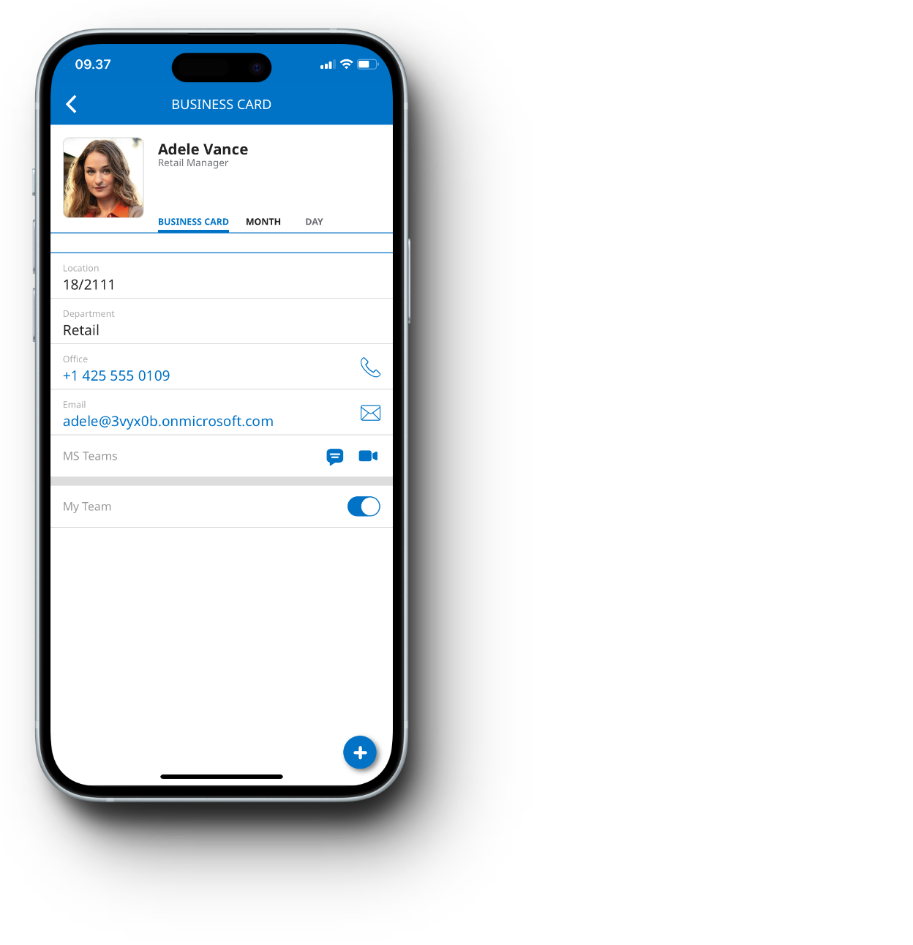
Corporate Calendar goes Mobile
OnTime Mobile
Allows you to:
Find available time for a meeting
Create and send out invitations
Create new appointments for co-workers
Find and book available rooms or shared desks
Call, e-mail or send a text message based on information in your co-worker’s business card
and much more…

Slide 21
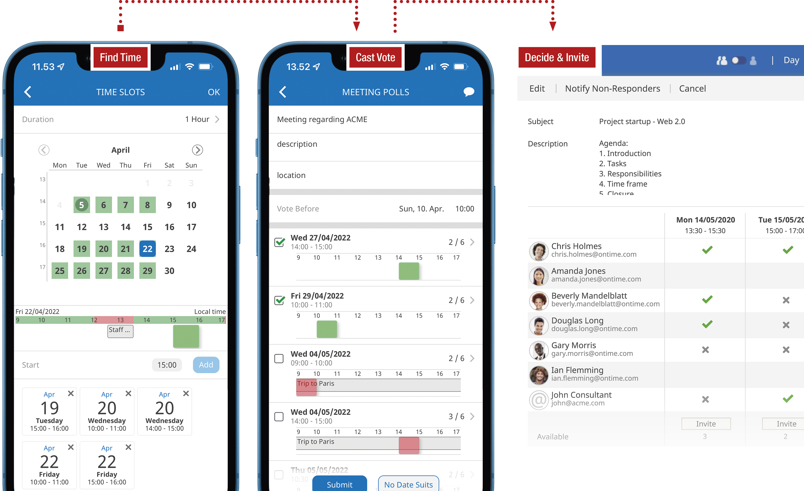
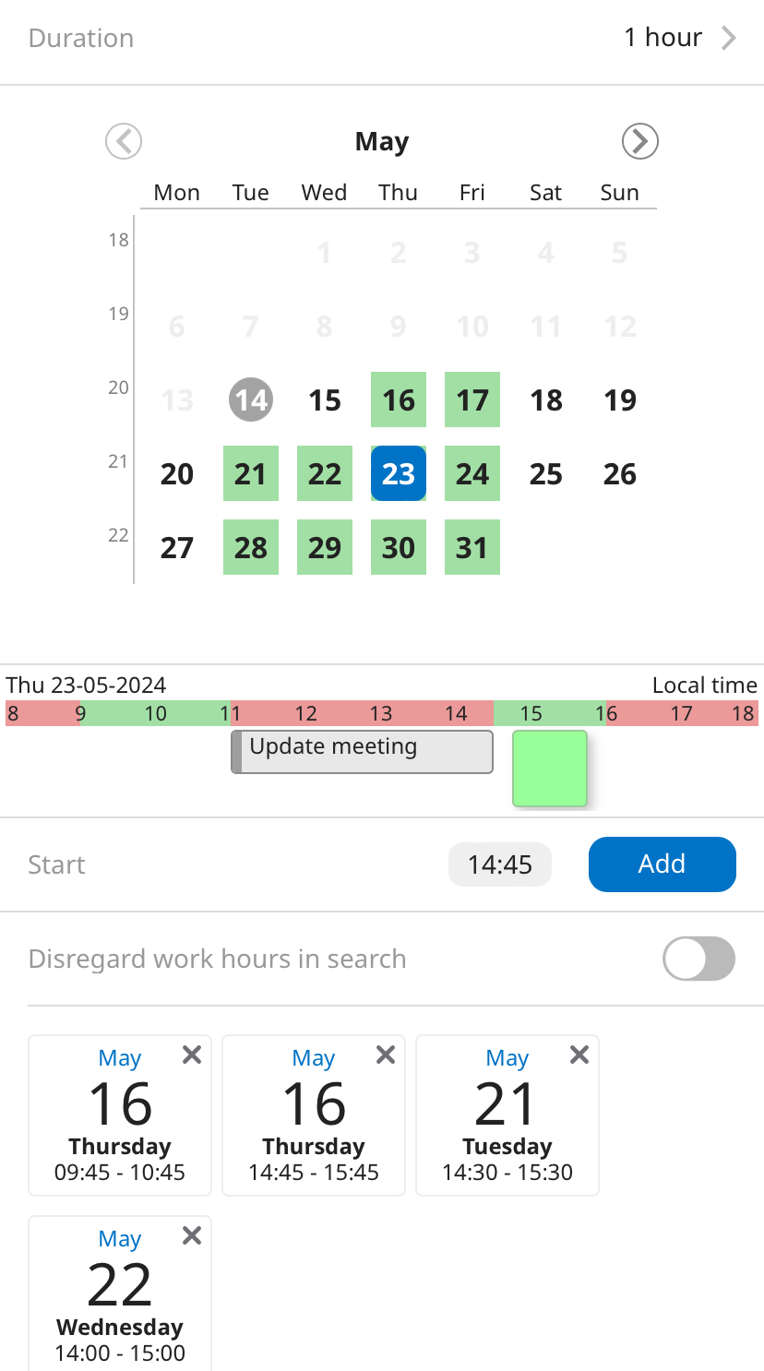
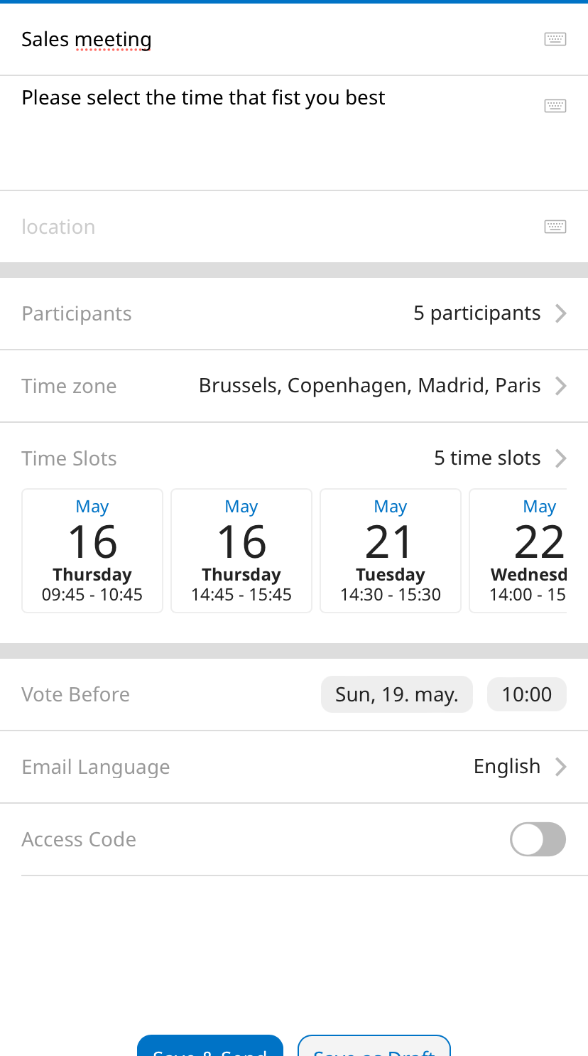
Streamline Scheduling
by Polling
Find Time
Significantly reduce the time used to decide upon a common time slot for a meeting by polling the intended participants. Poll both internally or poll mixed groups which include external participants.
Increase your probability of success for each proposed time slot by enriching the poll with the current calendar information for internal OnTime users.

Slide 22
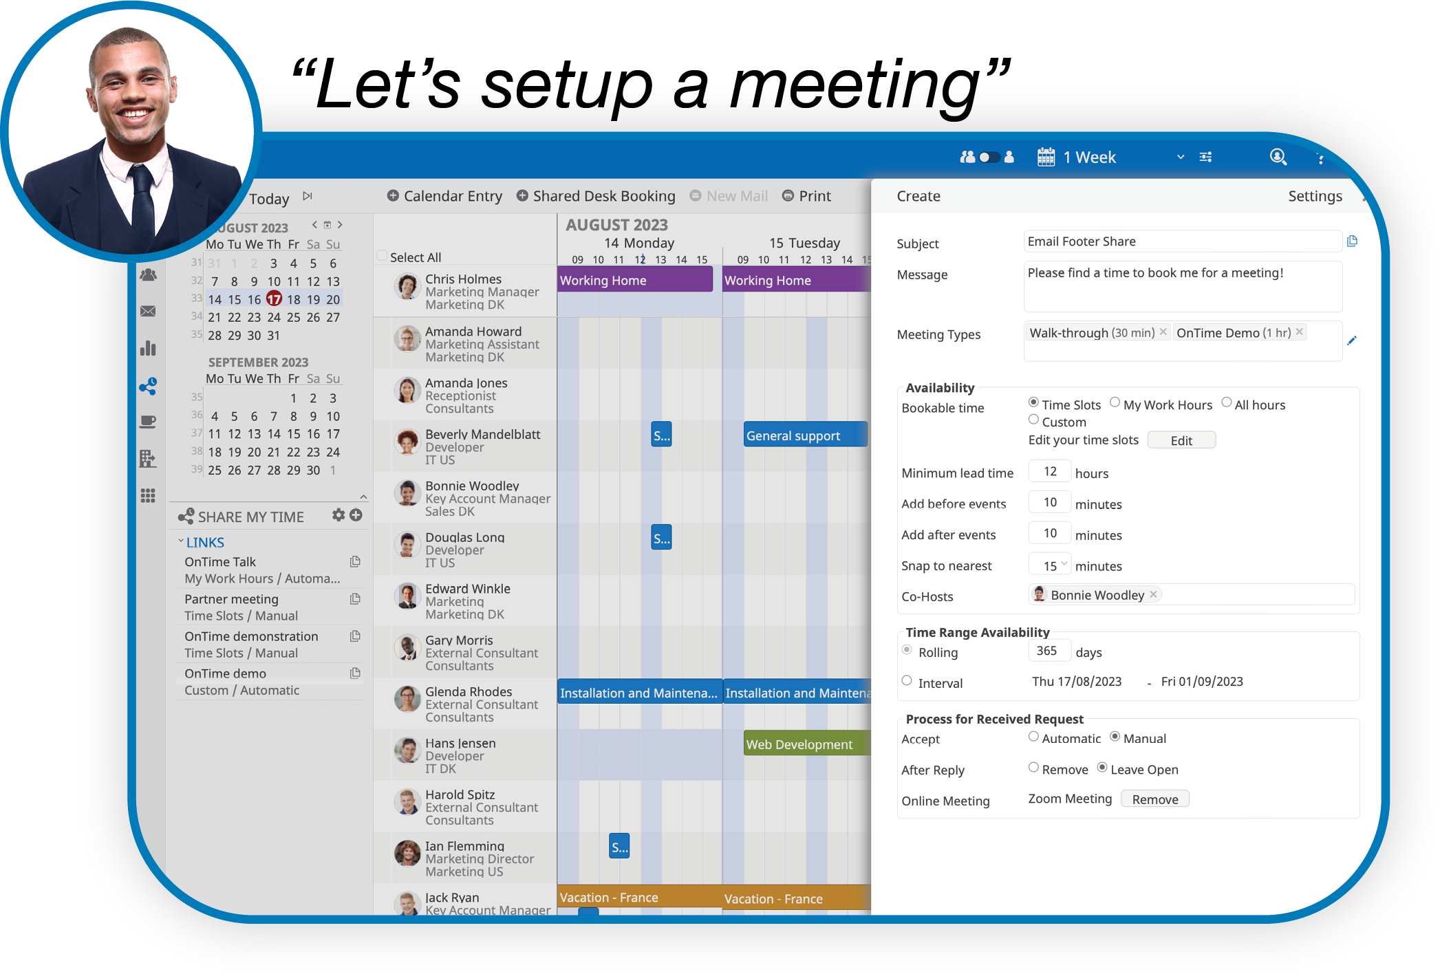
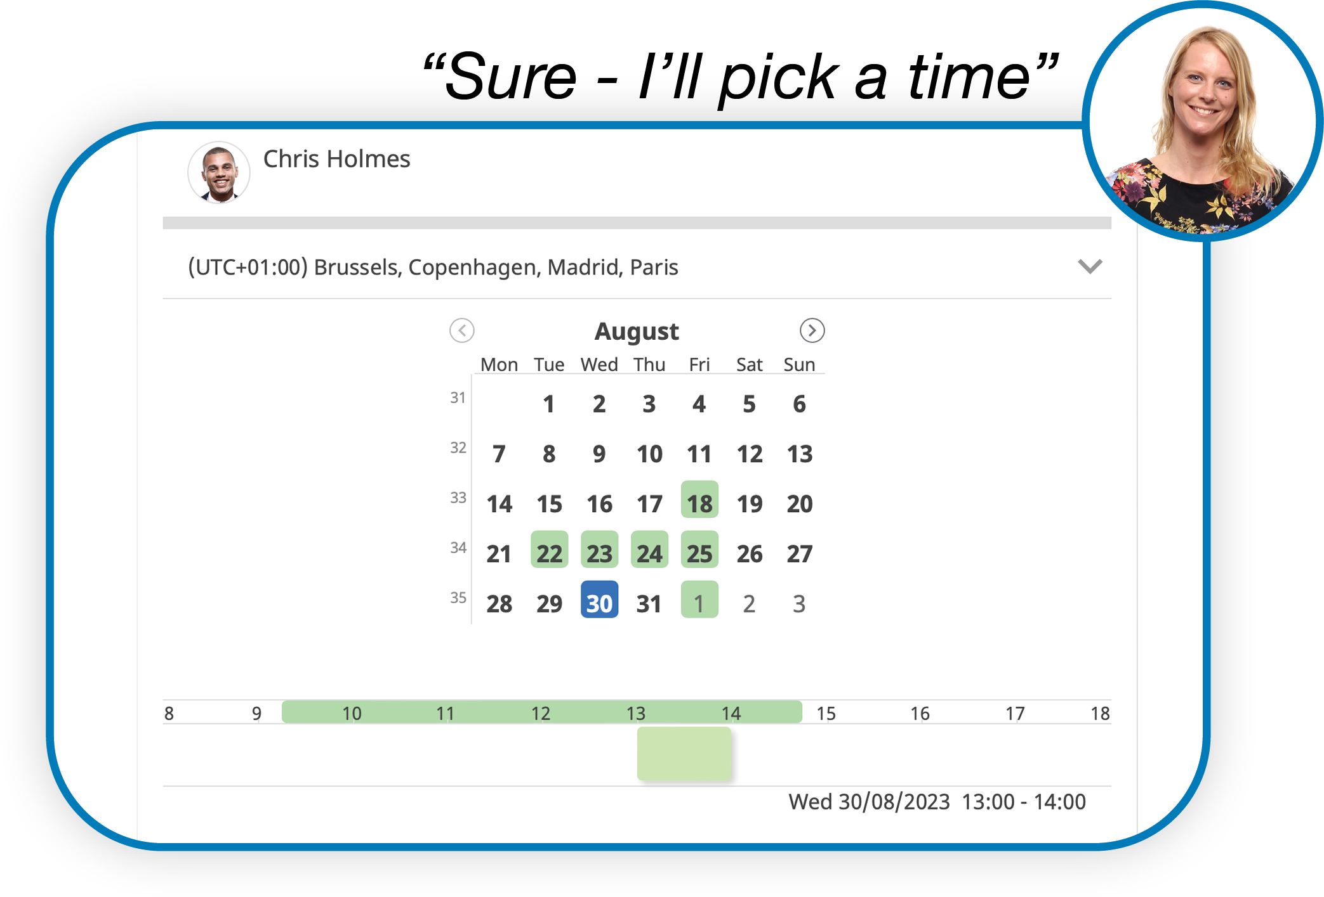
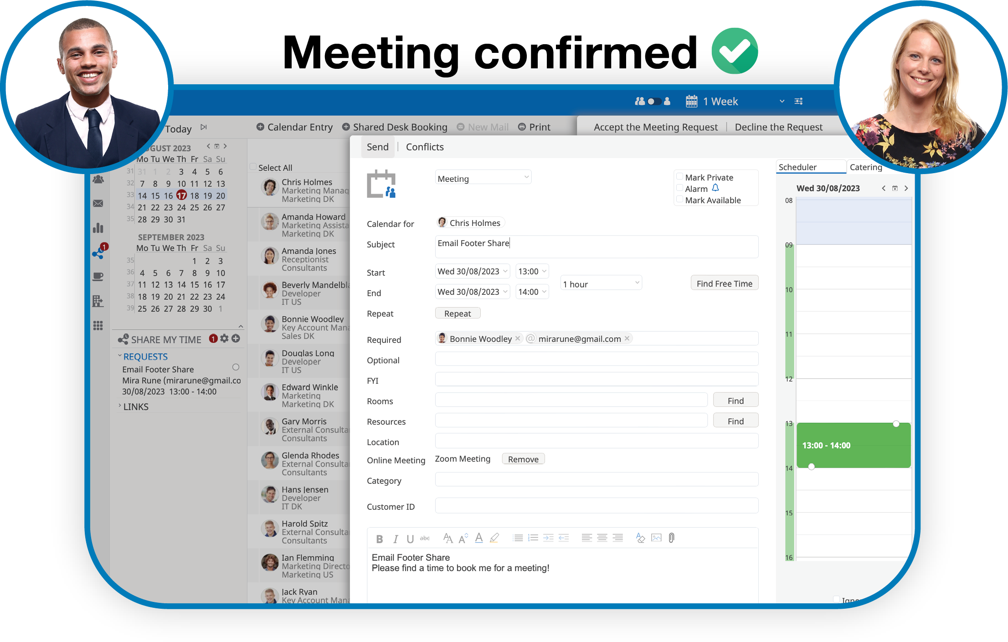
Find Time
Effortless Scheduling with Calendar Sharing
Tired of wasting hours coordinating conflicting meetings and dealing with endless back-and-forth messages?
With Share My Time, You Can give external parties access to your calendar, Allowing Them to seamlessly view and book Meetings without revealing your actual schedule, but only your availability.
It is available for all registred OnTime users, but with different features depending on your OnTime commitment.

Slide 23
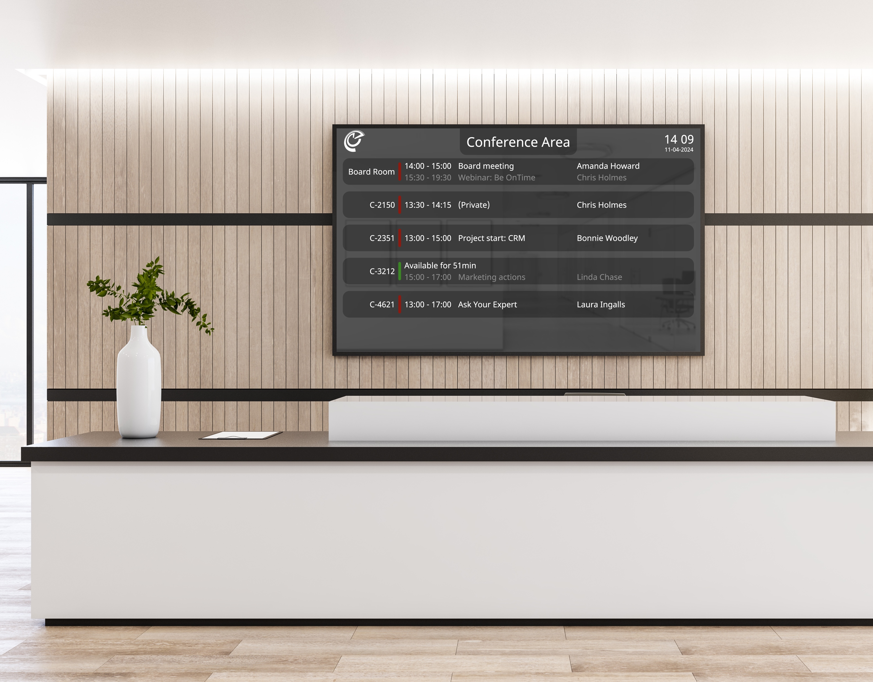
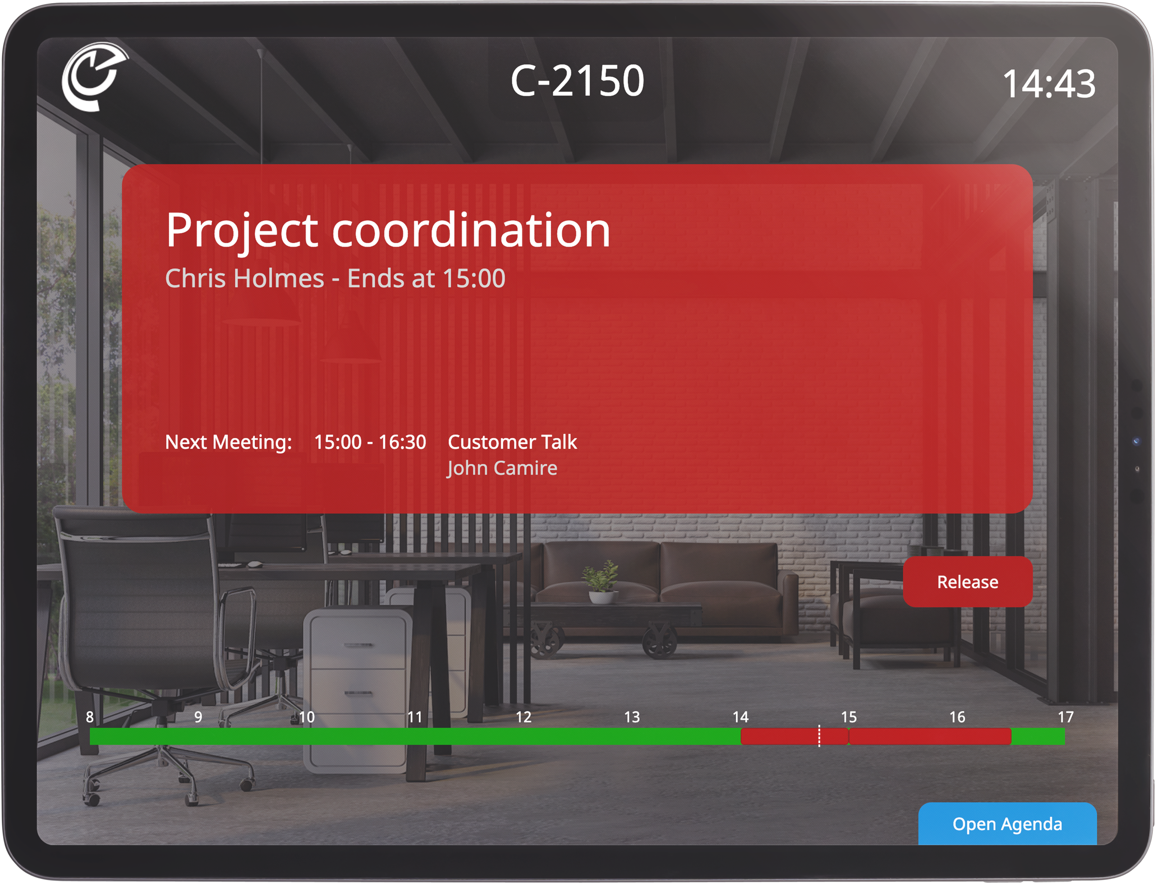
Room Display
Increase Utilisation Rates
of Your Rooms!
Room Display offers a convenient solution to seamlessly manage meeting rooms and conference areas.
With Room Display, you can effortlessly cross-check, book, and monitor the availability of meeting spaces, whether you’re using your OnTime client or directly interacting with the display itself.

Slide 24
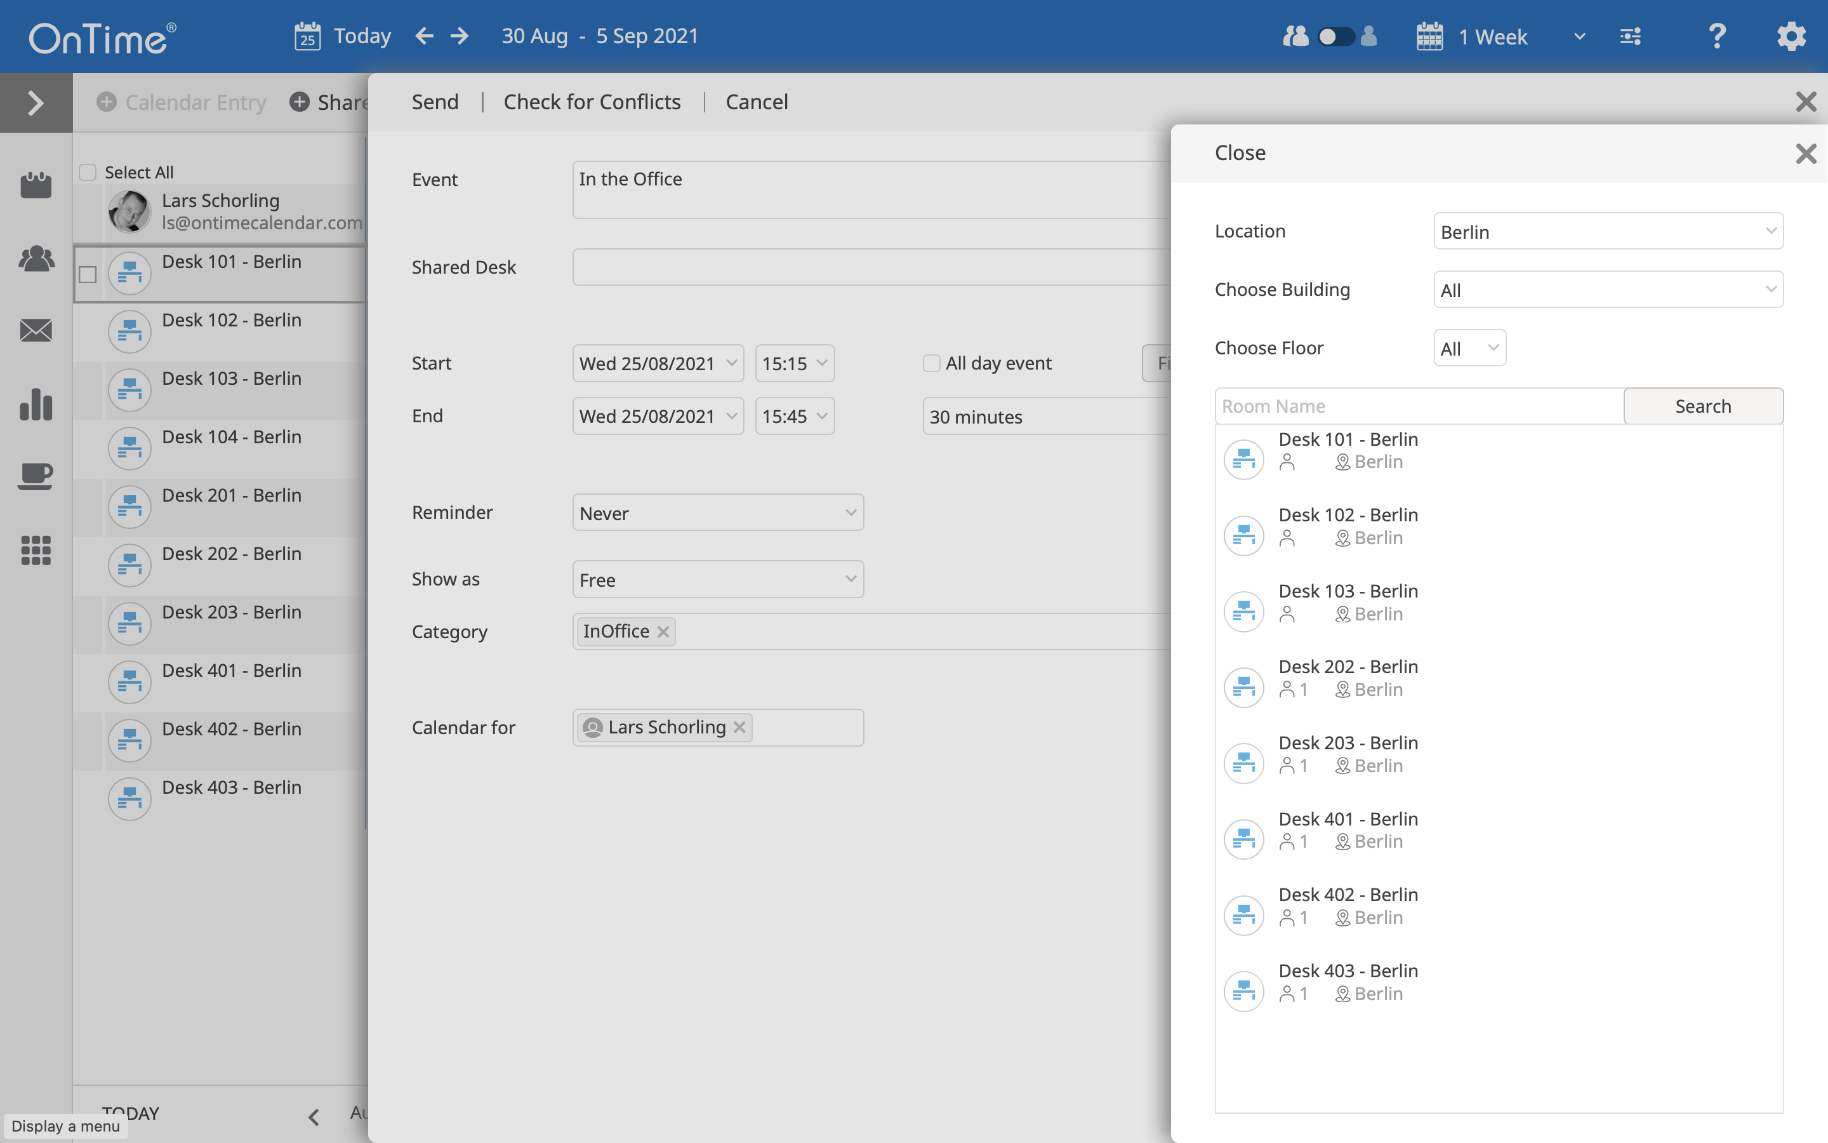
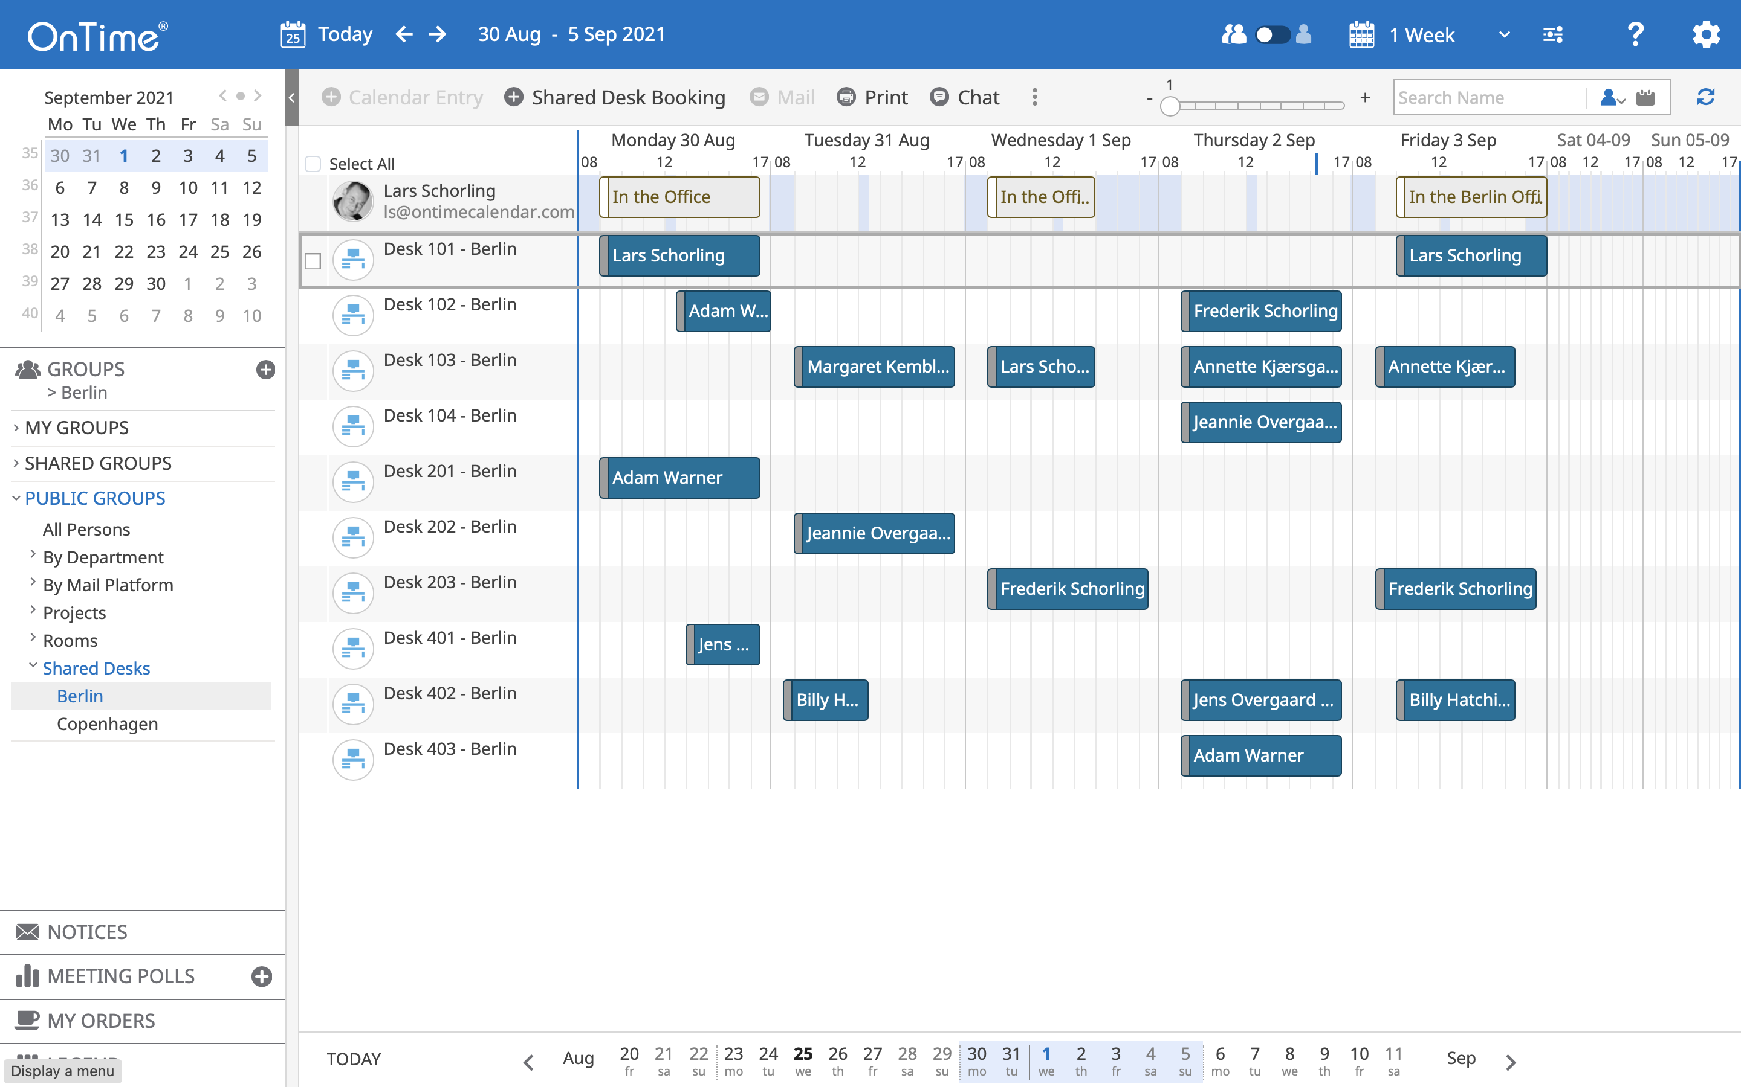
Shared Desks
Hybrid Workplace Challenges
How can we avoid overcrowding in the office?
How can we implement a hybrid working concept without giving ourselves too much manual work?
Find and Book Desks
View Workspace Availability

Slide 25
Streamline Your Catering Process
New
Accept
Serve
Finalise
Complete
Organisation's one-stop shop for managing catering within the organisation, in a simple and timesaving way for everyone involved..
Catering Manager

Slide 26
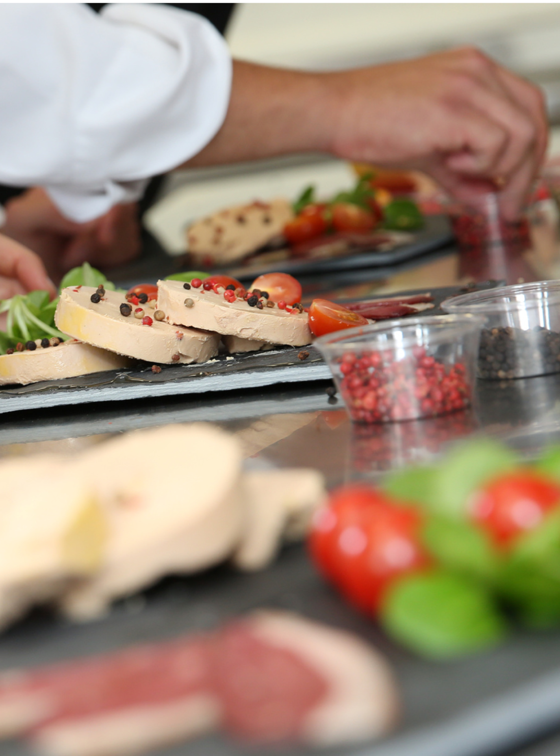
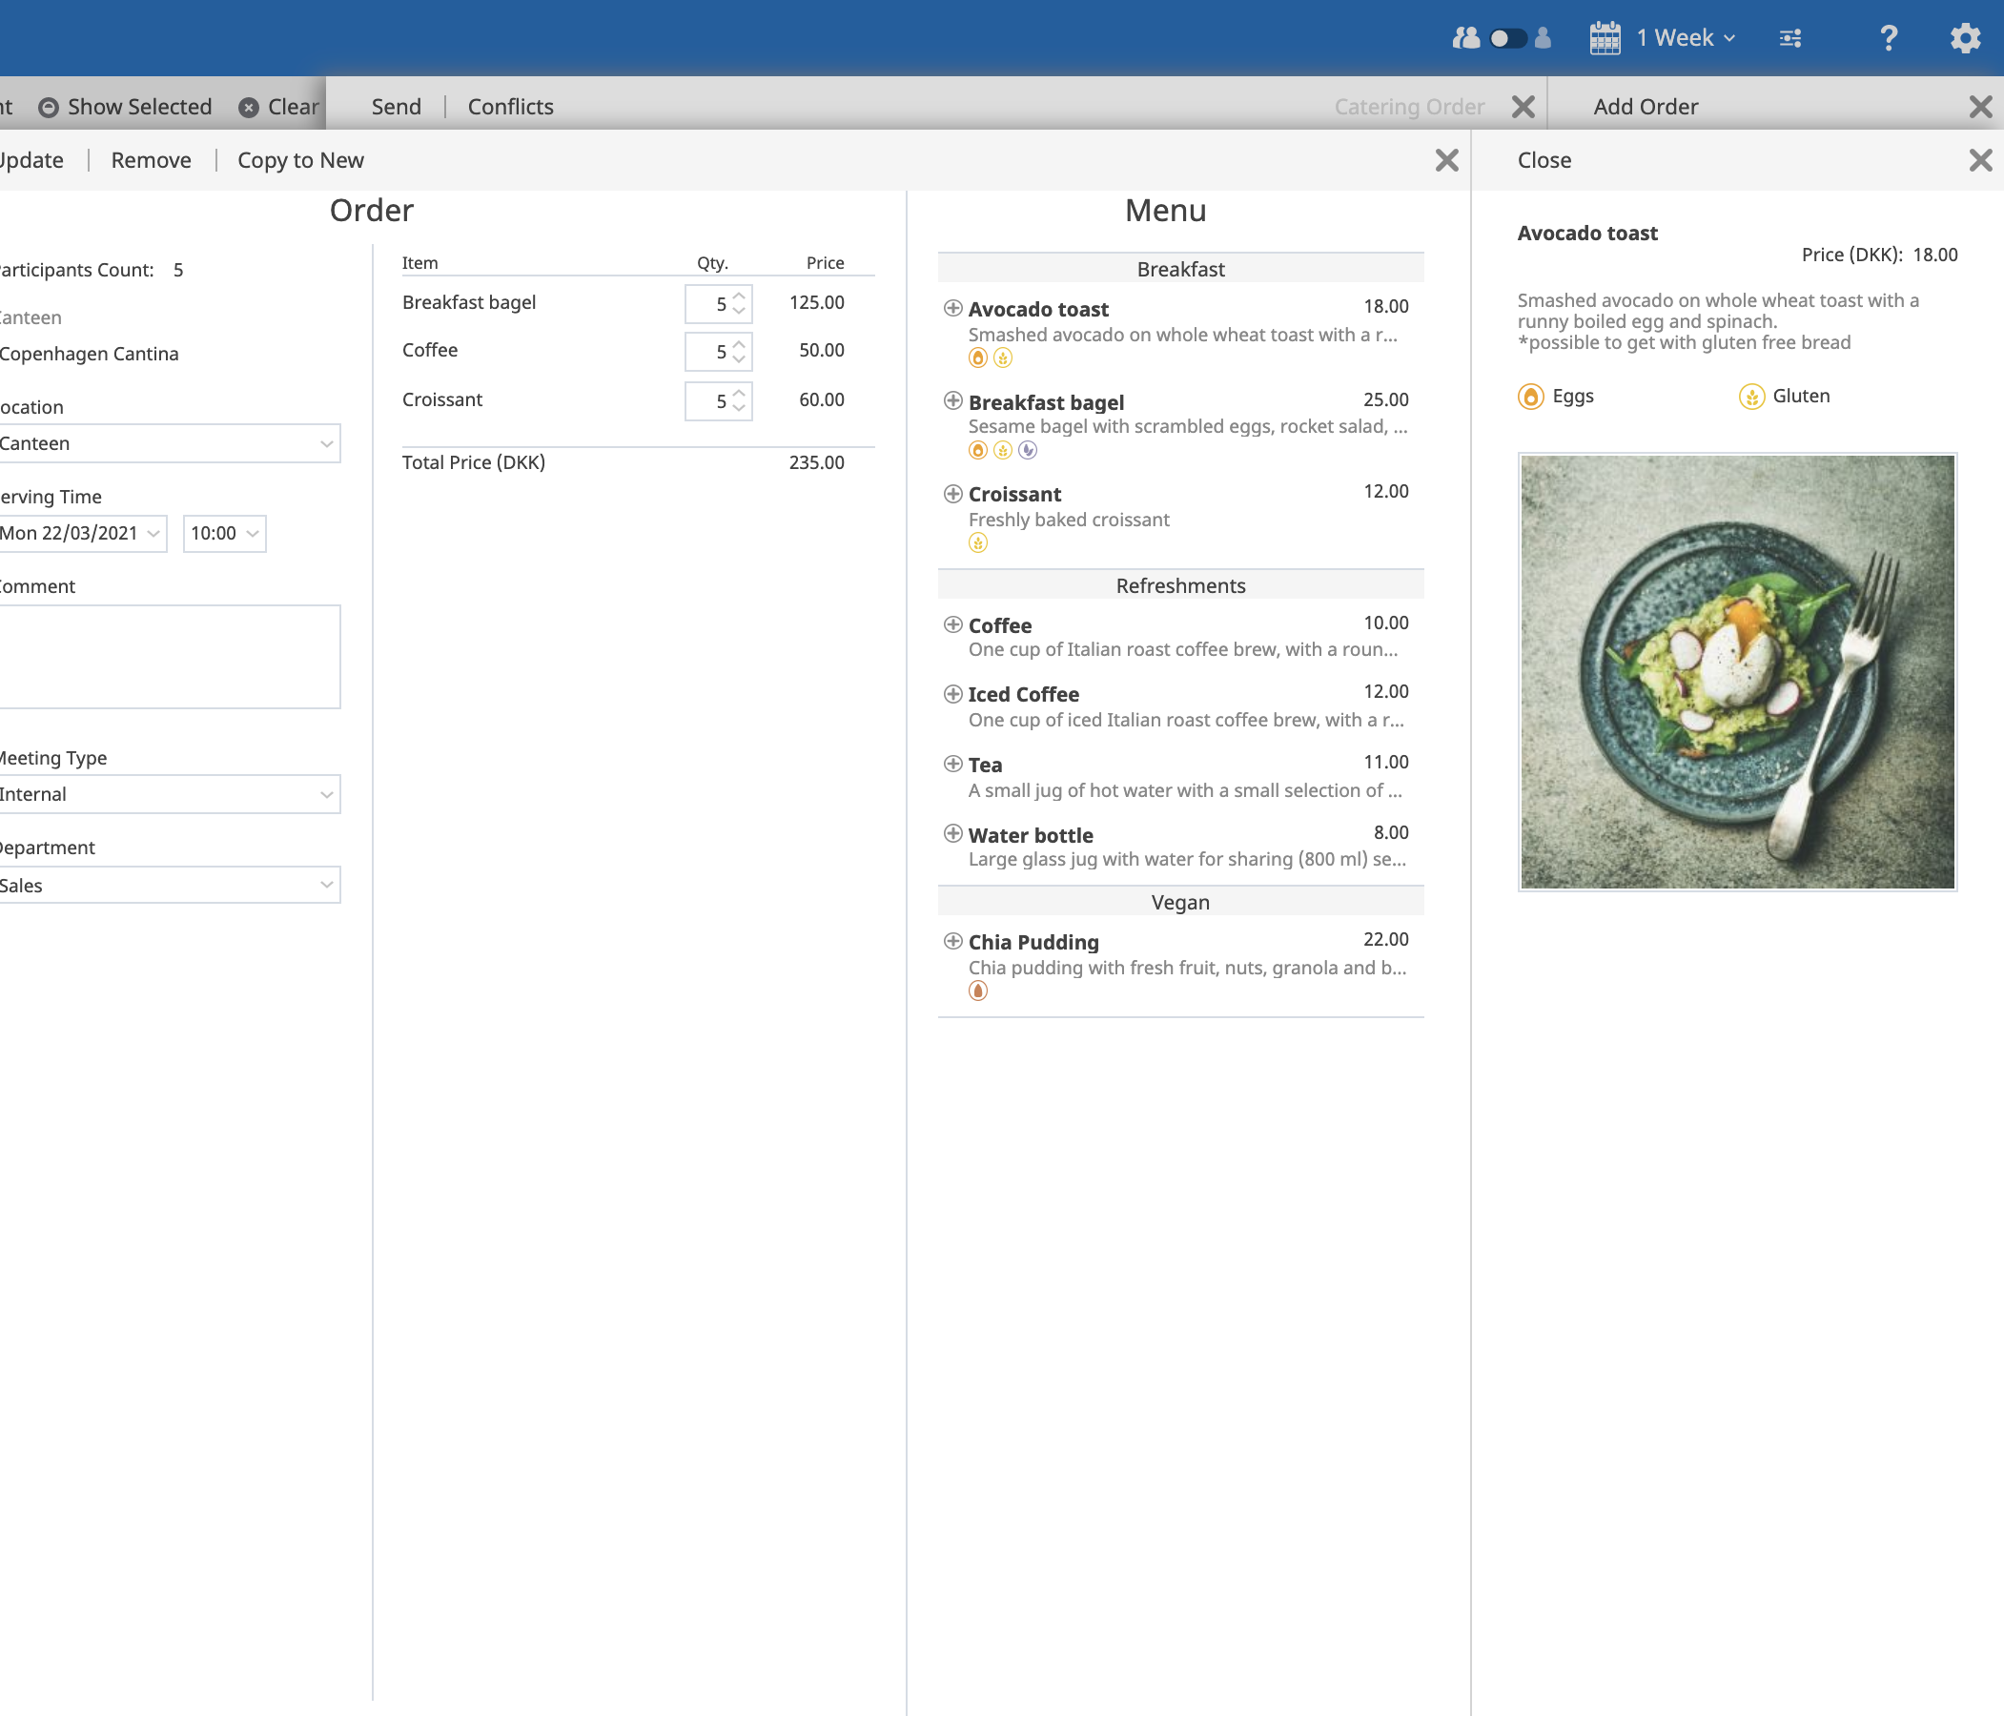
Catering Manager
Business User
Selected Benefits
Catering can be ordered in the same process as the meeting invitation in OnTime.
Only items that are available at the scheduled time of the meeting are offered to the user.
Change of schedule for a meeting automatically initiates the required changes to the catering order.

Slide 27
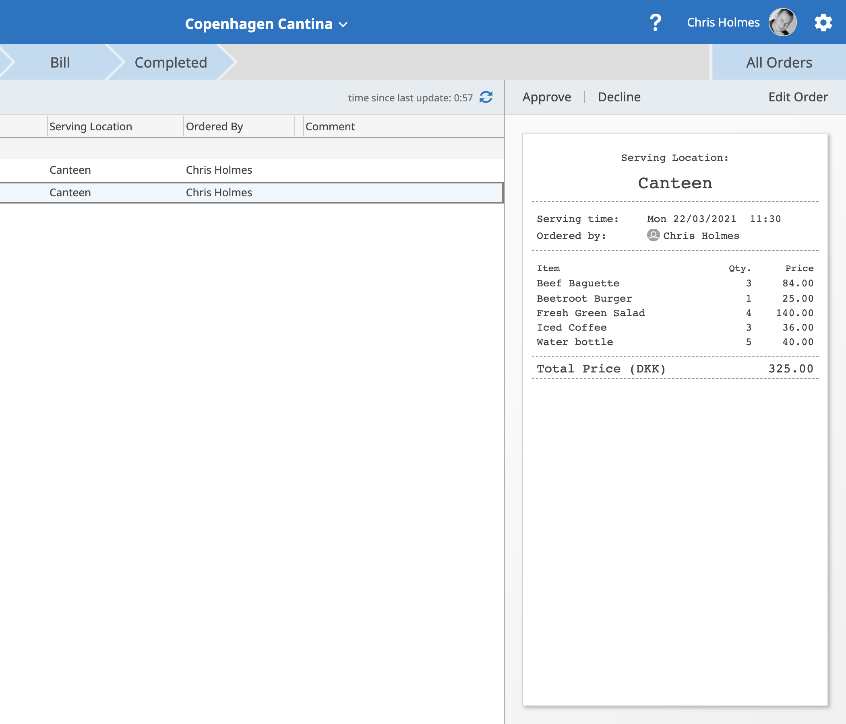
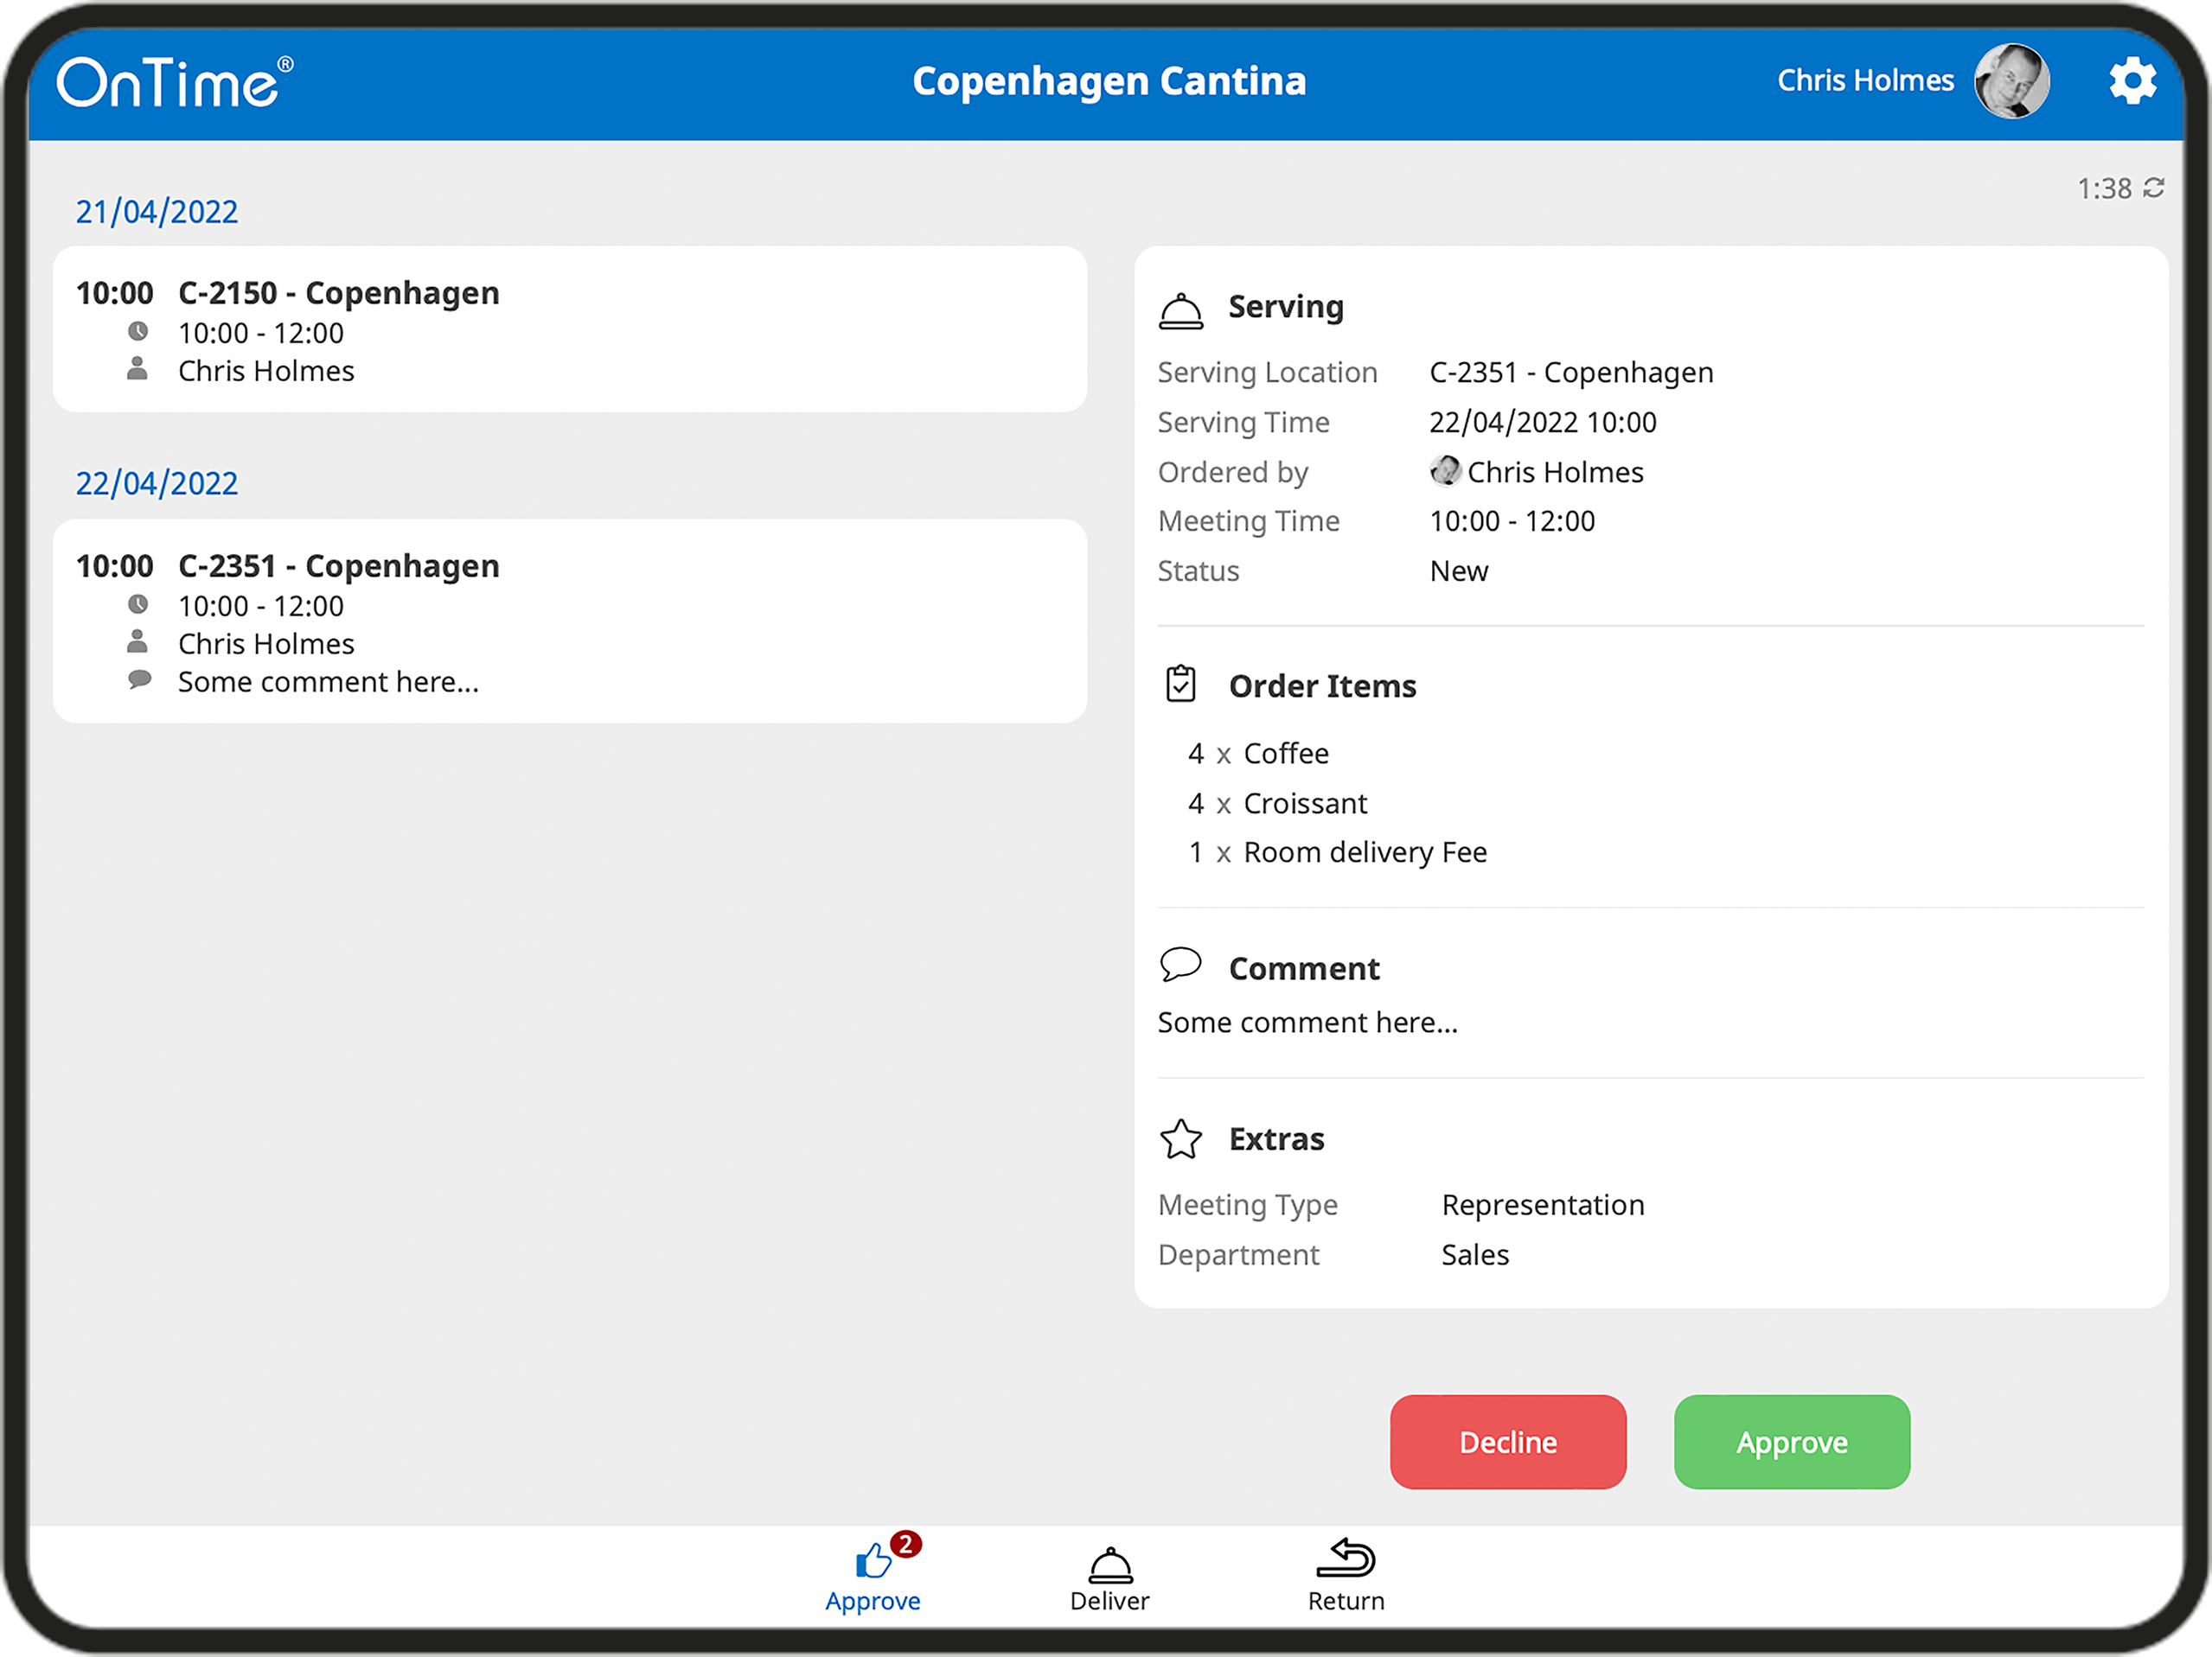
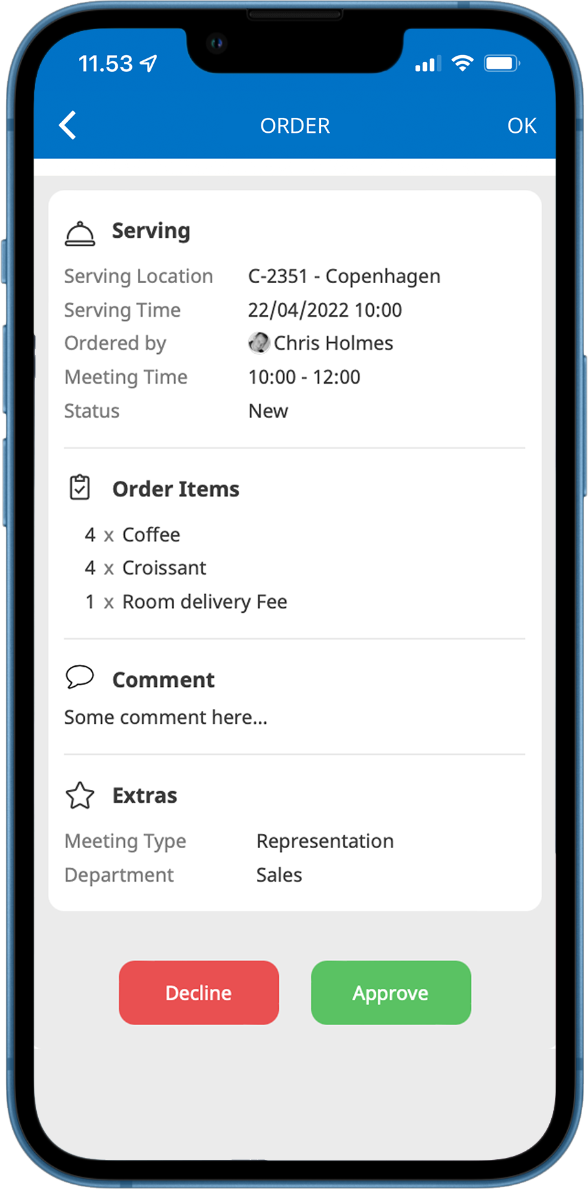
Catering Manager
Catering Manager and Staff
Selected Benefits
Tracking, accepting, delivering and invoicing of orders.
Rosters ensures that the correct order is delivered at the right time.
Changes between ordered and actual consumption can easily be adjusted.
Completed orders can be exported to an ERP system.
Working with both your desktop, tablet, and mobile devices

Slide 28
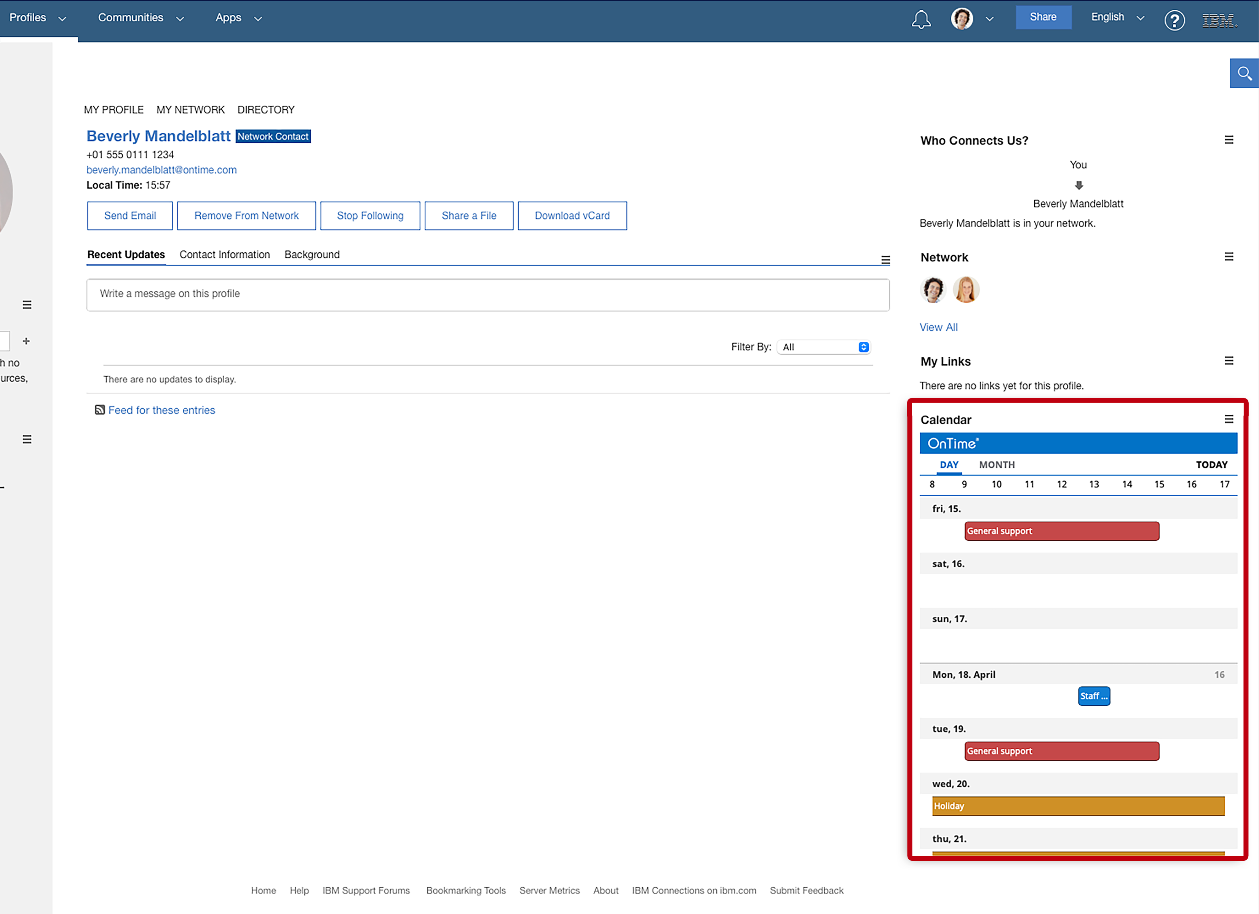
HCL Connections
OnTime in Connections
Becoming a True Social Group Calendar
Profiles
Communities
HCL Connections allow for a group calendar experience that was never possible before. The profiling of individuals and their relationships, including who the user is following, and which networks they belong to provides users with the ability to search and filter the scheduling information in entirely new ways.
OnTime integrates into both HCL Connections Profiles and Communities.

Slide 29
Integration
using the OnTime API

Slide 30
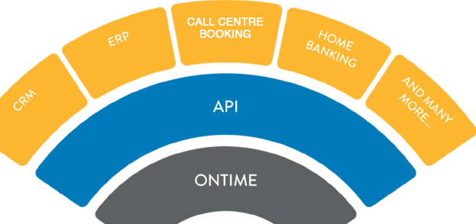
OnTime API
The Power of Integration
With the OnTime REST API, you can easily create real-time CRUD integration of your corporate calendar data with your other business applications.
No more updating of multiple systems, no more issues with keeping scheduling data in sync.
Examples from our customers:
SIEBEL CRM
SALESFORCE CRM
HOMEBANKING
SAP PTO SYSTEM (Paid Time Off)

Slide 31
Architecture &
Security

Slide 32
Platforms, Interfaces and Languages
 | Recommended | Lowest version supported
Domino Mail Server | Domino 14 or 12 on Windows and Linux | Domino 7 on Windows and Linux
Exchange Mail Server | Windows Server 2019 and above Online: Current version On-premises: Exchange 2019 and above | Windows Server 2012 Online: Current version On-premises - Exchange 2013
OnTime Application Server | Domino 14 or 12 on Windows and Linux | Domino 9.0.1FP10 on Windows and Linux
Supported platforms
Supported interfaces and languages:
Clients
Mobile
Languages

Slide 33
Architecture
Domino Directory /
Exchange Directory
Desktop
OnTime
Backend
OnTime Databases
Configuration
Data Client
Broadcast
Time Off
Share My Time
Pollarity
Catering
Log
Mobile
Administration
OnTime API
REST like http based API
Synchronisation
Room Display
Mail
Personal calendars
Business API
Domino
Exchange / O365

Slide 34
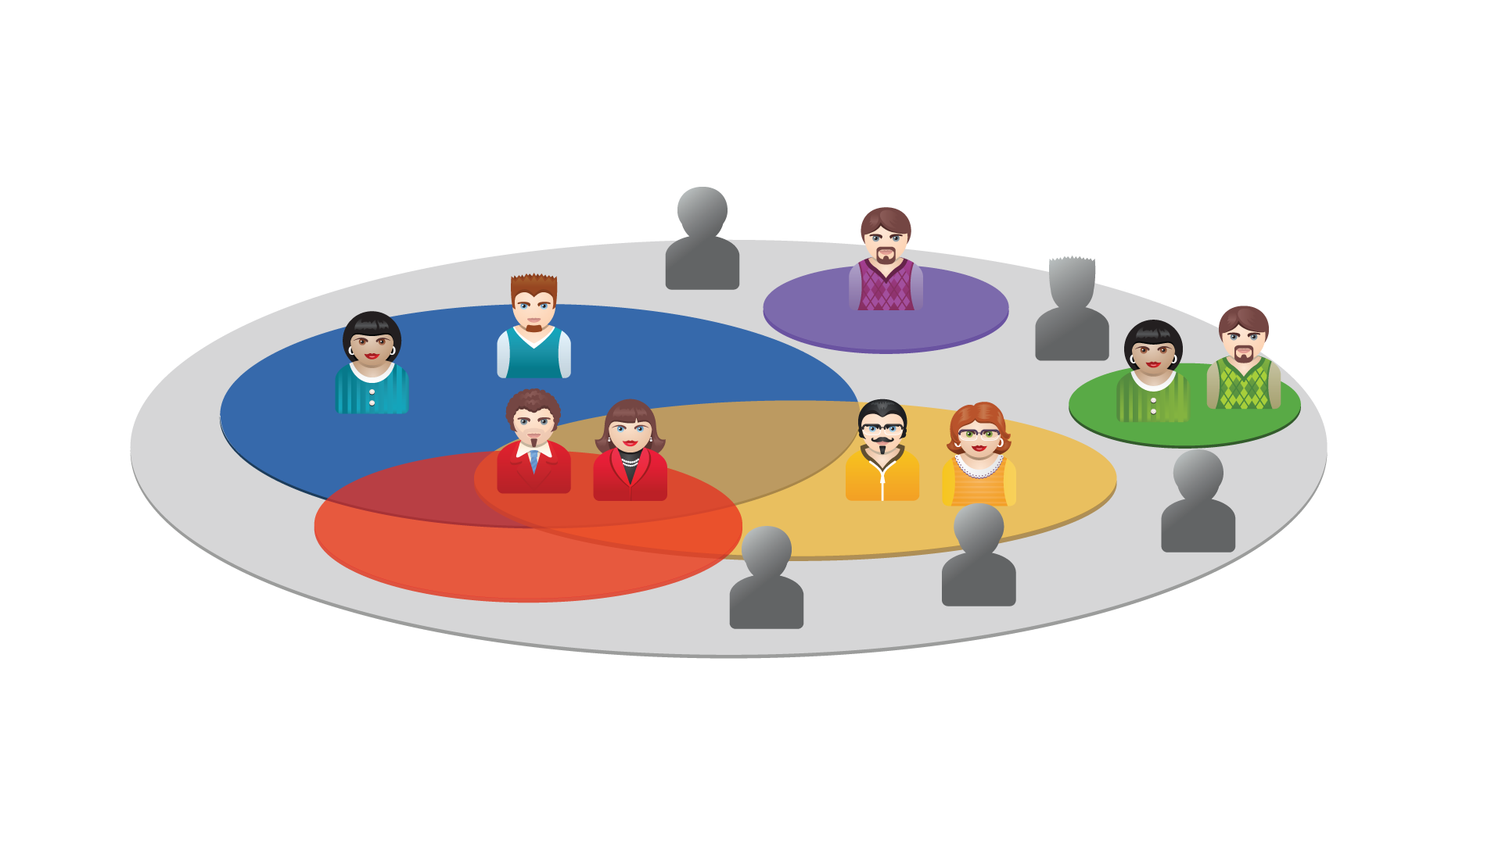
Roles
PRIVATE ACL
CREATE AND EDIT
OUT OF OFFICE
READ
VIEW SCHEDULE INFO

Slide 35
Live
Demo

